Slide 1
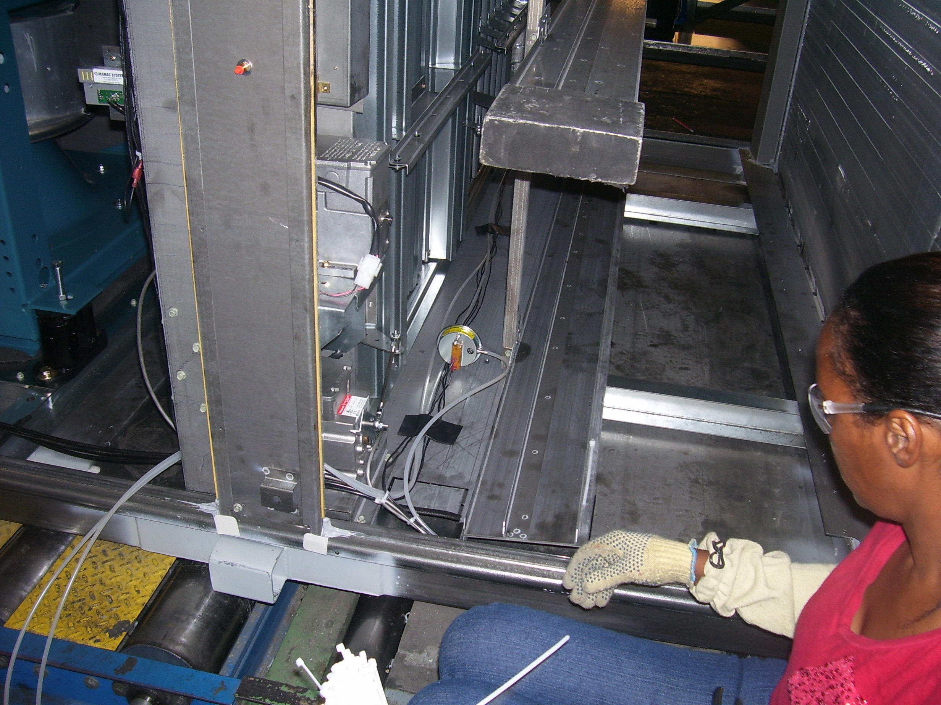
Tee into this pneumatic line to measure clean filter pressure differential.
Depending on their recommended filter maintenance requirements with a squeeze bulb or hand pump pressurize line 0.5 – 1.0 i.w.c above the clean filter differential pressure.
Turn adjustment screw on dirty filter switch until the closed normally open contacts reopen.
Remove pressure from line.
Re-pressurize and verify if normally open contacts close at specified pressure.

