Slide 1
Updating the Touchscreen Firmware
100+ Years of Performance, Innovation, Commitment and Knowledge

Slide 2
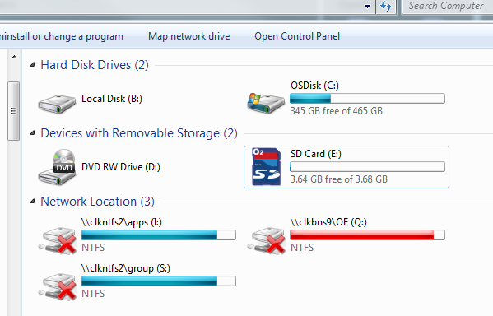
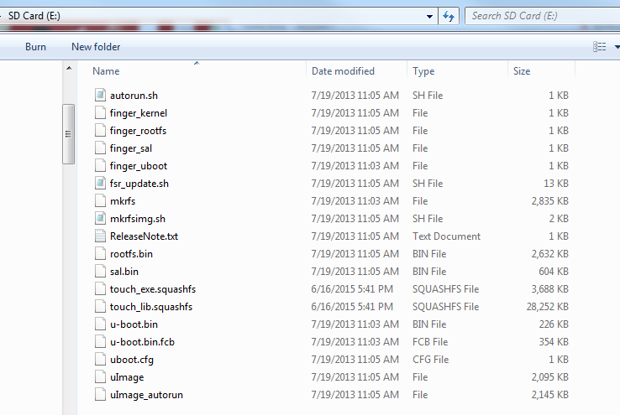
Touchscreen
Double Click the SD card
Unzip and drag all the files onto the SD card

Slide 3
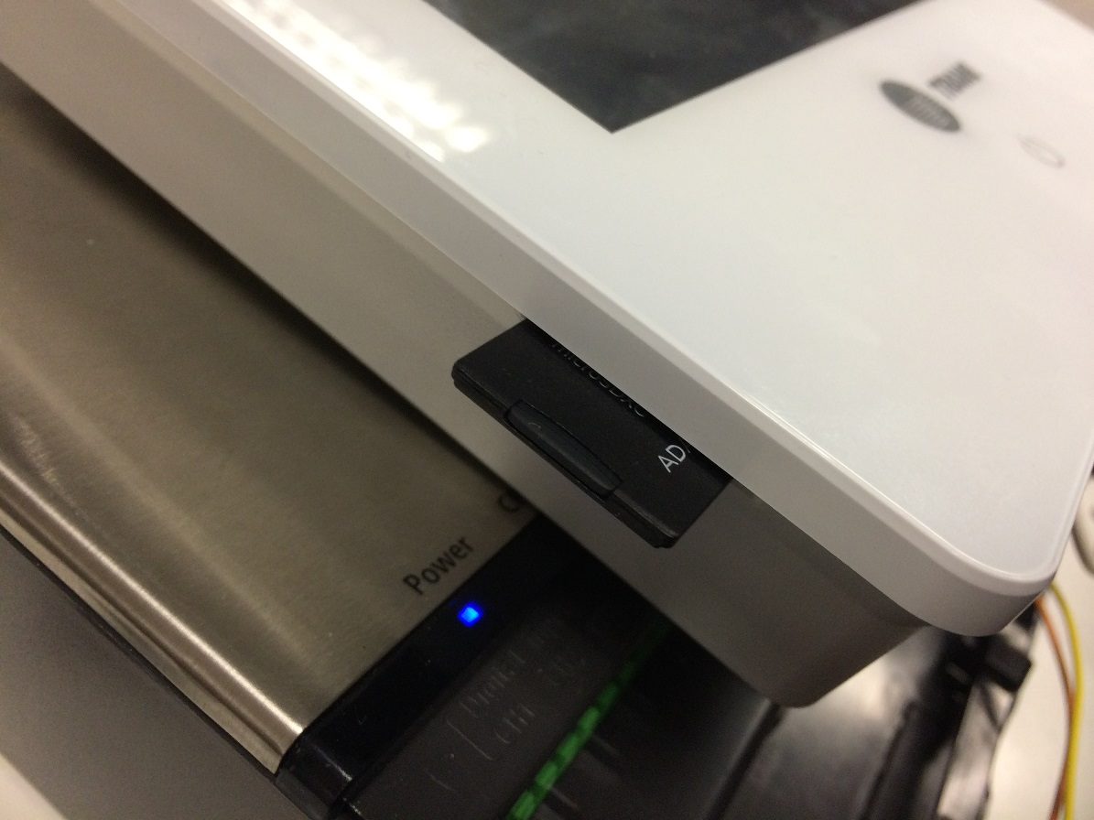
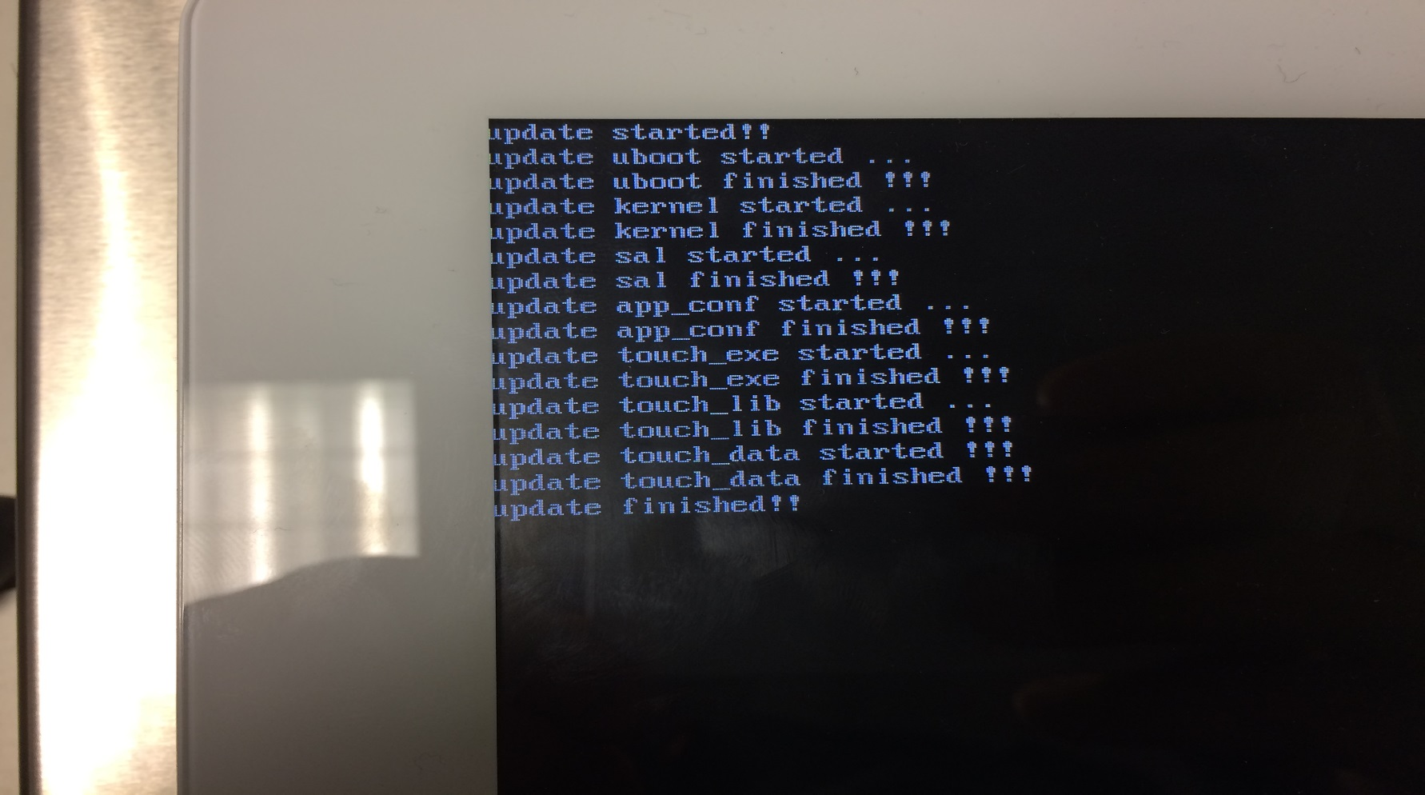
Touchscreen
Insert SD card
Cycle the power to the touch screen.
Wait until it says update finished.
Once finished cycle power again.

Slide 4
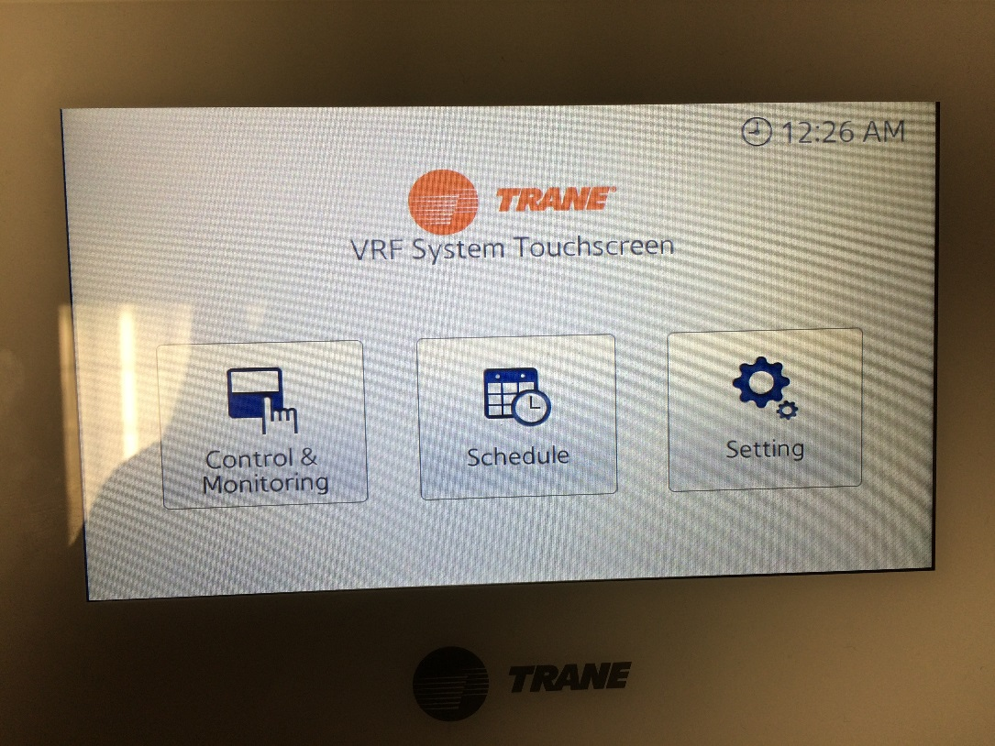
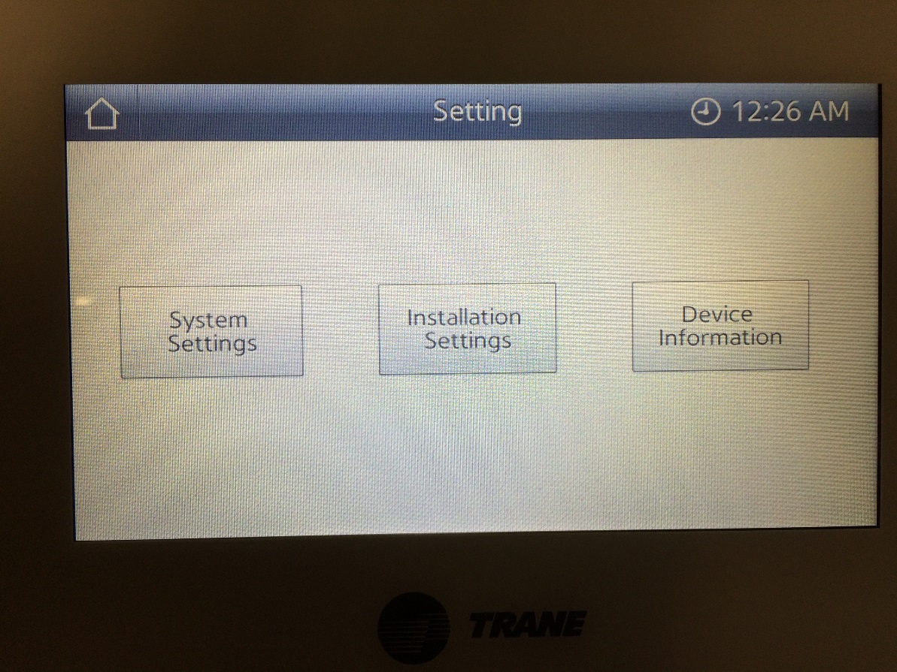
Touchscreen
Checking Version
Click Settings
Click Device Information

Slide 5
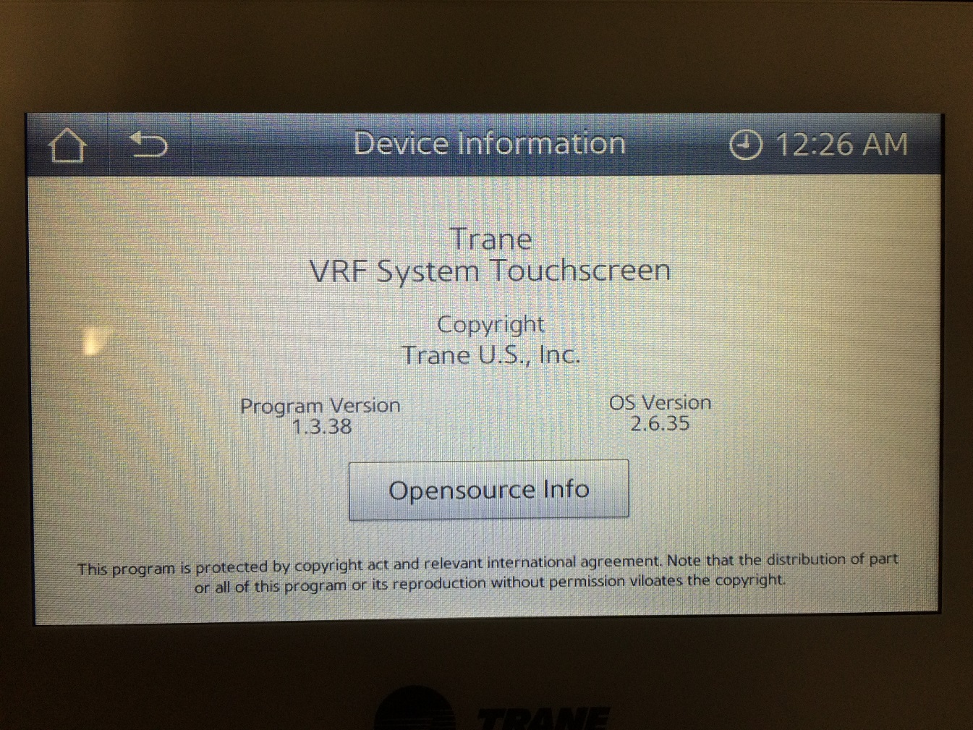
Touchscreen
This is the current version you are running.

Slide 6
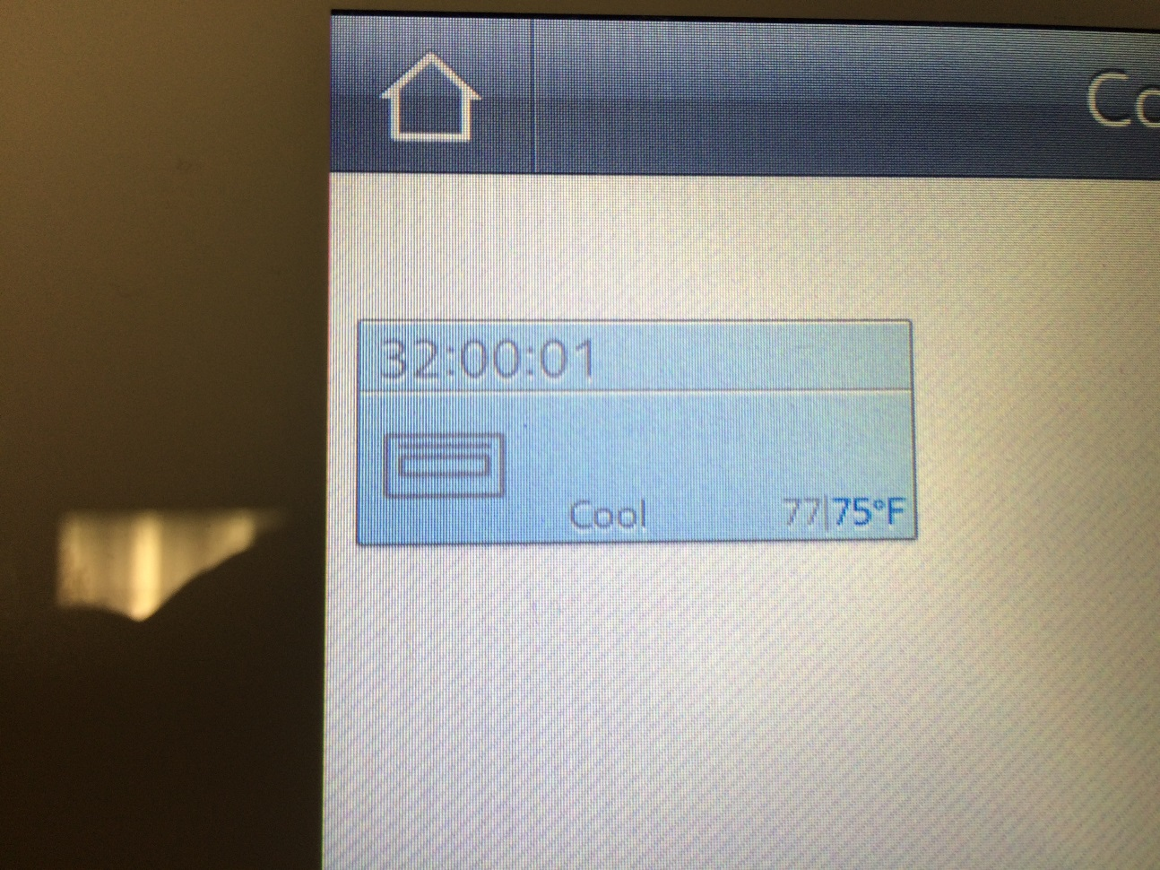
Touchscreen
New Feature
The new version allows you to see space temperature.

