Slide 1
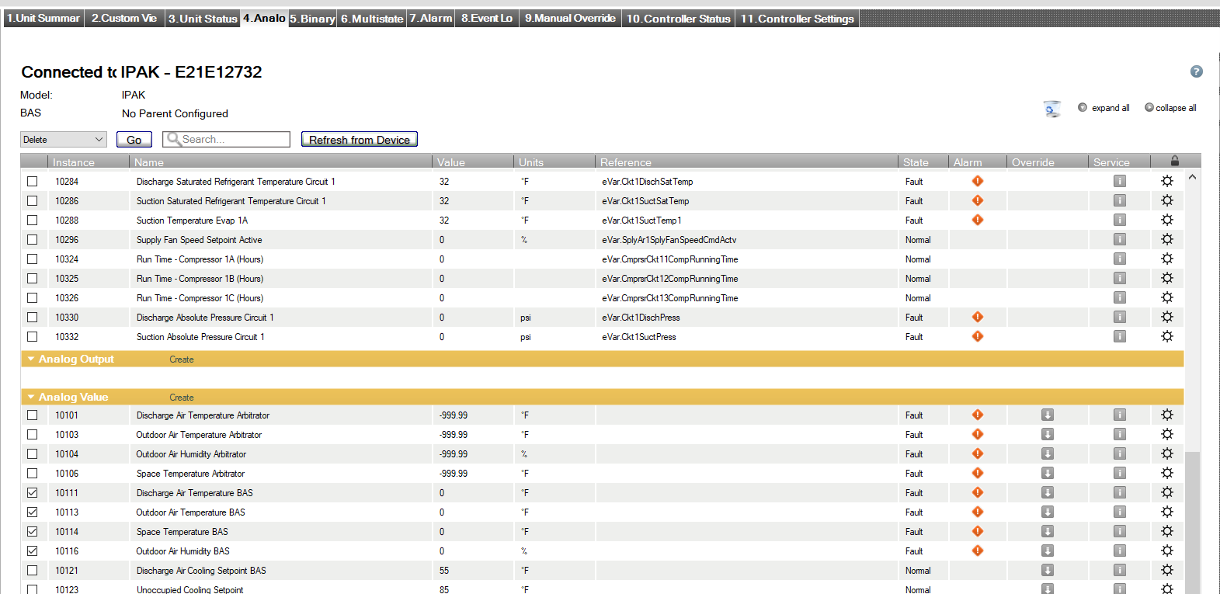
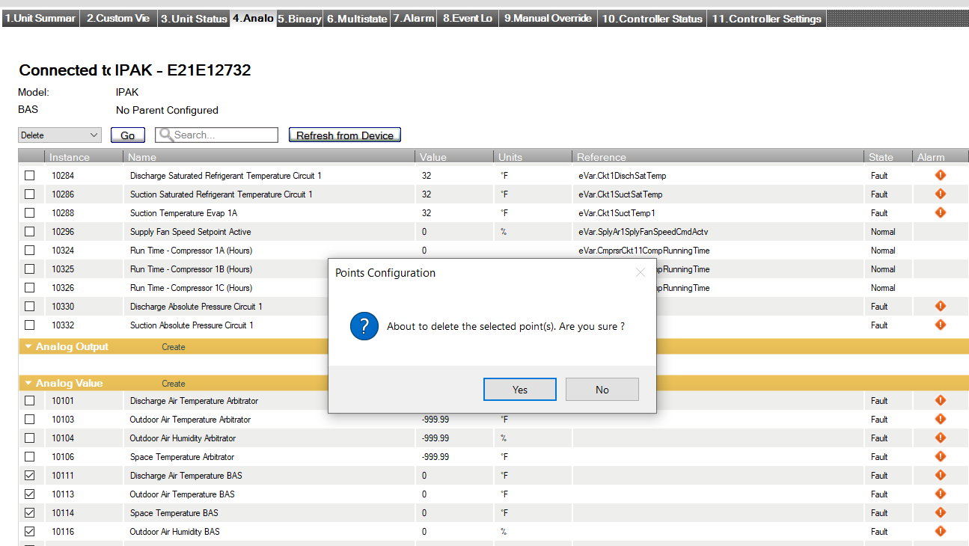
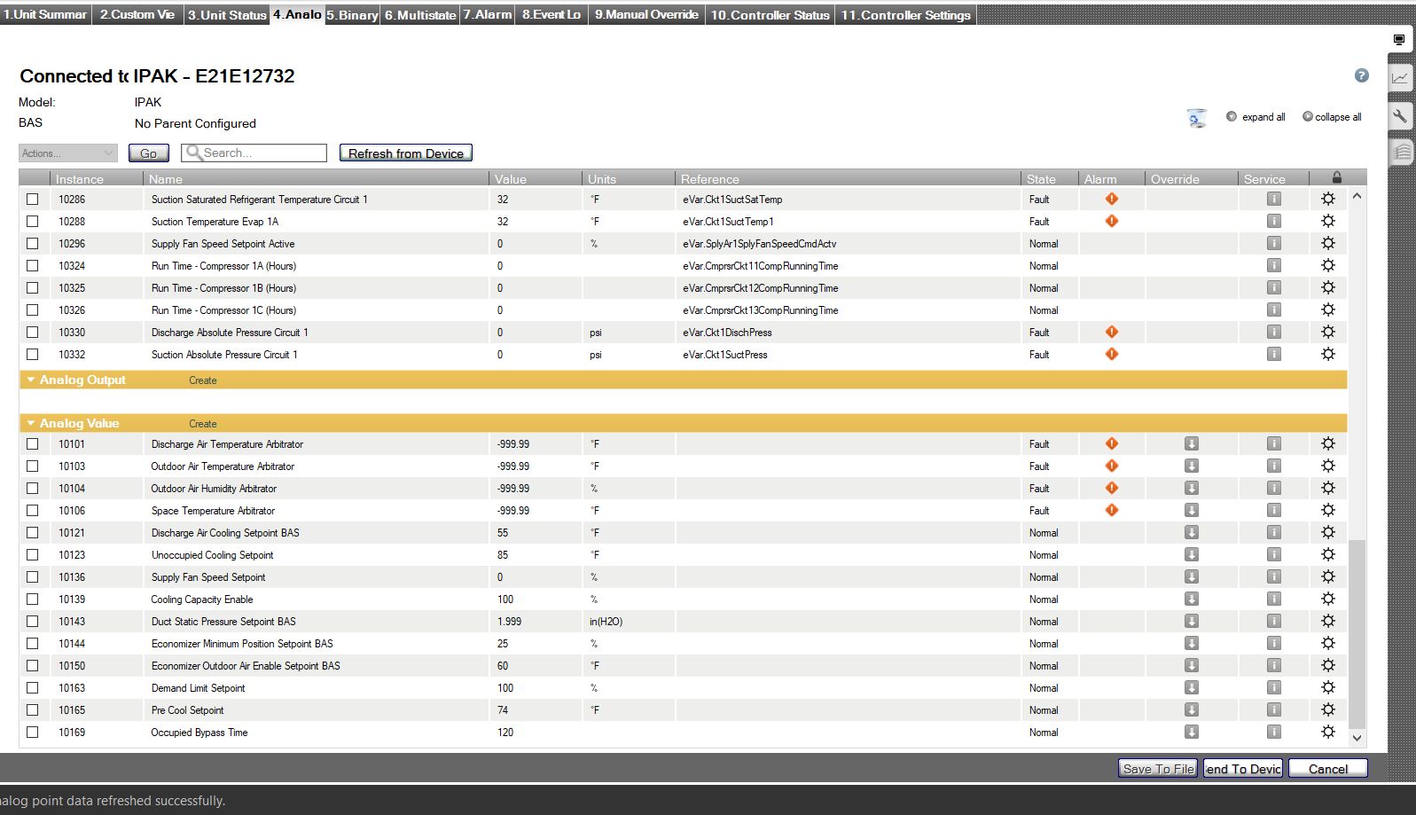
Deleting Point(s) with TU
Actions Menu – select “Delete”
Select unused BAS points
After selections are made, click on the “Go” button
Hit the “Yes” button to confirm selections
Lastly scroll to the bottom of the screen and hit the “Send to Device” button
1
3
2
4
5

Slide 2
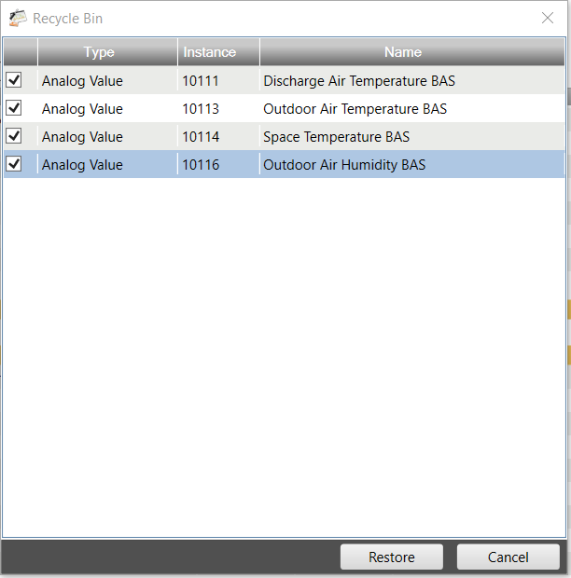
Restoring Point(s) with TU
Click on the Recycle Bin
Select BAS points that you would like to “Restore”.
Click the “Restore” button
1
2
3

