Slide 1
How to backup and re-configure a unit with UC800 controller
RTAE, RTHD and RTAF units.

Slide 2
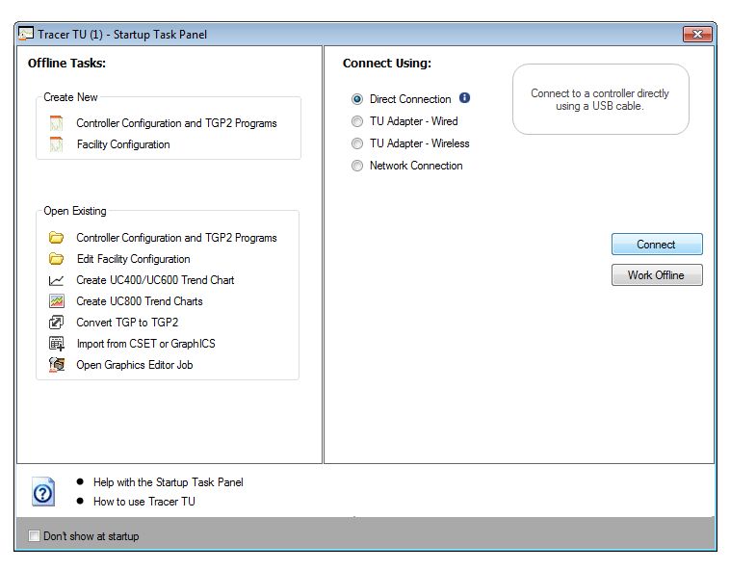
How to Backup
Open TU and connect to the unit with a USB “type A” to “type B” cable.
Select “Direct connection” and click “Connect”

Slide 3
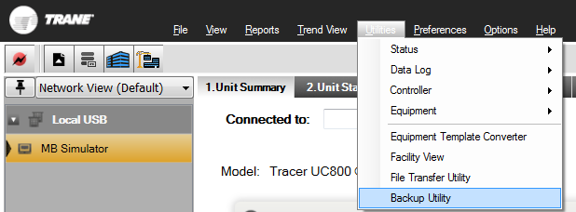
How to Backup
Go to “Utilities” and select “Backup Utility”

Slide 4
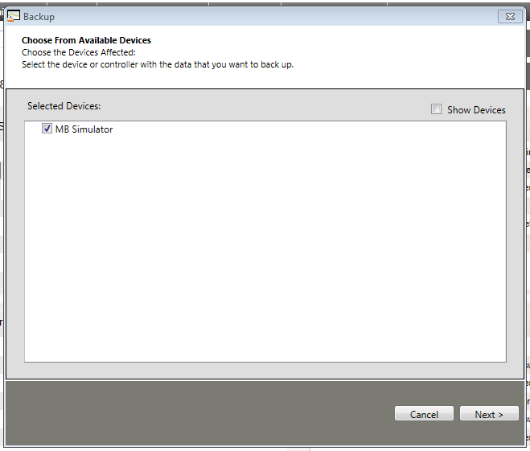
How to Backup
Make sure the check mark is selected for the unit you are connected to and then click “Next”.

Slide 5
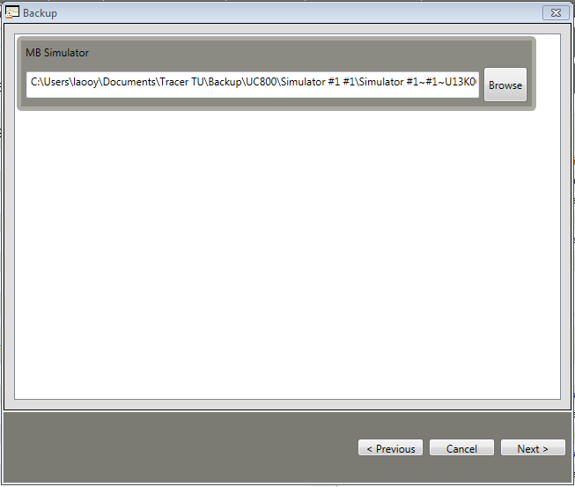
How to Backup
Make sure the file (.zip) is being saved to the correct folder, then click “Next”

Slide 6
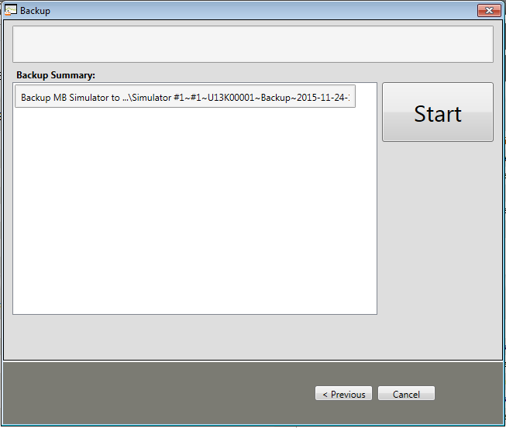
How to Backup
Click “Start”

Slide 7
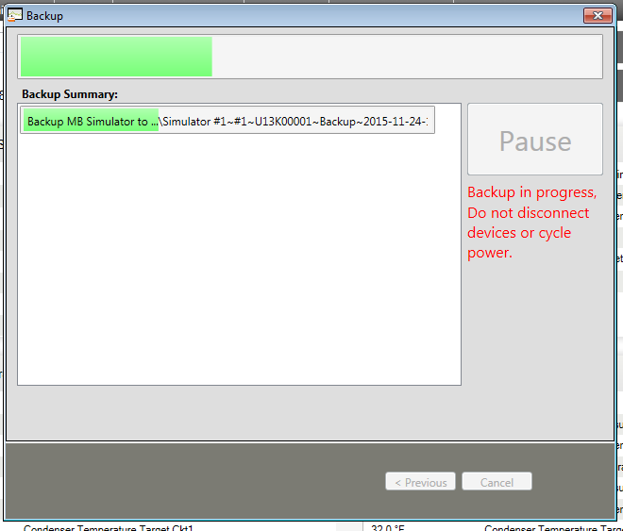
How to Backup
Be patient as this process may take several minutes

Slide 8
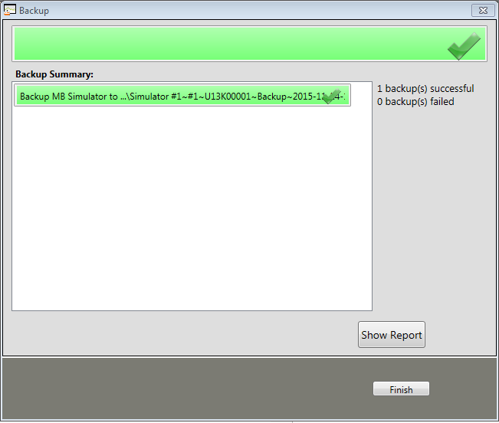
How to Backup
Once the file has been saved you will get a message indicating backup successful, click “Finish”
Backup process complete.

Slide 9
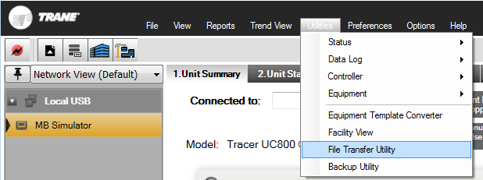
How to Re-configure
Open TU and connect to the unit with a USB “type A” to “type B” cable.
Using TU connect to the UC800 and download the latest MP.
Go to “Utilities” and then select “File Transfer Utility”

Slide 10
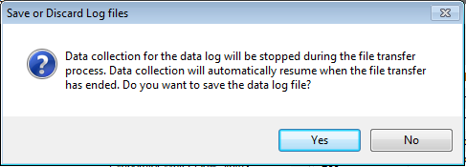
How to Re-configure
You will get a message indicating data log collection will be interrupted, click Yes to save the current log or No to discard it.

Slide 11
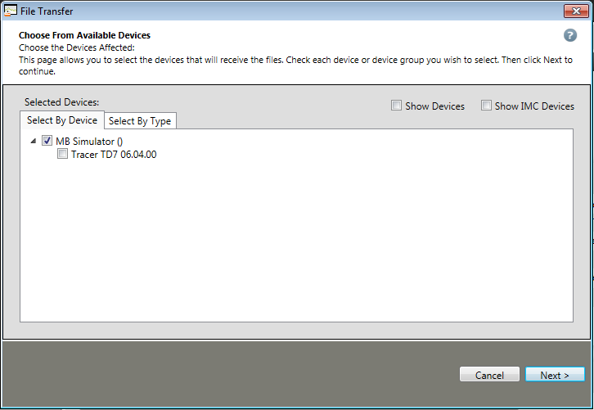
How to Re-configure
Make sure the check mark is selected for the unit you are connected to, click “Next”
Do not check the TD7 box.

Slide 12
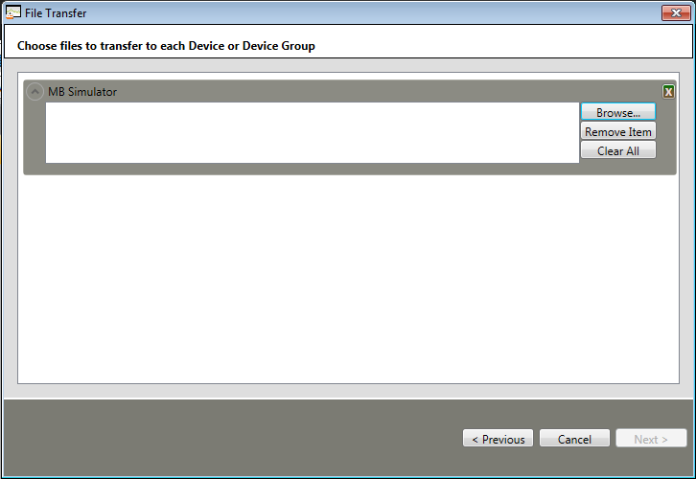
How to Re-configure
Click “Browse” and select the .zip file previously backed up for the desired unit.

Slide 13
How to Re-configure
Search and select the correct .zip file and click “Open”

Slide 14
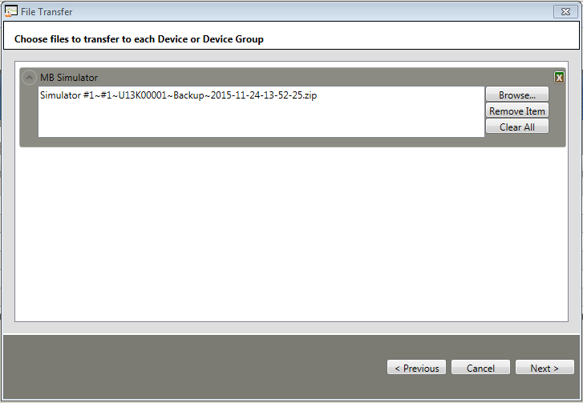
How to Re-configure
Once the correct file has been selected click “Next”

Slide 15
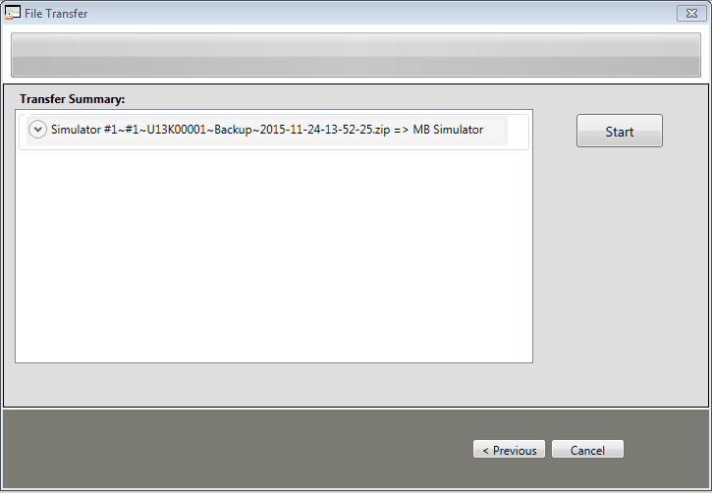
How to Re-configure
On the next screen click “Start”

Slide 16
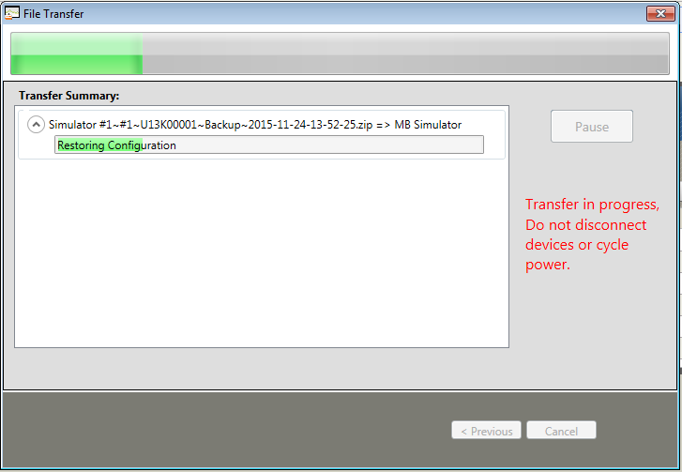
How to Re-configure
Restoring configuration in progress, this may take a few minutes, do not disconnect or power down.

Slide 17
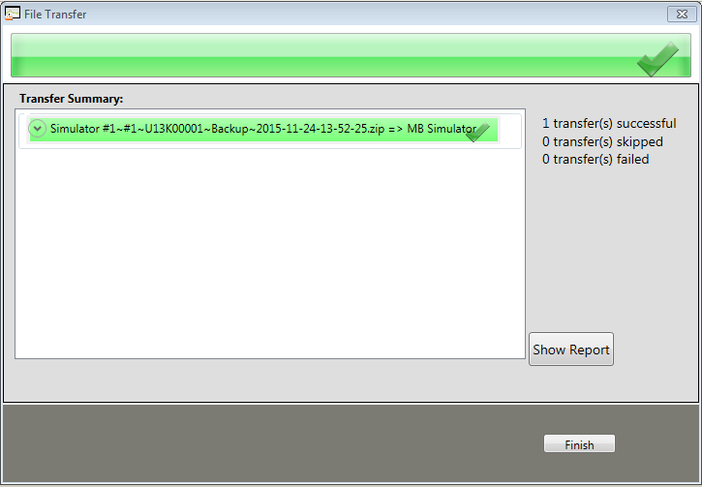
How to Re-configure
Once the re-configuration is complete you will get a message indicating “Successful”, click “Finish”
Re-configuration process complete.

Slide 18
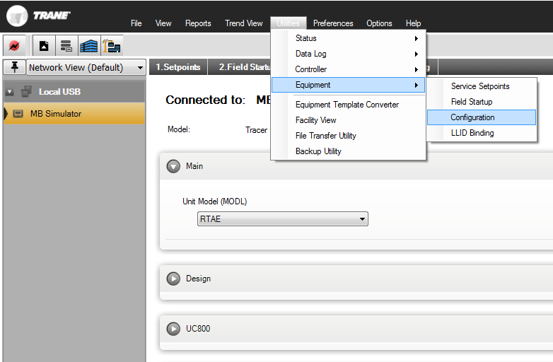
How to Re-configure
To confirm, go to “Utilities” and then “Configuration” and confirm the correct the settings.

