Slide 1
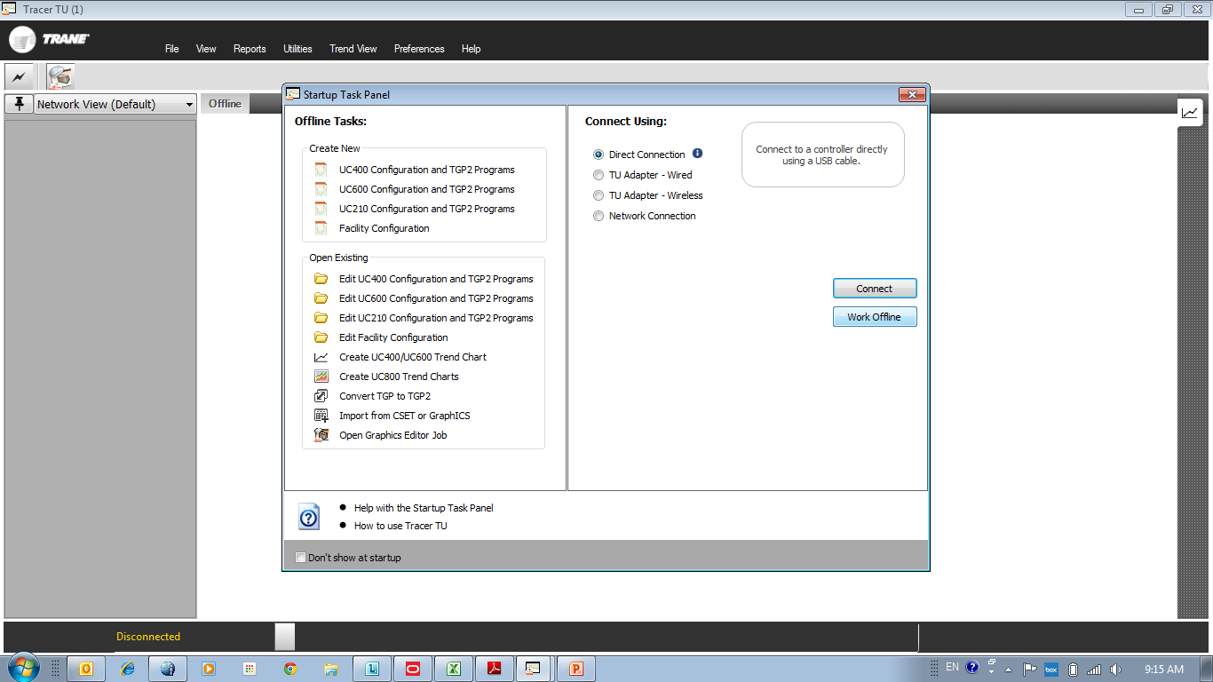
How to save the Archive files from the AFD3
Use a USB cable and connect to the AFD3 drive you are working on, then select “Work offline”

Slide 2
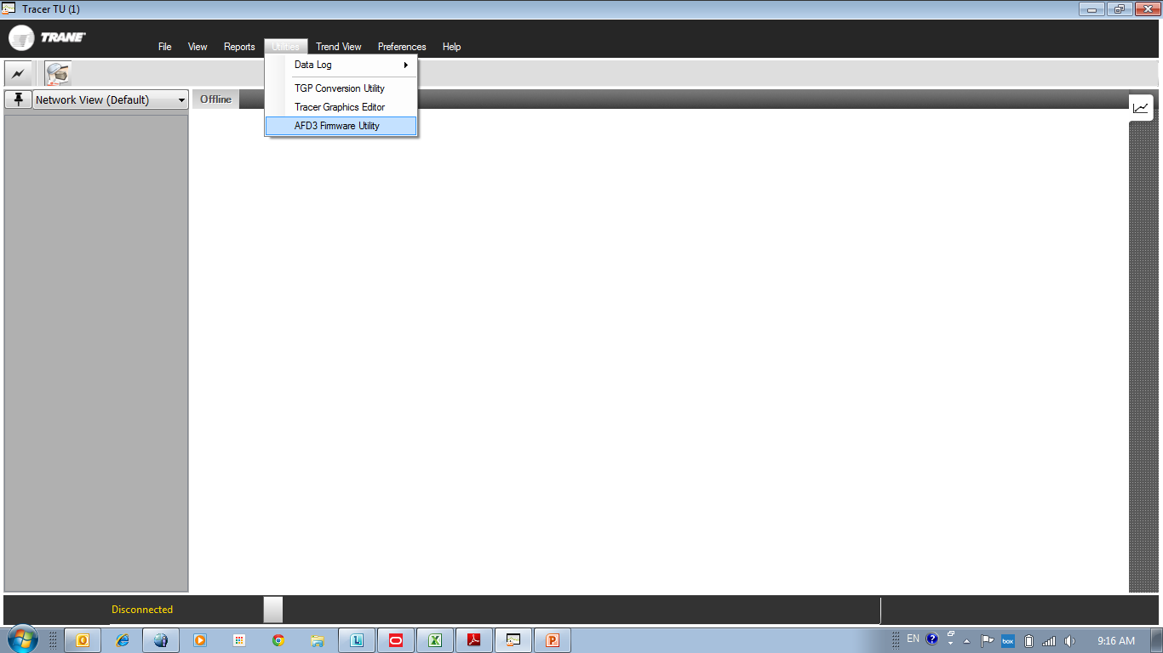
Select AFD3 Firmware Utility

Slide 3
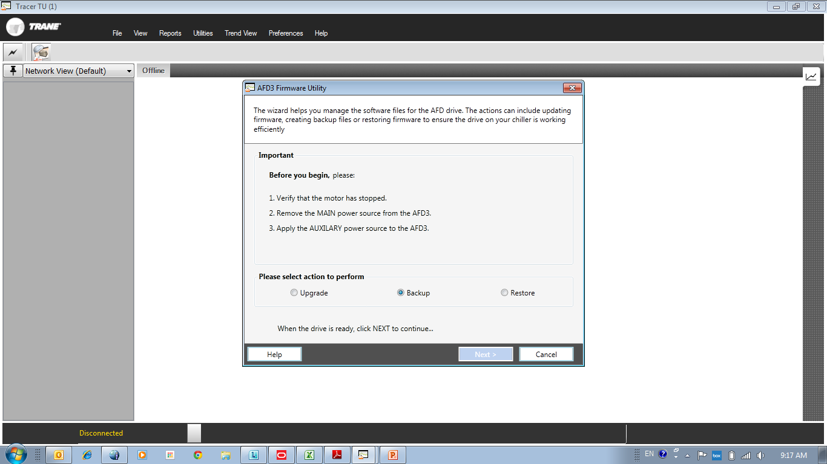
Select “Backup”
Then click “Next”

Slide 4
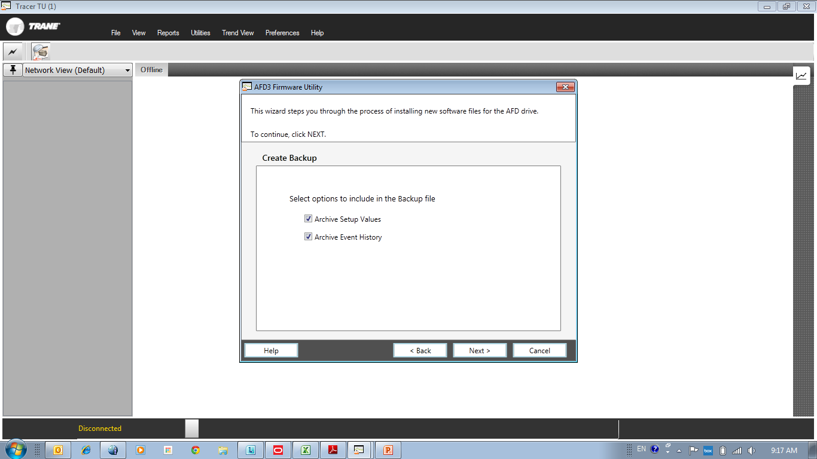
Check both archives and click “Next”

Slide 5
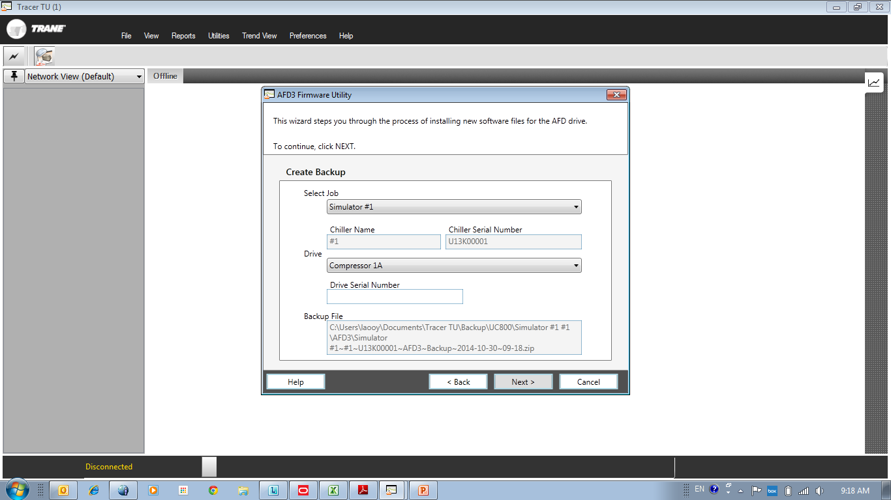
Select the unit you are working on, make sure the serial number matches.
Select the compressor for the AFD you are backing up.
Make sure to note the path where these files are being saved.
Click “Next”

Slide 6
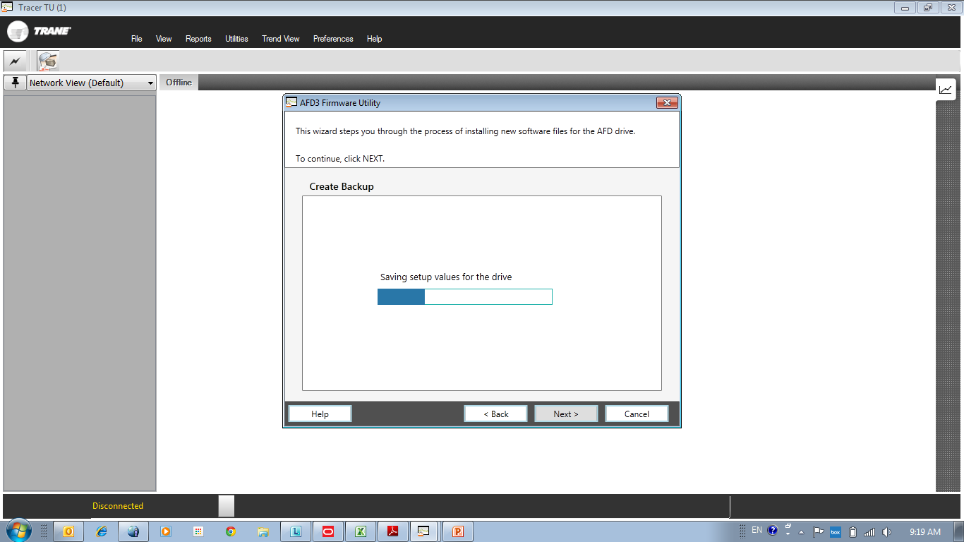
Wait for the files to be saved

Slide 7
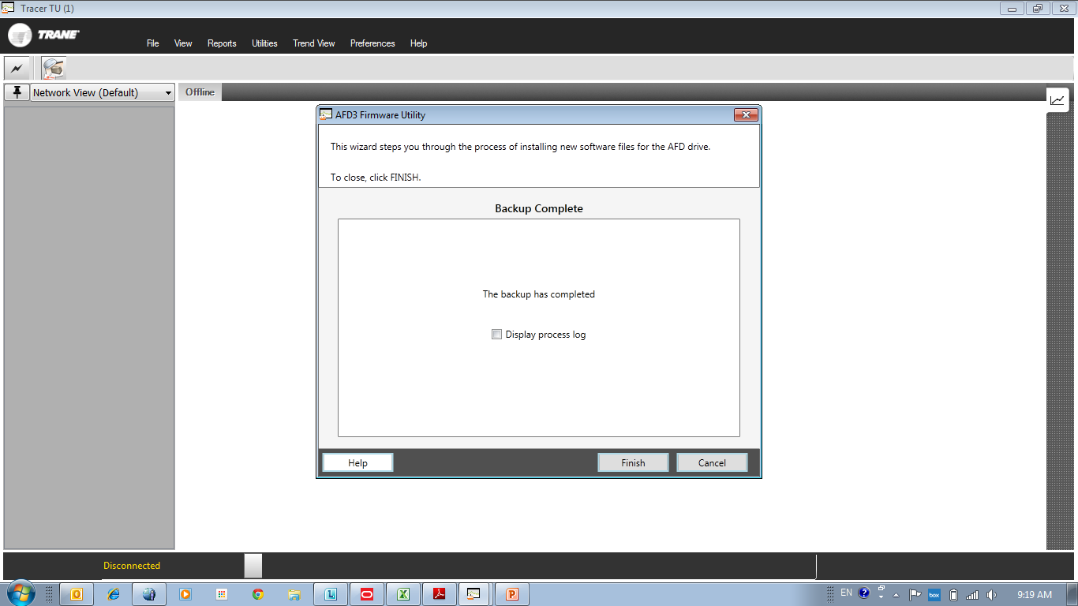
Backup complete, click “Finish”

Slide 8
Confirm the files are saved.

