Slide 1
LCU Motor Addressing with EBM EC-Control Software
Required tools:
Ability to install software on laptop
RS485 adapter (Rover Comm4 Adapter)
EC Control software (min ver 3.3)

Slide 2
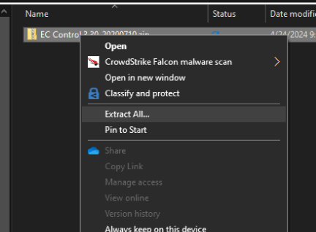
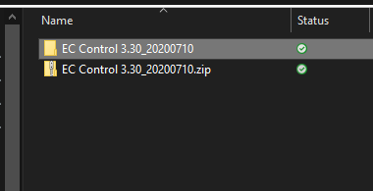
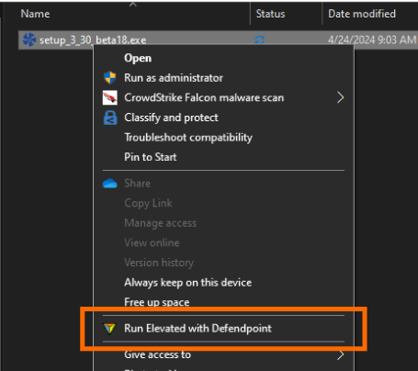
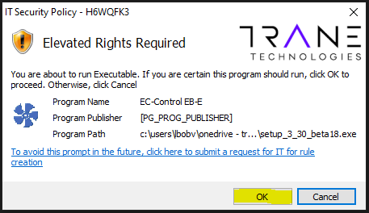
Installing EC Control
Save the EC Control .zip file in an accessible location on your laptop
Access that location and right click on the .zip file and select “Extract All”
A new folder will show up with the same name as the .zip file
Open the newly created folder and find the setup_3_30_beta18.exe file and right click then select Run Elevated with Defendpoint
If you don’t have the Defendpoint option, you may not have the ability to install software on your computer
Be patient, Defendpoint will scan the file and it can take up to 1 min to complete
The Elevated Rights Required message will come up, select OK

Slide 3
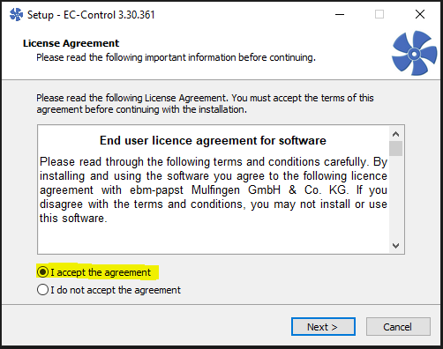
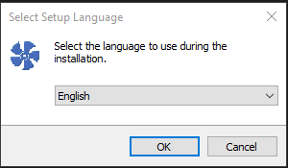
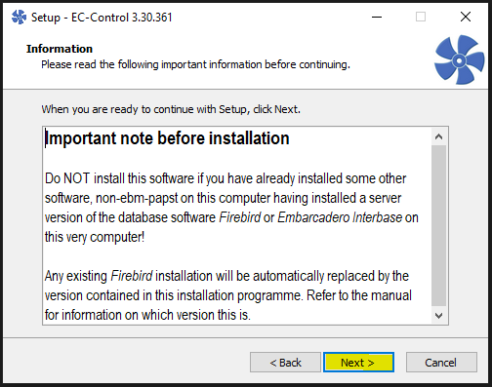
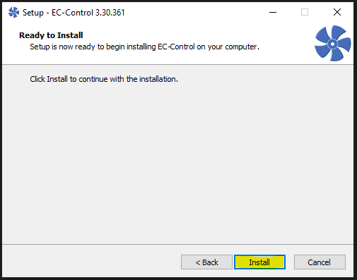
Installing EC Control
Select your preferred language
Accept the license agreement
Read the important note and hit NEXT
Select Install to begin

Slide 4
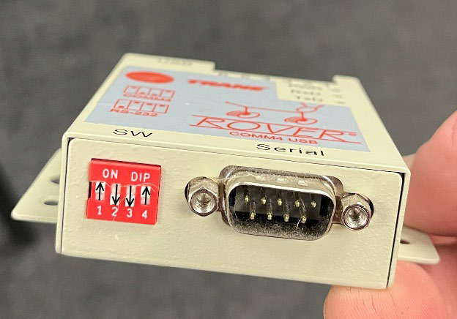
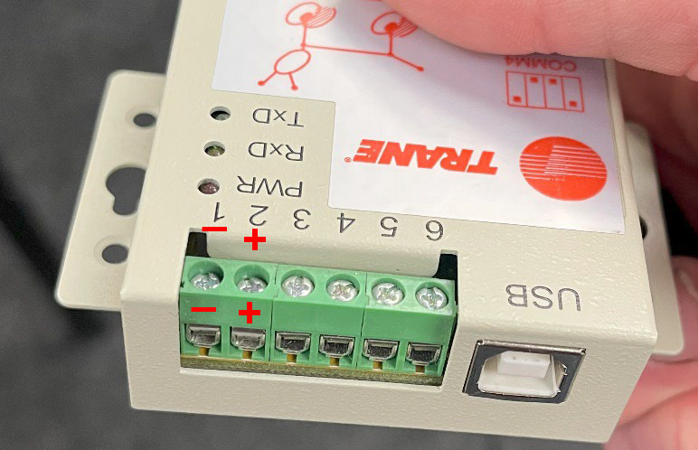
Configuring the RS 485 Adapter
If you are using something other than the Rover Comm4 adapter, please follow that manufacturer’s instructions on how to set up that device.
The settings for a 3rd party adapter should be set for RS-485 Half Duplex (2 wire) with Echo.
Set the dip switches on the Comm4 adapter for ON-OFF-OFF-ON (same as Comm4 communications) for RS-485 Half Duplex (2 wire) with Echo.
Connections to the Comm4 adapter for the Modbus communications are
Terminal 1 = negative (connect to motor Modbus red wire)
Terminal 2 = Positive (connect to motor Modbus black wire)
Connect Comm4 adapter to your laptop BEFORE connecting to the motor

Slide 5
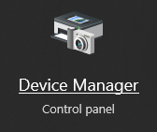
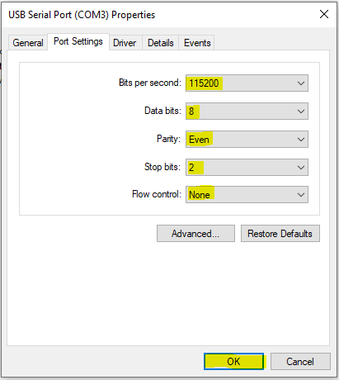
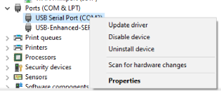
Configuring the RS 485 Adapter
Once the adapter has been connected to the laptop long enough for Windows to acknowledge it, open Windows Device Manger
Navigate to Ports (COM & LPT) and expand it to show the adapter.
The Comm4 adapter will show up as a USB Serial Port (COMx)
3rd party adapters will show up as some sort of serial device
Take note of the COM port and right click and select Properties or double click
Once in the Properties menu, select the Port Settings tab and set the following parameters:
Bits/Second (baud rate) = 115200
Data Bits = 8
Parity = Even
Stop Bits = 2
Flow Control = None
Click OK
IMPORTANT
IF you use the Comm4 adapter for Comm4 links, you will need to document the settings before changing them as you will need to set them back for Comm4.
Connect Modbus to fan motor as described on previous slide
****NOTE****
WE HAVE SEEN ISSUES WHERE
SETTING THE STOP BITS TO
2 DOES NOT WORK. WE HAVE
FOUND THAT SETTING TO 1 RESOLVES
THE ISSUE
YOU WILL ALSO NEED TO SET YOUR STOP BITS TO 1
IN THE ADVANCED COMMUNICATIONS SETTINGS

Slide 6
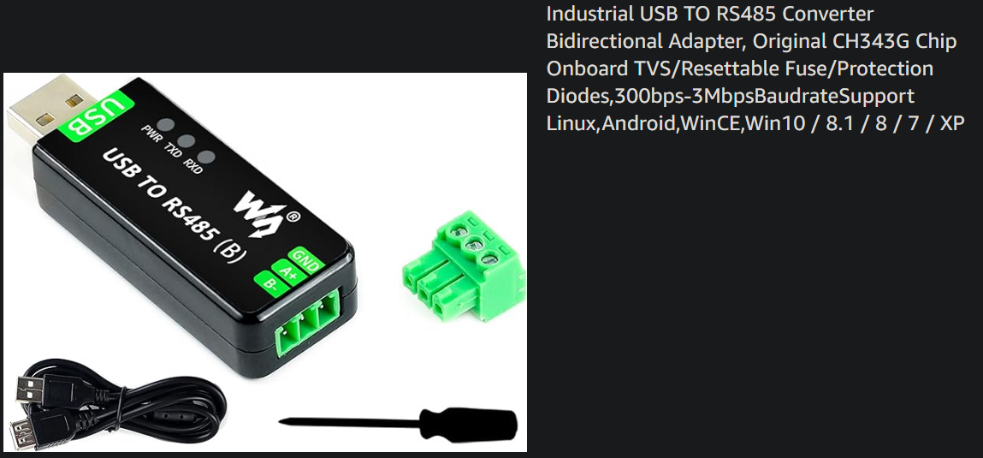
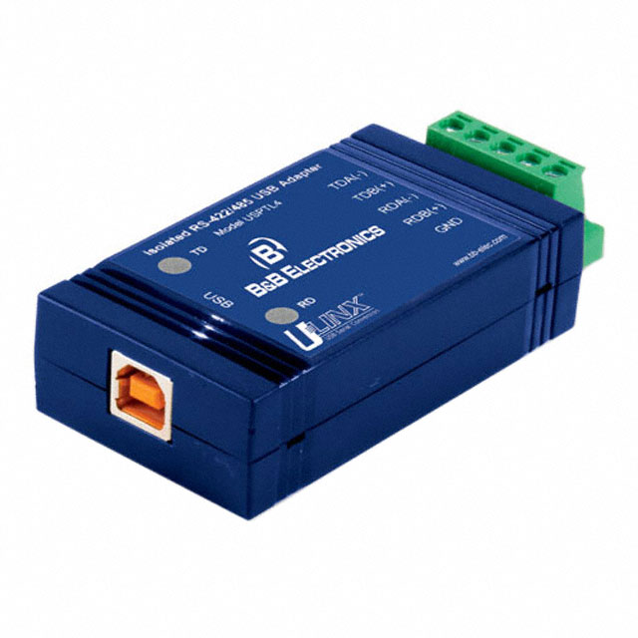
Alternate RS485 Adapters
There are other RS485 adapters out there that work well with EC Control, if it can be configured to match the setting used with the Rover adapter. The adapter below is commonly used and has proving to work well, it can be sourced from Amazon.com (manufacturer is WaveShare)
This adapter can be sourced from DigiKey.com under part #BB-USPTL4-LS, this one has also worked well, but does require the use of their driver.

Slide 7
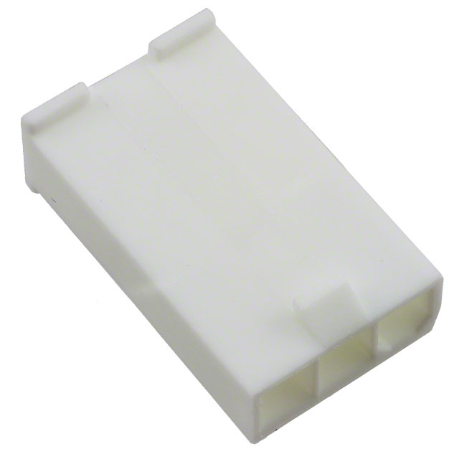
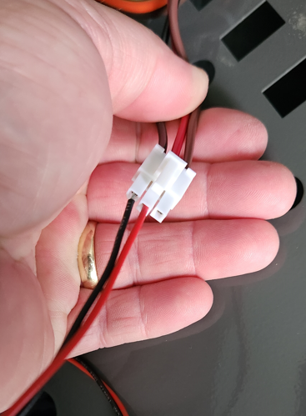
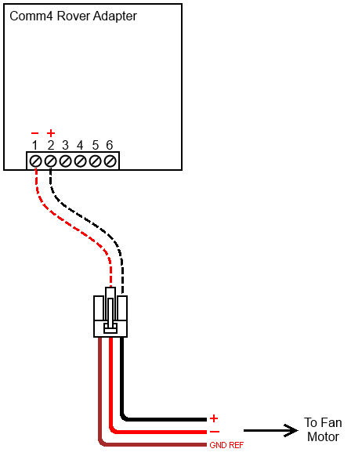
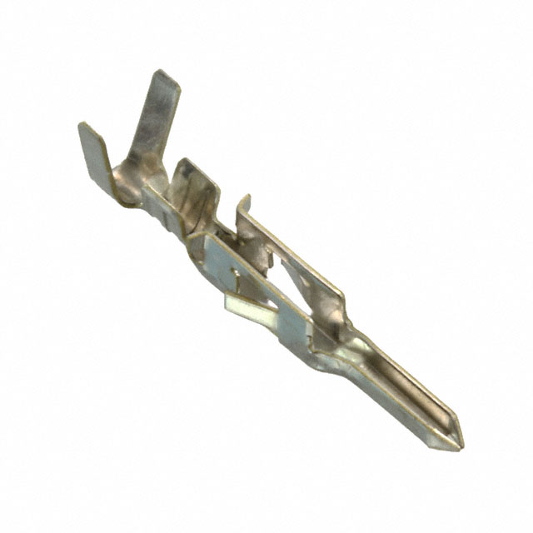
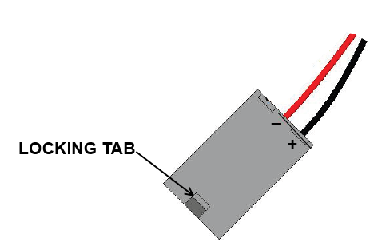
Connecting the RS485 Adapter to the motor
Connecting the to the motor Modbus connection is simple and does not require a special harness
The wire can be pushed into the individual pins at the motor connector
Just make sure they make good connection.
If you do desire to make a harness, the required material are listed below. They can be obtained from DigiKey.com or Mouser.com. You will also need crimpers, the ones shown below are from Amazon.com
You need:
1 – Molex #39-01-4037 Connector Body
2 – Molex #39-00-0040 Pin
For 18-24GA wire
1 – Crimpers, Amazon Iwiss
Note: Making this connector /harness is optional. Pushing the wires into the connector works as well.

Slide 8
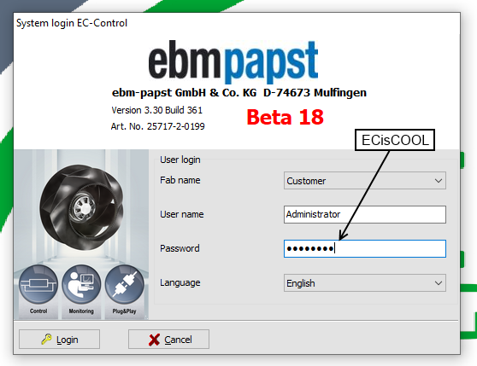
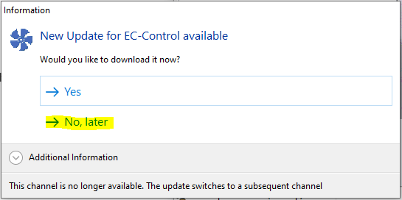
Launching EC Control
Once your laptop reboots, launch the EC Control software from the desktop by double clicking the EC-Control icon
The software will boot and show the login screen, the password is ECisCOOL
You will be prompted to update the EC Control software, do not agree and select No, Later

Slide 9
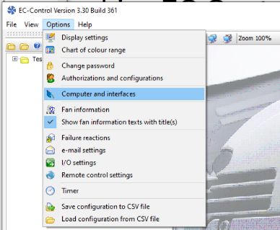
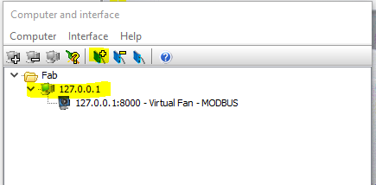
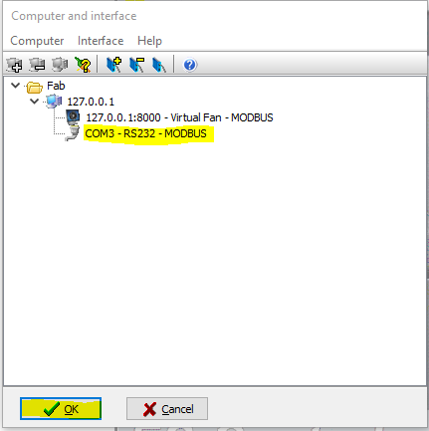
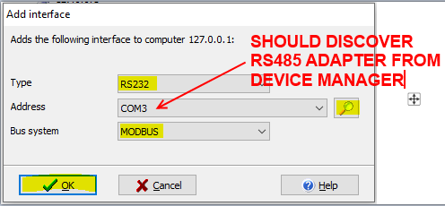
Configuring the RS485 Adapter in EC Control
Once in the software, select Options>Computer and Interfaces
Select the virtual machine 127.0.0.1 and then press “+” to add an interface
In the Add Interface:
Interface Type = RS232
Press the magnifying glass to search for your adapter
If more than one adapter shows up, select the adapter from the Device Manager steps earlier
Bus System = MODBUS
Press OK
The Computer and Interface screen should update to show the added interface, press OK
Once you hit OK, it will validate comm to the adapter and you should get a confirmation screen that shows a green status bar that clears on its own and then returns to the main EC Control screen.

Slide 10
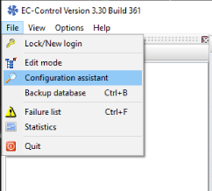
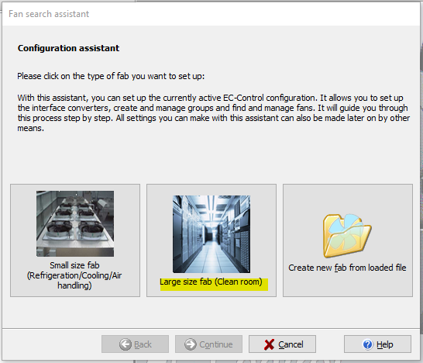
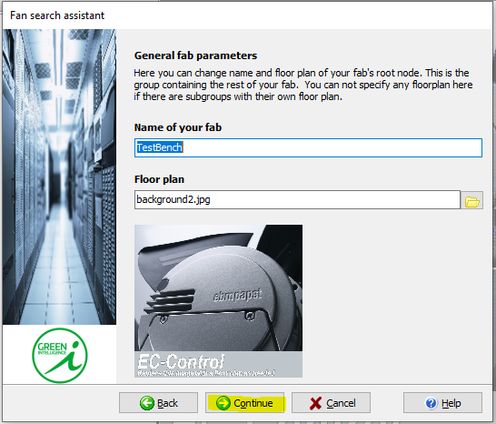
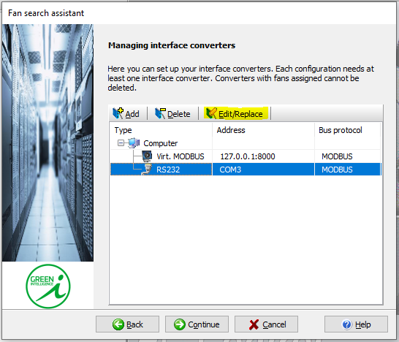
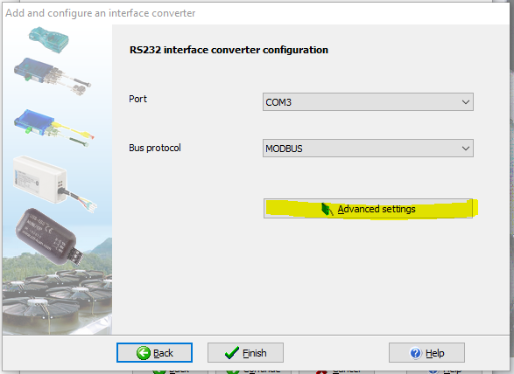
Discovering Fans in EC Control
From the main EC Control screen, select File from the drop-down menus and select Configuration Assistant
Select Large Size Fab (screen will advance on its own)
You can name your fab but it is not necessary, select Continue
Important Step
In Managing interface converters, select the RS485 adapter and select Edit/Replace
Allow the Port field to auto populate with the COM port of the RS485 adapter, then select Advanced Settings

Slide 11
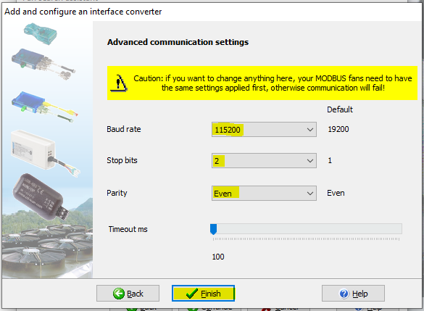
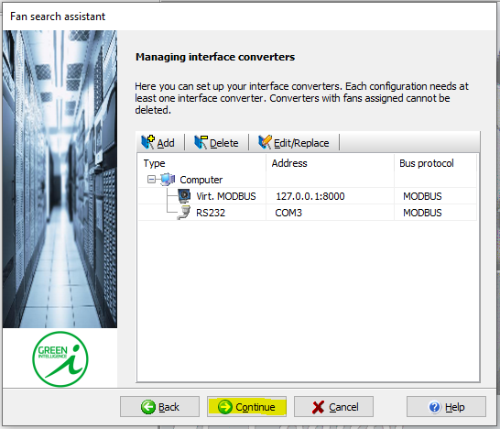
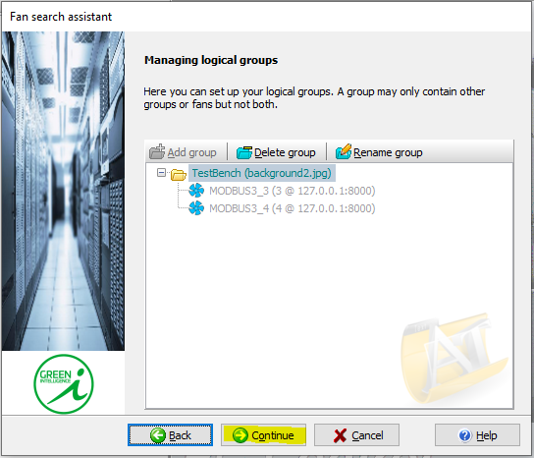
Discovering Fans in EC Control
Set the communication parameters to match the RS485 settings from earlier:
Baud rate = 115200
Stop Bits = 2
Parity = Even
Select Finish
You should get a status window with a green check mark indicating that the interface is initialized
If you get a popup with an error, hit restart application then close everything down and restart EC Control. If this continues, contact Tech Support
The status window will clear itself if no issues are found and take you back to the Managing interface converters screen, select Continue
In Managing logical groups, make sure your fab is present and select Continue
****NOTE****
WE HAVE SEEN ISSUES WHERE
SETTING THE STOP BITS TO
2 DOES NOT WORK. WE HAVE
FOUND THAT SETTING TO 1 RESOLVES
THE ISSUE
YOU WILL ALSO NEED TO SET YOUR STOP BITS TO 1
IN DEVICE MANAGER PORT SETTINGS

Slide 12
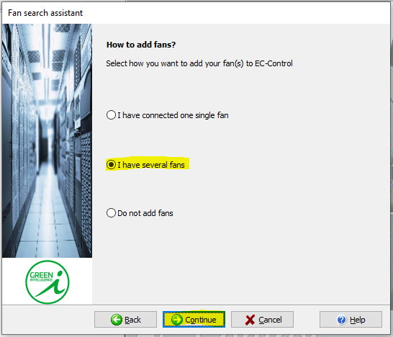
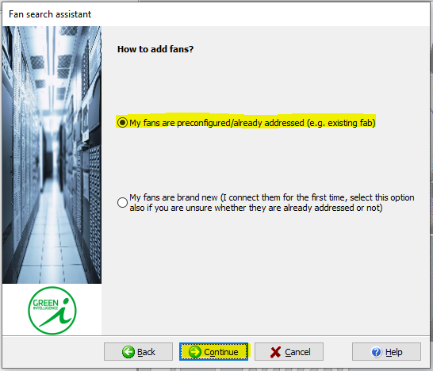
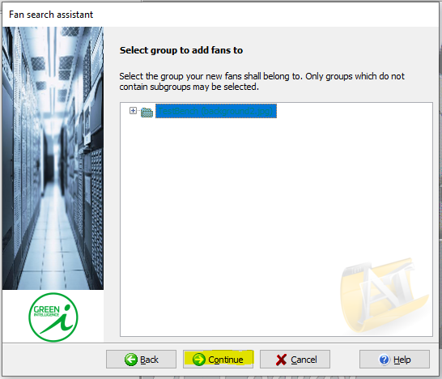
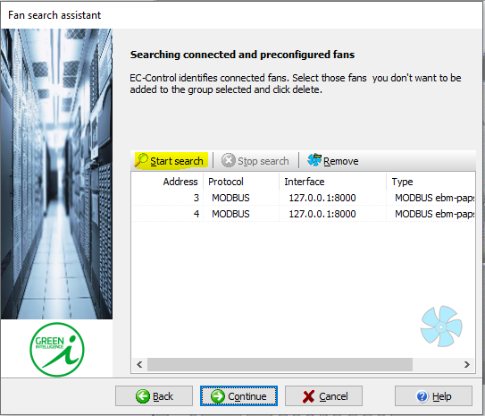
Discovering Fans in EC Control
In the first How to add fans? window, select “I have several fans”, then select Continue
In the second How to add fans? window, select “My fans are preconfigured/already addressed”, then select Continue
In the Select group to add fans to window, make sure to select your fab/group name, then select Continue
You will now be in the Searching connected and preconfigured fans window, select Start Search

Slide 13
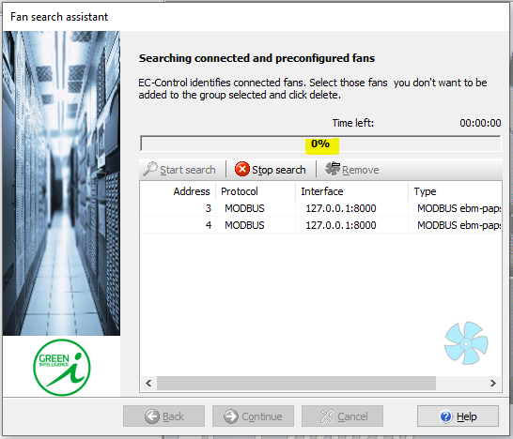
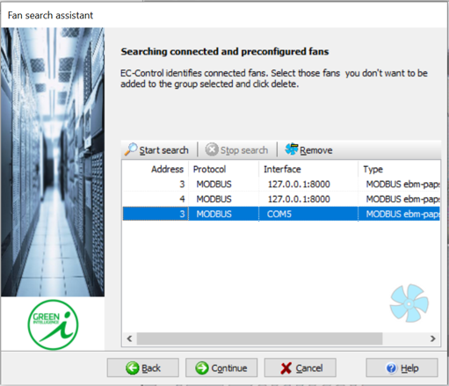
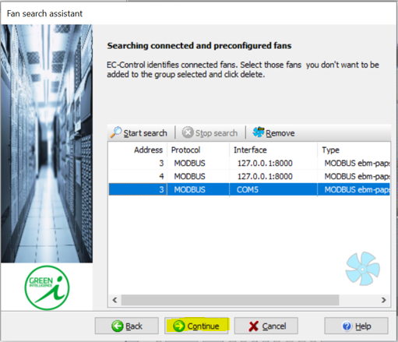
Discovering Fans in EC Control
The software will begin to search for any available addresses it can see.
Typically, the motors will show up quickly, usually within the first 10 seconds of the scan.
Once the scan finds the motor(s), the Stop Search can be used to stop the scan, select Continue
If no fans are found, start the process over and check all communication parameters
Indoor motor #1 is address 3 (fan closest to control panel/front of machine)
Indoor motor #2 is address 4 (fan furthest from the control panel/front of machine)
All motors from Parts will be addressed as 3
Once motor(s) are discovered, press Continue

Slide 14
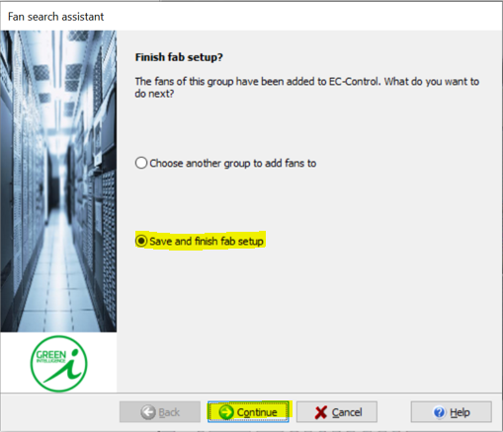
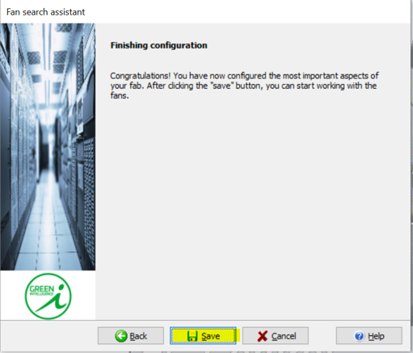
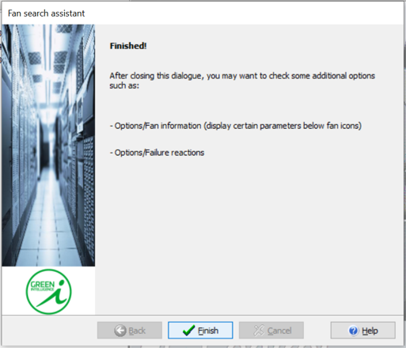
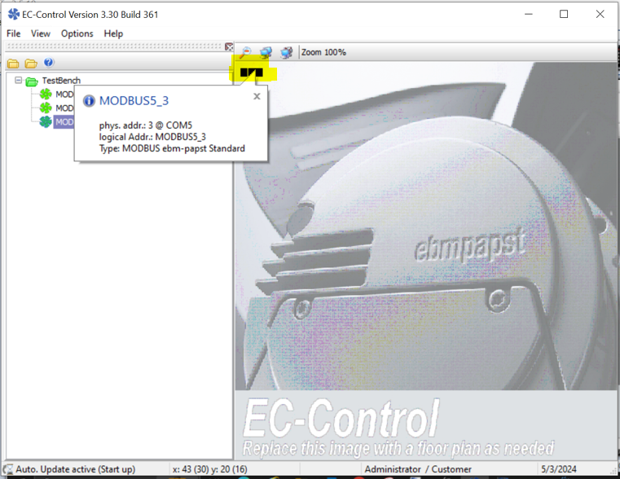
Discovering Fans in EC Control
On the Finish Fab setup, make sure the Save and Finish button is selected, press Continue
On the Finishing Configuration, press Save
On the last window, press Save
This will take you back to the main screen and you should now see one or two black squares in the fab field indicating the fan(s) are communicating

Slide 15
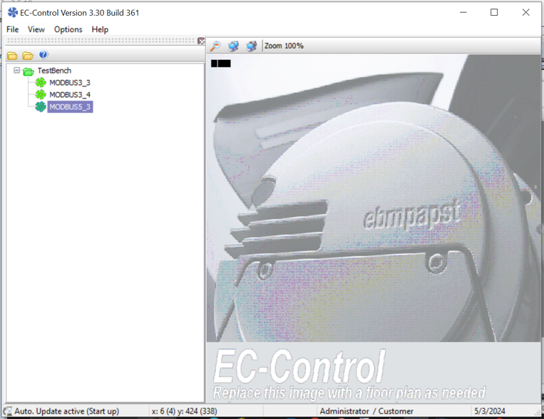
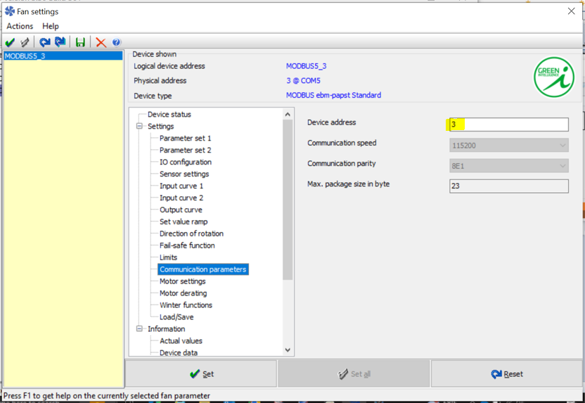
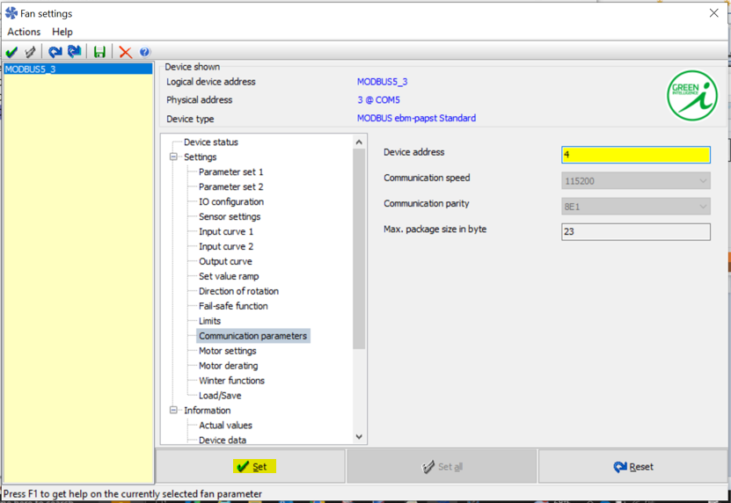
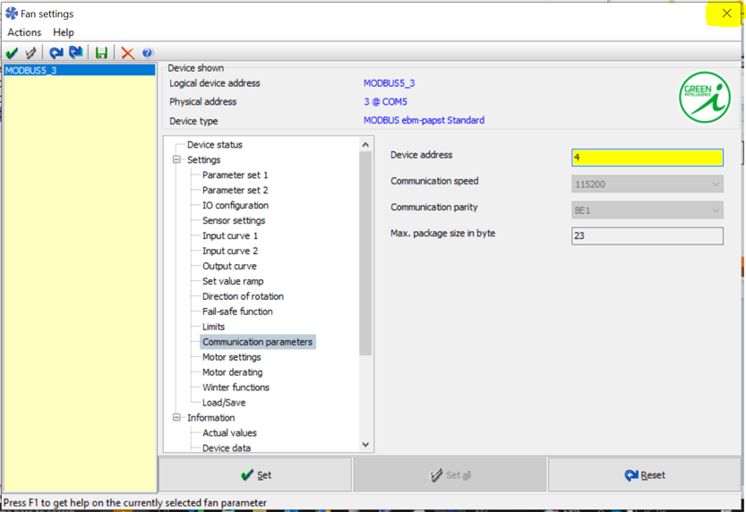
Addressing Fans in EC Control
Select the desired fan from the list by double clicking on it from the list and it will open up the fan settings window (allow it to load completely before clicking).
Once the fan settings have loaded, select Communication Parameters and find the device address field (will be set to 3 on a new motor)
***Reminder***
Fan Motor #1 (closest to control panel) is address #3
Fan Motor #2 (furthest from control panel )is address #4
To address Fan Motor #2, set the address to 4 and press Set
Once the address is set to 4, hit the close window in the top right corner of the window

Slide 16
Addressing Fans in EC Control
Select the desired fan from the list by double clicking on it from the list and it will open up the fan settings window (allow it to load completely before clicking).
Once the fan settings have loaded, select Communication Parameters and find the device address field (will be set to 3 on a new motor)
***Reminder***
Fan Motor #1 (closest to control panel) is address #3
Fan Motor #2 (furthest from control panel )is address #4
To address Fan Motor #2, set the address to 4 and press Set
Once the address is set to 4, hit the close window in the top right corner of the window
You can reconnect the motor to the unit and close EC Control.

