Slide 1
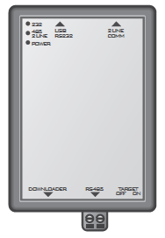
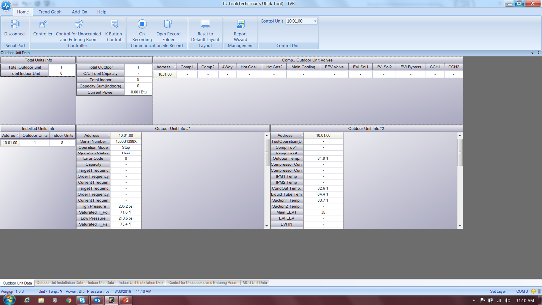
“TUT”- Technician Utility Tool:
PC Interface with VRF System
F1/F2 Connection
Configuration
Testing
System Recordings- “Run Data”
Documentation
Error Code Locator
Service Tool
USB Cable

Slide 2
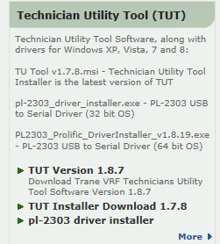
TUT: Purchase and Download
Purchase Trane Supply P#TVCTRLTIMC0300
Downloads are available on “Comfort Site”
Download Latest Version
Install Proper Driver
WCU- Version 1.5.6 Only!
Notes:
The Technician Utility Tool or “TUT” is available from Trane Supply as Part# TVCTRLTIMC0300. After purchasing the ‘TUT” tool log-on to Comfort Site,
(Click on) “Product Info” tab on the left,
(Click on) “Trane ProSpace VRF” Tab, (Located middle of page on the right)
(Click on) Latest TUT Version Available.
Note: WCU Units are only compatible with version 1.5.6.
See the HUB for “TUT Version for WCU VRF”.
To download Driver, (Click on) “pl-2303 driver installer”.
Choose proper drive per your operating system.
Note: Installation of the TUT Tool is critical and required for proper start up execution, documentation and evaluation.

Slide 3
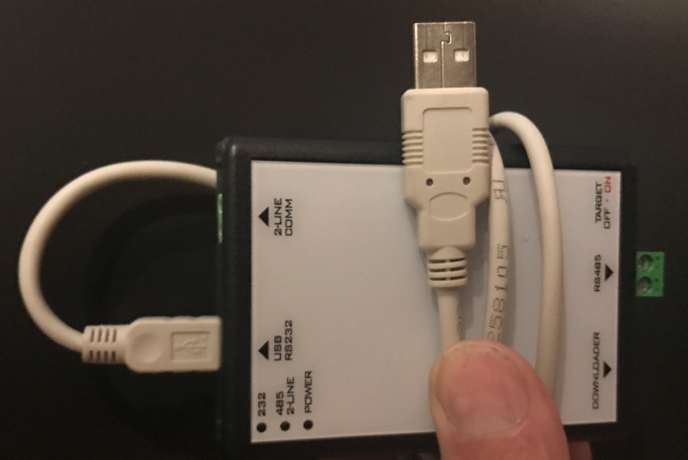
TUT: Connection (USB and F1/F2)
USB Connect to Computer and (F1/F2) connect to Green RS485 plug
Notes:
The F/F2 buss wire can connect at any point within the F1/F2 buss. When service work is being done at a later date, it would be better to connect inside at an AHU or MCU. The TUT is most commonly connected at the ODU. With the Rotary Dial Switches and F-Buttons that have to be set up and exercised the ODU is normally the best place to connect. Once the TUT is connected to the computer and the VRF F1/F2 terminals your next step would be to open the software and begin TUT operation.

Slide 4
TUT Connection to VRF System:
Select “Connect” to establish communication with Trane ProSpace VRF system.
Notes:
The first TUT screen you will see is a home screen. In the top left press “Connect” to establish communication with the VRF System.

Slide 5
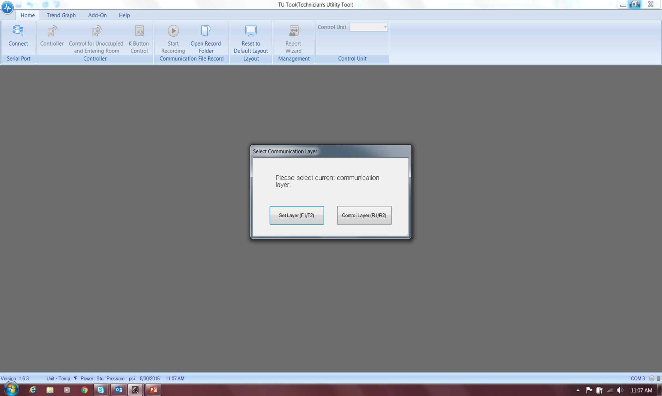
TUT: Select F1/F2
Select the F1/ F2. Service layer is to configure indoor units, create commissioning report, and record operation.
The R1/ R2 Control Layer has limited use in the Commissioning Process.
Notes:
The next TUT screen you will see will give you a choice of what type of connection. Choose the F1/F2. There will not be a time when the R1/R2 connection is used with the TUT tool.

Slide 6
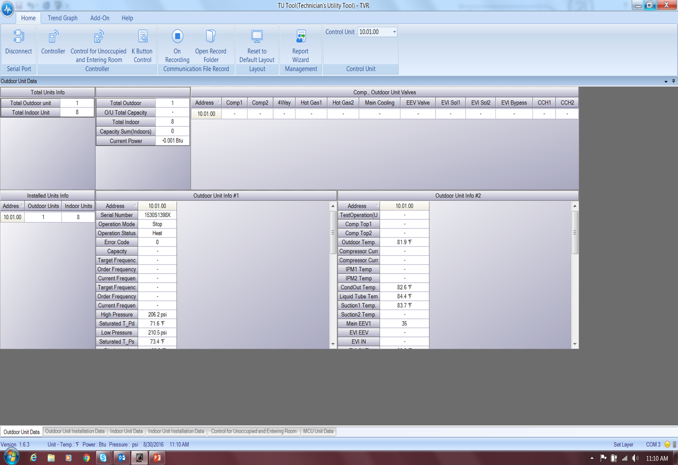
TUT: Outdoor Unit Data (TAB)
Notes:
To view the ODU’s, Press at the bottom of the “Home” page the “Outdoor Unit Data” tab.

Slide 7
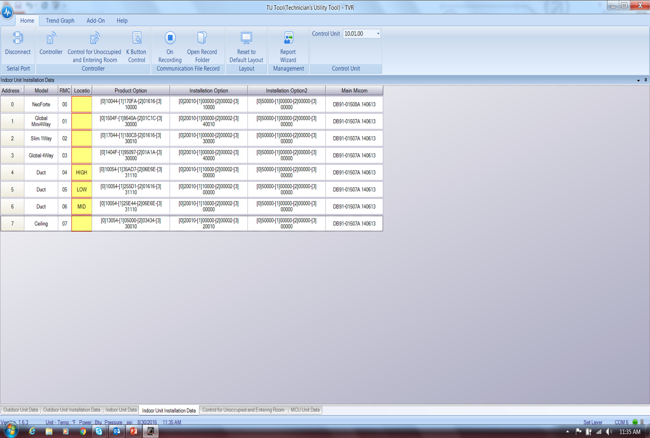
TUT: Indoor Unit Installation Data (TAB)
Notes:
The next tab to the right is the “Indoor Unit Installation Data” tab. This tab will become a very familiar place over time for the startup agent.

Slide 8
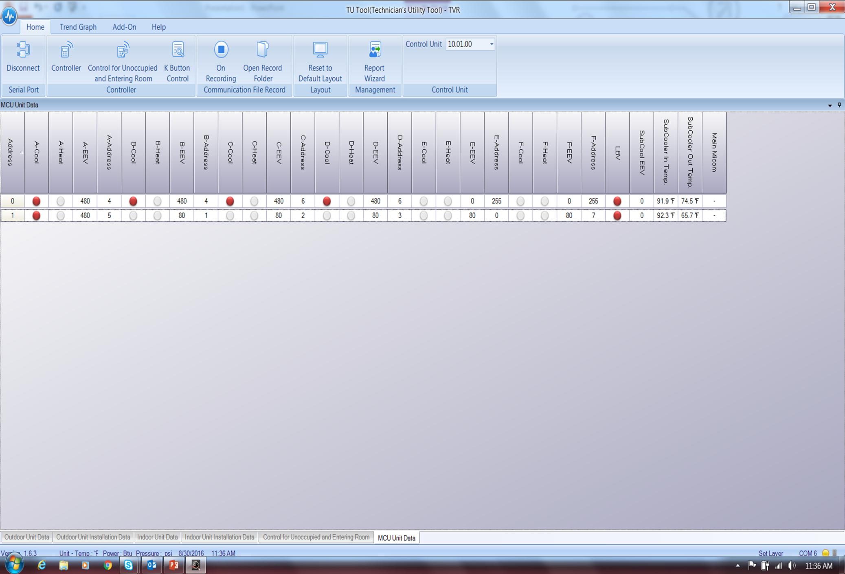
TUT: MCU Unit Data (TAB)
NO M# and S#
Notes:
If the system is a heat recovery the “MCU Unit Data” tab will be active and provide data for the MCU systems that are communicating. One unique feature to the MCU system is that the TUT will not provide a model or serial number for the product. This is not an issue due to the fact that all MCU systems are given a manual address. Remember to follow the CLS and address the MCU in the system with a “00” address.

Slide 9
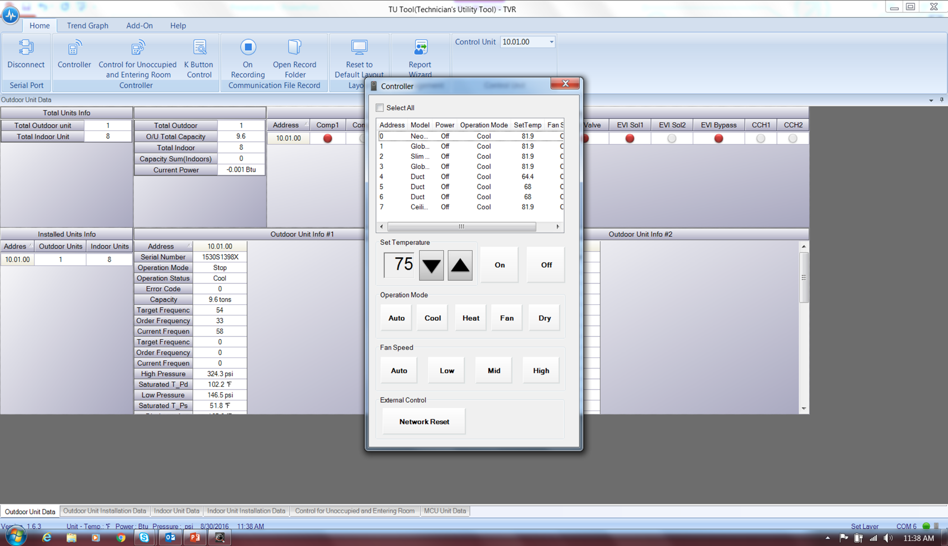
TUT: Controller (TAB)
Notes:
The TUT “Controller” is accessible on the Home page of the software. Selecting the “Controller” button provides control access to every connected indoor unit by address. When identifying indoor units, prior to the “Auto Test”, the fan operation should be used to identify indoor units if necessary. After proper startup has been completed the TUT “Controller” can be utilized to cycle through operational modes and alter fan speeds for evaluation. Also if group identification is necessary, the “Controller” function allows selection of any number of indoor units to control.

Slide 10
TUT: Modify IDU Addresses
2
3
4
1
Notes:
Press the “Home” tab to begin to modify the IDU address to match the planned address from the CLS. Press the “Indoor Unit Data” tab and then press the “Add-On’ tab at the top of the screen. There will be a “Address Change” option on the top left of the screen and now select this button. A second sub menu screen will appear listing all IDU units available on the system. Hover the prompt over the dash of the top unit and then select it.

Slide 11
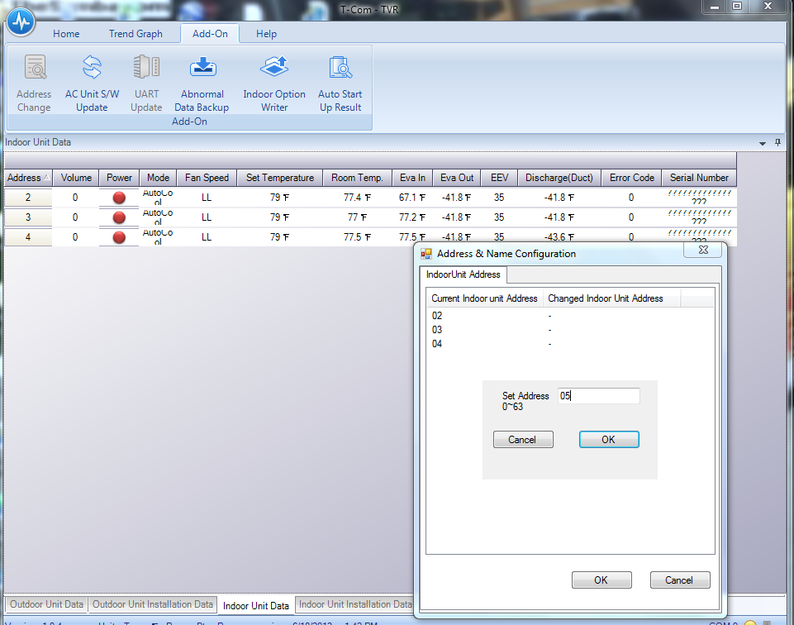
TUT: Modify IDU Addresses
Work Top Down
With IDU Change
5
Complete
Notes:
After selecting an IDU to make a change an additional sub menu will appear and the address desired can be entered, press “OK” just below the entry. Repeat these steps working from the top of the screen down and then confirm all address. When complete with the last change press the “OK” button at the bottom of the sub menu box “Address & Name Configuration”.

Slide 12
TUT: Modify Product and Installation Option Codes:
1
2
Notes:
IN TUT, Press the “Home” button to confirm location. Select at the top of the screen the “Add-On” button and then “Indoor Option Writer”. The screen will now change.

Slide 13
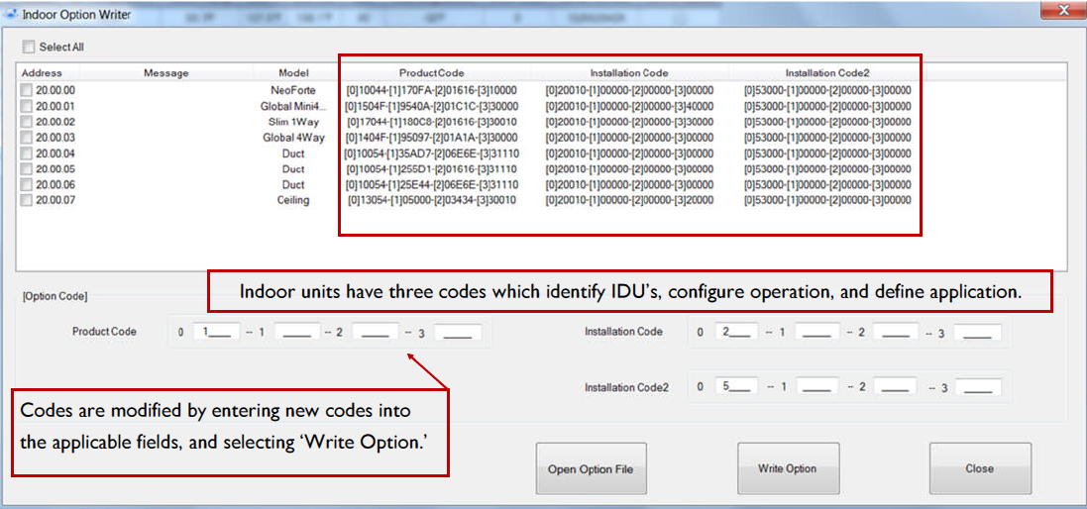
TUT: Product and Installation Option Codes
Notes:
The “Indoor Option Writer” menu screen will appear. At this location there are a number of options available to the TUT user. The Product Code and the 2 Installation Option Codes are available to be changed. Look at the CLS to locate the address for your IDU and then in TUT look for the address for the IDU that needs modification which will be located and selected at the left hand side of the screen. The code can now be written in the proper box.

Slide 14
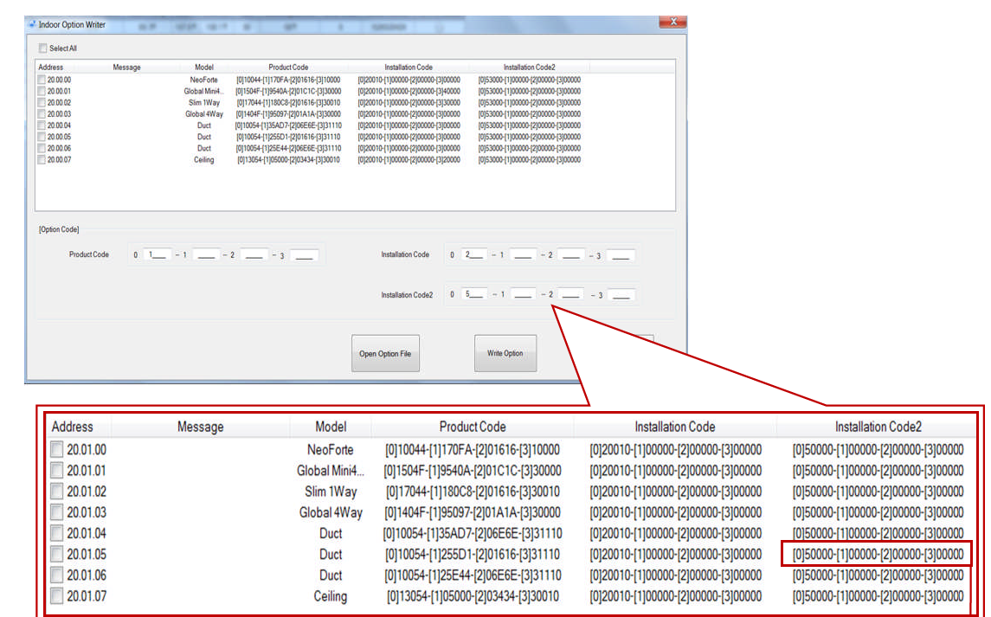
TUT: Product and Installation Option Codes
Notes:
(Lookup digit 2=5/digit 23 for fan operation in thermal off conditions for the Slim Duct IOM)
Often the reason the option codes have been accessed are to add a feature but often it is to provide sequence of operation changes. For option code digit 2=5/ digit 23 on a Slim Duct after reviewing the IOM we can change the fan operation. The fan by default is off during thermal off in heating. This feature can be changed when “A” is written into the 23 place in the “Installation Code 1” above. The complete string is entered left to right with using the tab key between the 6 digit segments. Once complete press “Write Option” .

Slide 15
TUT: Indoor Unit Installation Data (TAB)
Notes:
Once you have written the option and made the change you will be placed at the “Indoor Unit Installation Data” tab page. If there is another change necessary choose “Add-On” then “Indoor Installation Writer” and repeat the steps taught above once you have reviewed the IOM specific to the IDU to confirm the proper code change is required.

Slide 16
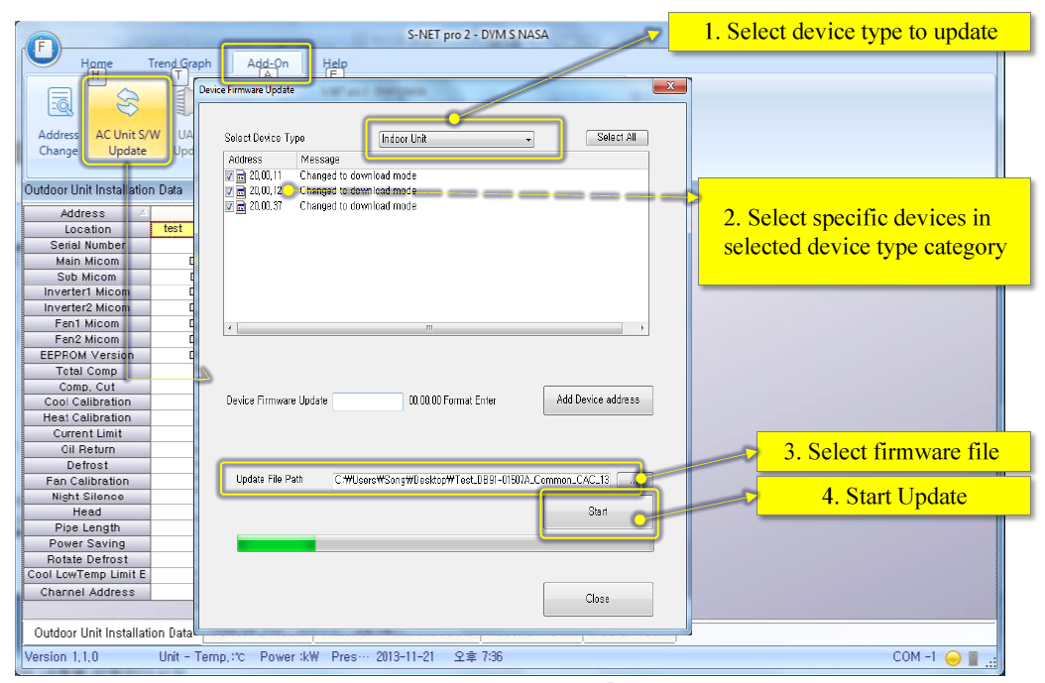
ODU (Digit 9=C): IDU Firmware Upgrade
NOTE: Make sure to disconnect any COMM wires connected to R1/R2. Also, ensure there are no interruptions once download has started.
Notes:
Equipment Firmware Upgrade will be successful and easy if the tasks identified in the HUB Case ”2017 VRF Product Compatibility Evaluation: Procedures and Requirements” were properly executed from the “First Steps” training at the beginning of this module. Confirm power is stable for the IDU being updated. Power interruptions during this process can crash the MICOM creating delays in the start up process.
Connect the TUT to F1/F2- When software is ready, press “Connect” at the very first screen. Update the IDU system address to match the CLS per the serial numbers using the “Indoor Unit Data” tab. Remember to work top down and save the update at the end. Now your IDU addresses match the CLS .
Next at the “Home” screen press “Add-On” then “AC Unit S/W Update” and then the “Device Firmware Update” sub menu will appear
1. Select device type.
2. Choose the address for the IDU.
3. Select firmware file.
4. Start Update
Repeat for additional IDU if necessary and when complete press “Close” in the sub menu.
All IDU’s are now ready for the “Auto Port Addressing” process.

