Slide 1


How to change a compressor
Presented by: Peter Kallas III, Jay Broadrick
Supported by: Jay Broadrick, John Willis, Jason Hamm, Jim Lawrence & Paul Solberg

Slide 2
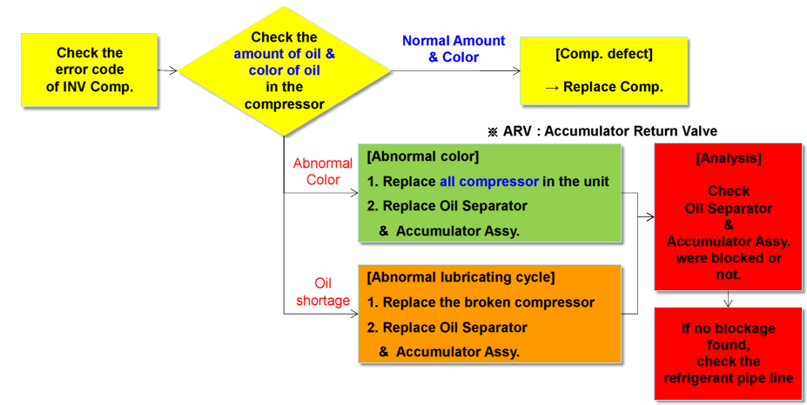
Cause of abnormal oil
Restricted pipe due to alien substance
Restricted pipe due to poor installation practices
AVR(Accumulator Return Valve) Failure

Slide 3
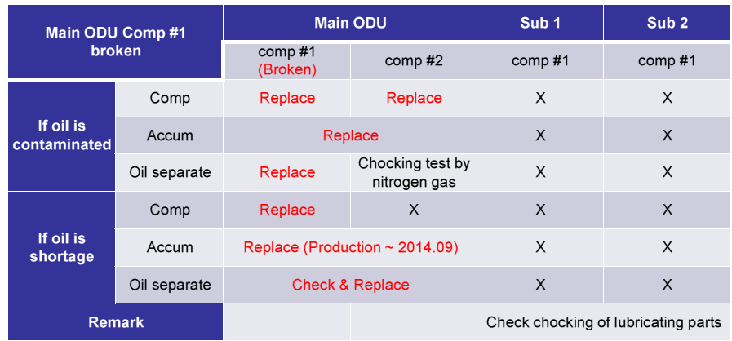

How to change a compressor
Parts inspection and replacement

Slide 4
How to change a compressor
Turn power off to the ODU
Reclaim the refrigerant in ODU (Use working compressor for a pump out to speed up the reclaim process) After pump out there will be approximately 3.3 lbs in the ODU.
Remove bad compressor
Weigh old compressor and new compressor
Check oil color and do an acid test on the failed compressor
Follow the chart on the previous slide depending on the conditions of the oil
Install new parts and preform a triple evacuation per installation instructions
Add the same amount of refrigerant that you removed

Slide 5
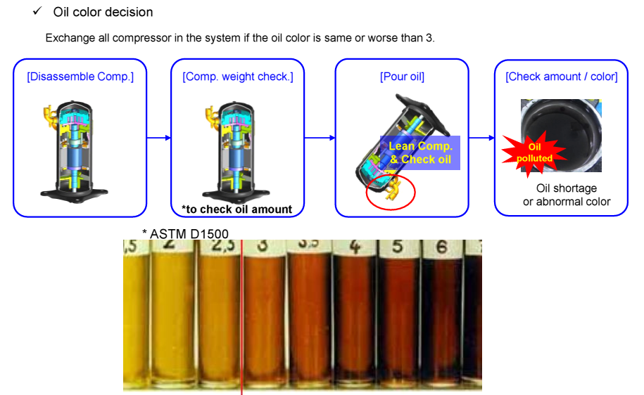

Slide 6

Determining oil level
Formula
Amount of oil (LBS) = Weight of old compressor (LBS) – Weight of new compressor(LBS)
Add 100cc of oil for every .22LB difference
Example:
Old compressor 79lbs (including oil 1100cc) / New compressor 78.043lbs (including oil 1100cc)
79 - 78.043=.957 (old compressor minus new compressor)
.957 / .22=4.35 (Weight difference divided by .22)
4.35*100= 435cc oil ( Times 100 to get your cc quantity)
Note:
Old compressor 69lbs (including oil 1100cc) / New compressor 78lbs (including oil 1100cc)
If broken compressor is 1.76 lbs or less than the new compressor the AVR valve is blocked

Slide 7
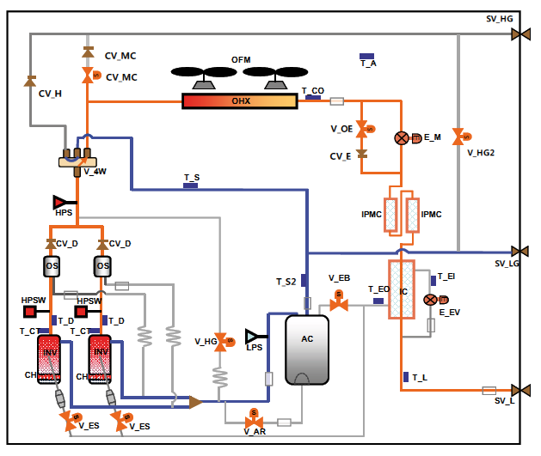
Piping
AVR=Accumulator Oil return Valve
OS= Oil Separator
AC = Accumulator

Slide 8
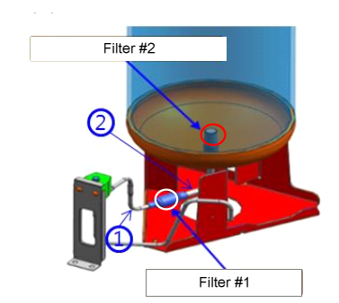
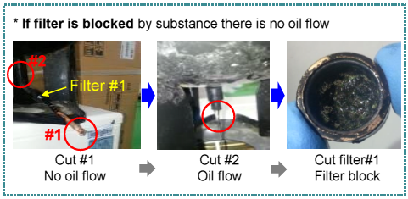
Check points
Component check after compressor removal
Compressor weight is low and excess oil is in accumulator
How to check the accumulator for a blockage
Cut at number 1, check for oil flow
Cut at number 2, check for oil flow

Slide 9
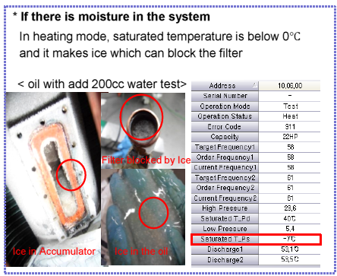
Moisture
Why pulling the proper vacuum is so important
Note: Push k1 11 times to open all valves during evacuation mode.
Note: check previous recordings

Slide 10
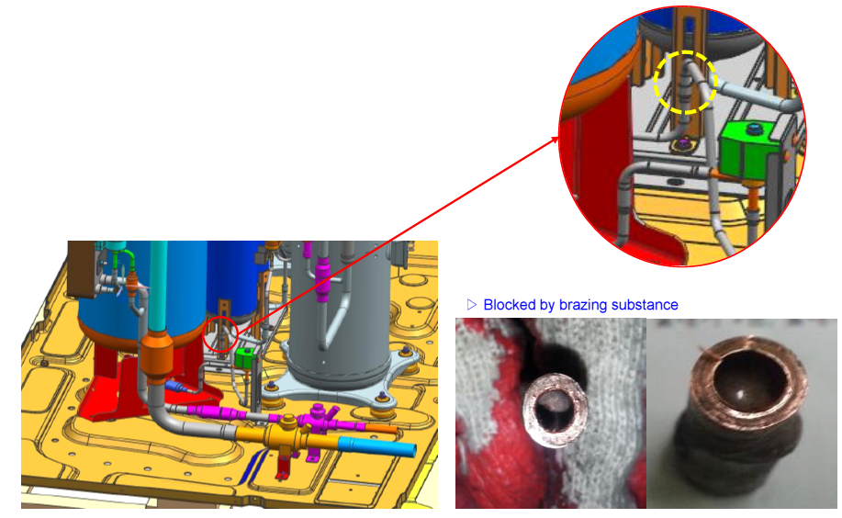
Check points
Component check after compressor removal
Compressor weight is low and excess oil is in accumulator
Oil is in accumulator
If there is oil in the accumulator and the filters are clean,
cut and check the brazed joint.

Slide 11
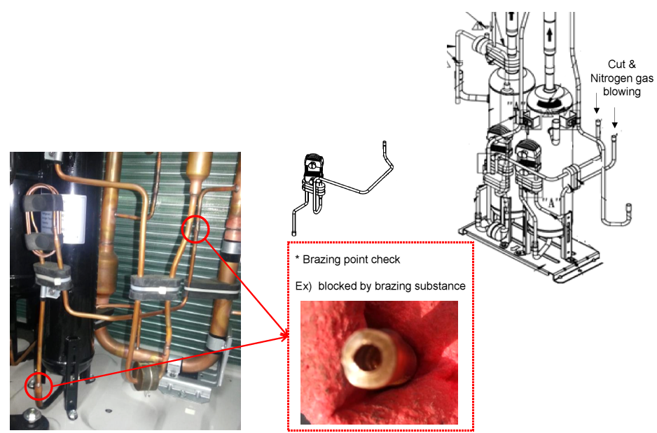
Check points
Component check after compressor removal
If there is little oil in the compressors & Accumulator
Flow nitrogen to check for a blockage.
Cut and check brazed joints

Slide 12
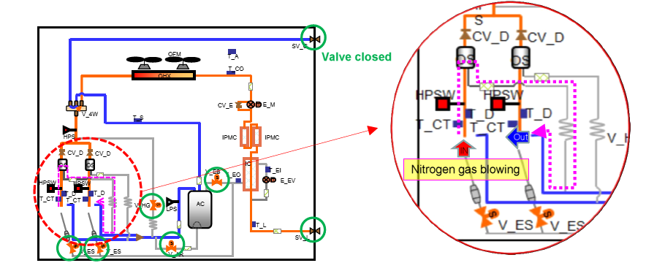
Flowing nitrogen
Flow nitrogen into the discharge pipe once the compressors are removed. With the system powered down, you should have nitrogen coming out of the suction pipe. If nothing comes out of the suction pipe, you will have to figure out where the blockage is.
Note: Some solenoids may leak, we recommend still checking with the temperature of the oil return line once the compressor is installed.

Slide 13
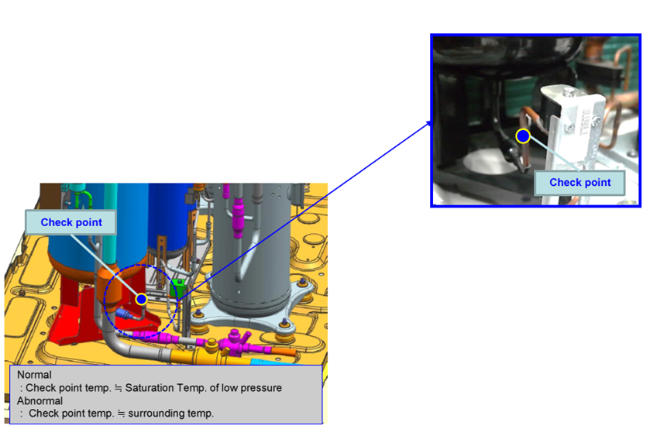
Compressor Replacement
Check points after new compressor is installed.
Test run to check accumulator oil flow
Normal condition: AVR closed temp – AVR open temp > 9˚F
Test run (30 minutes) then disconnect the AVR valve
Warm up pipe by hand for 5 minutes and check temp
Connect the AVR valve and check temp
 | ODU 1 | ODU 1 | ODU 2 | ODU 2
 | AVR off | AVR on | AVR off | AVR on
AVR | 71.6 | 51.26 | 68 | 66.2
NG

Slide 14
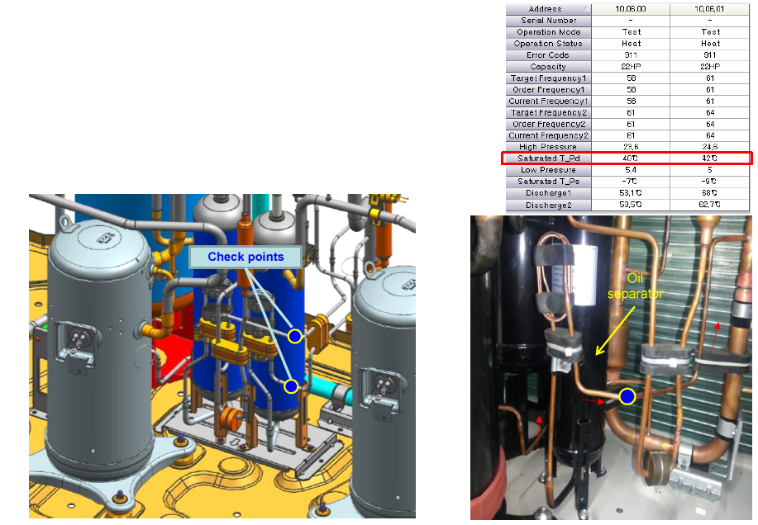
Compressor Replacement
Start in heating test run to check the oil separators
Normal Condition: Check point temp = Saturated T_Pd
Abnormal: Check point temp = surrounding temp
Check point: Oil line leaving oil separators
1325S1097X

Slide 15
Troubleshooting and Service.
Presented by: Peter Kallas III , Jay Broadrick
Supported by: John Willis, Jason Hamm, Jim Lawrence & Paul Solberg

