Slide 1
Regional Service Conference
Clarksville Update

Slide 2
Precedent/Voyager eFlex™
Start-up Procedure

Slide 3
Start-up is crucial!

Slide 4
Start-up procedure
Verify the following:
All electrical connections are secure
Condensate drain installed
Gas Piping (if applicable)
Economizer installed (if FIOP is it pulled out, linkages installed)
Incoming voltage, voltage balance, phase monitor

Slide 5
eFlex™ w/Ruking Drive
Check Compressor M/N

Slide 6
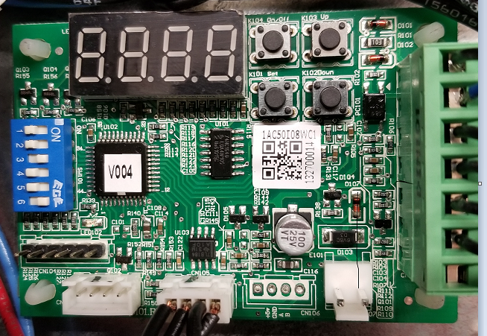
Drive Interface Module (DIM)
Verify the eFlex compressor dip switches are properly set
Notes:
With Ruking Drive

Slide 7
3 Ton eFlex™

Slide 8
4 Ton eFlex™

Slide 9
5 Ton eFlex™

Slide 10
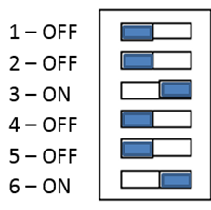
Voyager II eFlex™
12.5 Ton
15 & 17.5 Ton

Slide 11
Precedent 6 – 10 Ton eFlex™ Units, Mitsubishi Drive
Not required to set dip switches
Check configuration plug from the wiring diagram

Slide 12
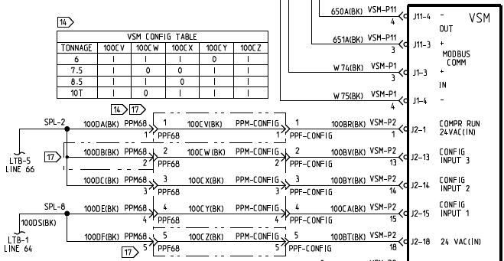

Slide 13
Precedent/Voyager Airflow Setup
Using test mode, 100% fan
Cool 2 or Cool 3
Heat
If mod gas heat, Heat 2

Slide 14
CFM/Ton Airflow Adjustment Precedent 3 – 5T eFlex™
RTOM
TP1
DA Cool Fan Speed
(CFM/Ton)

Slide 15
CFM/Ton Precedent 3 – 5T eFlex™
The indoor fan provides a constant maximum CFM per ton based on the DA Cool/ Fan Speed potentiometer on the RTOM.
To increase CFM/ ton turn potentiometer CW
To decrease CFM/ ton turn potentiometer CCW
This selects the maximum CFM, constant fan is 50% of the max CFM
Notes:
User selectable maximum CFM/ton range, 320 – 480. This ends the discussion on the Precedent 17+ 3-5 ton unit.

Slide 16
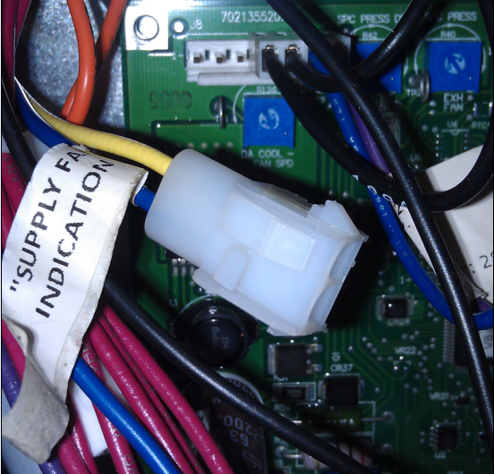
6 – 10T units w/Plenum Fan
Measure DC volts at the supply fan test plug, refer to the DCV to RPM table.
Adjust RPM at the DA Cool-Fan Spd pot R136
Notes:
Use the RPM/voltage chart to determine RPM’s, use the airflow performance charts (RPM & total ESP) to set airflow.

Slide 17
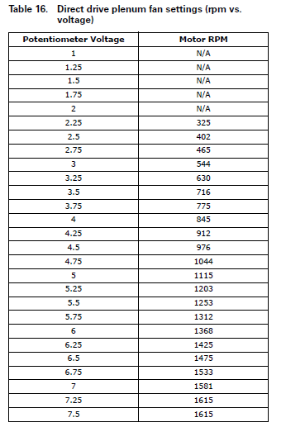
VDC to RPM
Gen III Fan
Notes:
The plenum fan operation and troubleshooting guide has tables for both the Gen II and Gen III fans

Slide 18
Determine ESP
Notes:
Easy way: Measure the external static pressure, add 0.1 for economizer, and look it up in the fan performance data.
Hard way: Measure the ESP, then add each accessory pressure drop subtracting for standard filters. Then, use the fan performance data in Service Facts.
The IOM and ReliaTel talk about using BHP to calculate CFM. Do not use this. This is a ECM and amp readings will be lower than expected giving you a misleading reading.

Slide 19
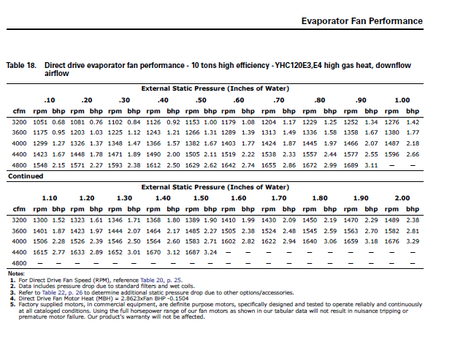
Use Service Facts Fan data to determine approximate CFM
Notes:
Some literature was incorrect, stating to use the BHP method to set airflow on the Plenum Fan. Use ESP and RPM to determine CFM.
Remember, you are setting maximum airflow

Slide 20
Voyager II Airflow
Notes:
Count the number of turns the motor sheave is open to determine blower RPM.

Slide 21
Voyager II Air Flow
Calculate theoretical brake horsepower
BHP$=\frac{actual motor amps}{motor nameplate amps}$ X motor HP

Slide 22
Determine ESP
Notes:
Easy way: Measure the external static pressure, add 0.1 for economizer, and look it up in the fan performance data.
Hard way: Measure the ESP, then add each accessory pressure drop subtracting for standard filters. Then, use the fan performance data in Service Facts.
The IOM and ReliaTel talk about using BHP to calculate CFM. Do not use this. This is a ECM and amp readings will be lower than expected giving you a misleading reading.

Slide 23
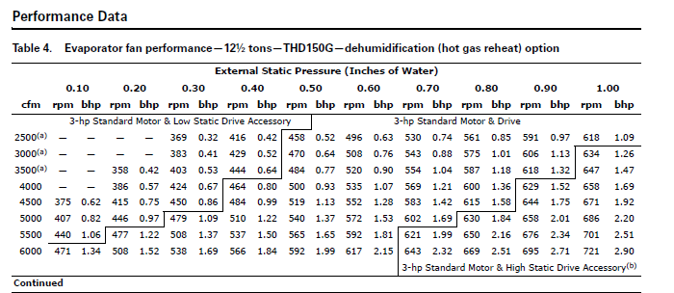
Voyager II Airflow
Notes:
Voyager II SZVAV/MZVAV airflow is set by adjusting the motor sheave! Not the VFD

Slide 24
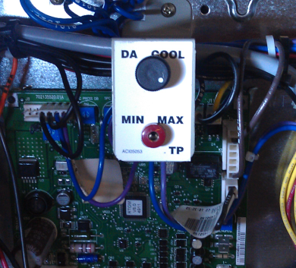
Discharge Air Controller
Precedent SZVAV
Turn completely CCW

Slide 25
RTOM DA Cool Setpoint
Voyager II SZVAV
Turn completely CCW
Notes:
to determine the discharge air minimum setpoint, read the DC volts from TP1 to ground, then use the DC volts to setpoint table to determine the temp. Then use the R136 potentiometer DA cool to set your temp.
REMEMBER… The ReliaTel boards are used in all ReliaTel units 3 – 50 Ton, Potentiometers may have multiple uses depending on how the unit is configured.

Slide 26
Demand Control Ventilation (DCV)

Slide 27
Demand Control Ventilation (DCV)
Connect the CO2 sensor directly at the unit to LTB4 for convenience.
Breathing on the CO2 sensor simulates a high CO2 concentration in the space.

Slide 28
Demand Control Ventilation (DCV)
For damper position adjustment, the Lower Limit (LL) CO2 PPM potentiometer should be set to the lowest position (counter clockwise)
The Upper Limit (UL) CO2 PPM potentiometer should be set to approximately half way.
These can be adjusted later to the required levels.

Slide 29
DCV w/SZVAV
There are 3 fan speed reference points which will be referred to as Low, Medium, and High fan speeds.
The DCV set up procedure should be done in test mode.
The supply fan test (1st step in test mode) forces the supply fan in the Low fan speed.
The compressor stage 1 test (3rd step in test mode) forces the supply fan into the Medium fan speed.
The compressor stage 2 test (4th step in test mode) forces the supply fan to the High fan speed.

Slide 30
Demand Control Ventilation (DCV)
All three of the Design Minimum adjustment potentiometers (R130 on the RTVM, R136 on the RTVM, and Design Min on the RTEM should be set to the maximum position (fully CW)
Both of the DCV Minimum adjustment potentiometers (R41 of the RTVM and DCV Min of the RTEM) should be set to the minimum position (fully CCW) as a starting position.
Notes:
These are starting positions

Slide 31
Mixed Air Formulas
Percent of Outside Air:
%OA $=\frac{RAT − MAT}{RAT − OAT}$ x 100
Mixed Air Temperature:
MAT $=$ %OA x OAT + %RA x RAT
(OA%+RA%=100%)
NOTE: Temperature readings need to be taken with fan on and no heating and no cooling, and the unit panels in place.

Slide 32
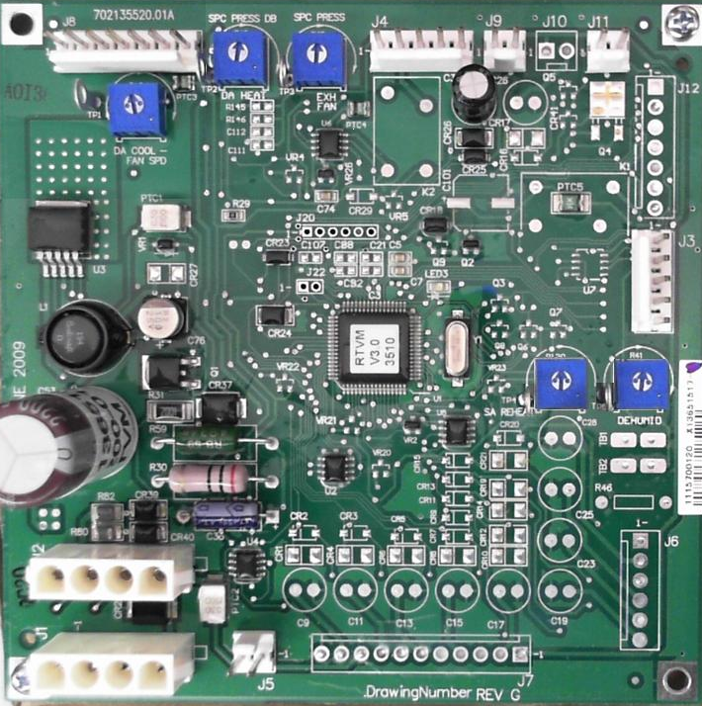
DCV w/SZVAV Low Speed Fan
1. Enter into the 1st step of test mode. Adjust the R130 potentiometer on the RTVM to set the LOW fan speed Design minimum damper position.
2. Adjust the R41 potentiometer on the RTVM to set the LOW fan speed DCV minimum position.
1
2
Notes:
1

Slide 33
DCV w/SZVAV Low Speed Fan
Ensure that the R130 LOW fan speed Design minimum damper position is set greater than the LOW fan speed DCV minimum damper position.
Blow on the CO2 sensor to simulate a high concentration of CO2 to confirm the economizer damper responds to the call for ventilation.

Slide 34
DCV w/SZVAV Medium Speed Fan
3
Enter 3rd step in the test mode (1st stage compressor). This forces the supply fan to the MEDIUM fan speed.
3. Adjust the R136 potentiometer on the RTVM to set the MEDIUM fan speed design minimum damper position.
Notes:
1
2. To set the Design Minimum Position setpoint at Middle Fan Speed, set the unit to operate at Step 3 (Cool 1) and make the proper adjustment.
3. To set the Design and DCV Minimum Position setpoints at Full Fan Speed, set the unit to operate at Step 4 (Cool 2) and make the proper adjustments.

Slide 35
DCV w/SZVAV Medium Speed Fan
There is no DCV Min setup for MEDIUM fan speed. The value from R41 from the previous step is retained for the MEDIUM fan speed.
Again blow on the CO2 sensor to simulate a high concentration of CO2 to confirm the economizer damper responds to the call for ventilation.

Slide 36
DCV w/SZVAV High Speed Fan
Enter 4th step in the test mode (2nd stage comp). This forces the supply fan to the HIGH fan speed
4. Adjust the Design Min potentiometer on the RTEM to set the HIGH fan speed Design minimum damper position.
5. Adjust the DCV Min potentiometer on the RTEM to set the HIGH fan speed DCV minimum position.
5
RTEM
4
Notes:
1. To set the Design and DCV Minimum Position setpoints at Minimum Fan Speed, set the unit to operate at Step 1 (Fan ON) or Step 2 (Economizer Open) and make the proper adjustments.
2. To set the Design Minimum Position setpoint at Middle Fan Speed, set the unit to operate at Step 3 (Cool 1) and make the proper adjustment.
3. To set the Design and DCV Minimum Position setpoints at Full Fan Speed, set the unit to operate at Step 4 (Cool 2) and make the proper adjustments.

Slide 37
DCV w/SZVAV High Speed Fan
Again blow on the CO2 sensor to simulate a high concentration of CO2 to confirm the economizer damper responds to the call for ventilation.

Slide 38
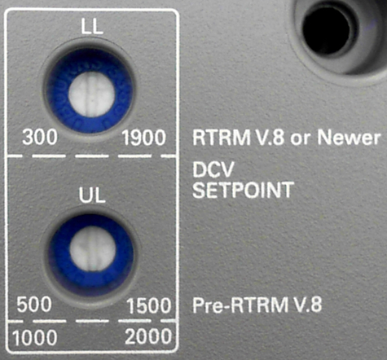
DCV CO2 LL/UL potentiometers
After this procedure is finished adjust the Lower Limit (LL) CO2 PPM adjustment potentiometer and the Upper Limit (UL) CO2 PPM adjustment potentiometer on the RTEM
The required settings for the application are often determined by local codes
If not known set as shown
Notes:
When set-up is complete, use a sharpie marker and make potentiometer positions so if someone makes changes it is easier to reset.

Slide 39
Precedent 6 – 10T Mod Gas Heat
Use test mode to put unit in heat 2
Check the RTOM J5 plug for 10vdc (this will be 100% heat)
Adjust manifold at standard gas valve but check pressure at the maxitrol valve.

Slide 40
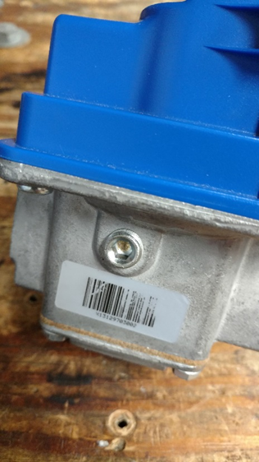
Mod Gas Pressure Adjustment
Manifold Pressure
HI = 3.5” wc
LO = 0.7” wc
Maxitrol Mod Valve
(Never fully closes - not a shutoff valve) Almost 1” pressure drop through Mod valve at full rate
Adjust Manifold Pressure
Here on Gas Valve BUT Read
Pressure from side of MOD
Valve
Gas Valve – Single Stage
High Capacity- ¾” pipe –
On/Off Safety Valve
(OUTLET PRESSURE set at 4.5” wc)
7” wc inlet
Tap Location to obtain Manifold Pressure for MOD Gas Units
FLOW
Notes:
Mod valve gas pressure is factory set. The single stage valve is the on/off safety valve energized with 24 VAC from the ignition control. The Maxitrol mod valve will be controlled with a 2 – 10 VDC signal from the RTOM. (like the VII mod burner). 2 VDC = 40% of full rate, 10 VDC 100%

Slide 41
Enhanced Dehumidification
A humidity sensor that is capable of providing a 4-20 ma output is wired to the NLTB pins 18 &19. The setpoint can be set at the RTOM R41 potentiometer or through a BAS system.

Slide 42
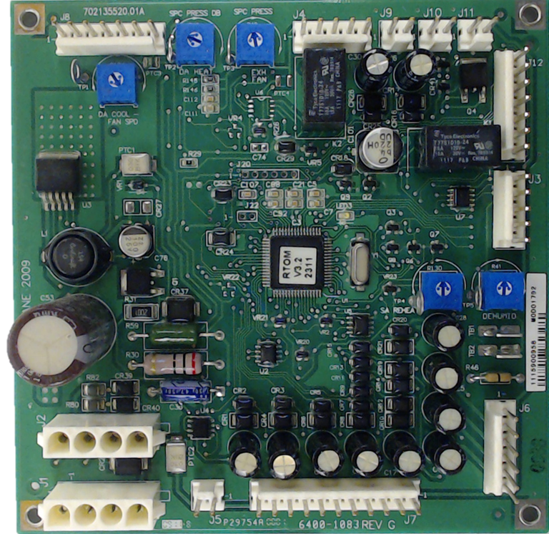
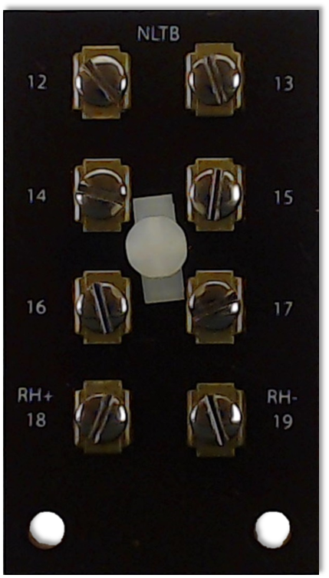
Enhanced Dehumidification
R41
Space Humidity sensor

Slide 43
Refrigerant Operating Pressures
Test Mode Step 5 – all compressors on, allow run time to stabilize
Notes:
See IOM, this is for 12.5 – 17.5T

Slide 44
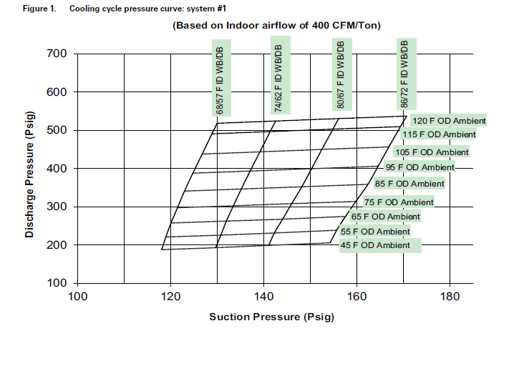
Refrigerant Operating Pressures – Fixed Speed Compressors

Slide 45
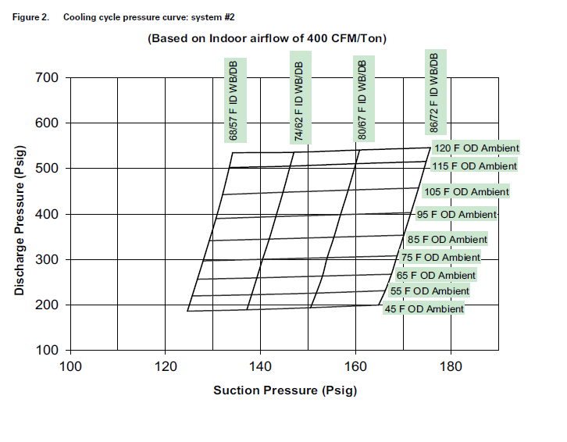
Refrigerant Operating Pressures – VS Compressor

Slide 46
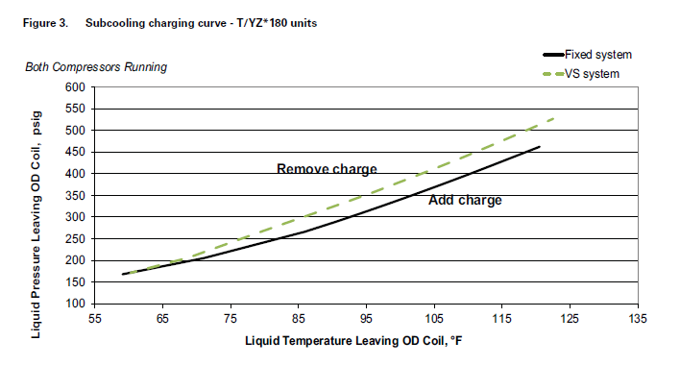
Subcooling Charging Curves

Slide 47
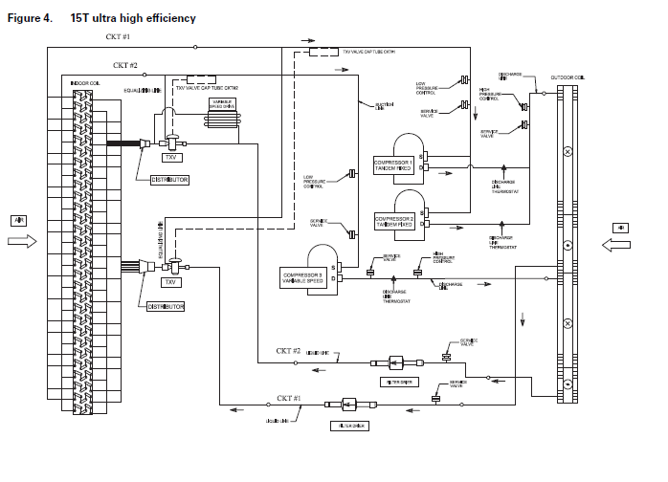
Refrigerant Circuit

Slide 48
Additional Information
RT-SVD03L-EN ReliaTel Diagnostic Manual
Unit Service Facts/IOM’s
RT-SVP08C-EN 6-10T Plenum Fan
RT-SVD05B-EN eFlex Ruking Drive
RT-SVD008B-EN eFlex Mitsubishi Drive
RT-SVD007B-EN 5T Toshiba Drive

