Slide 1
Common wiring.
J4 from bcir to baysens 13 &14 Need to be twisted shielded wiring

Slide 2
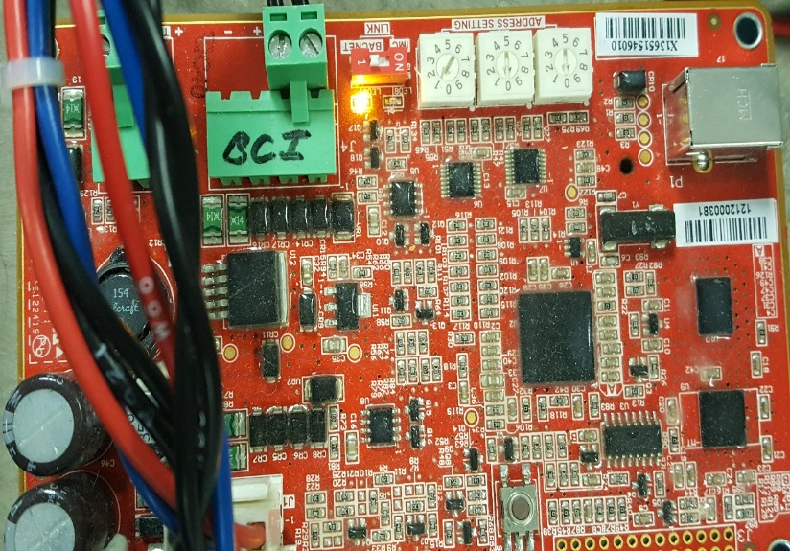
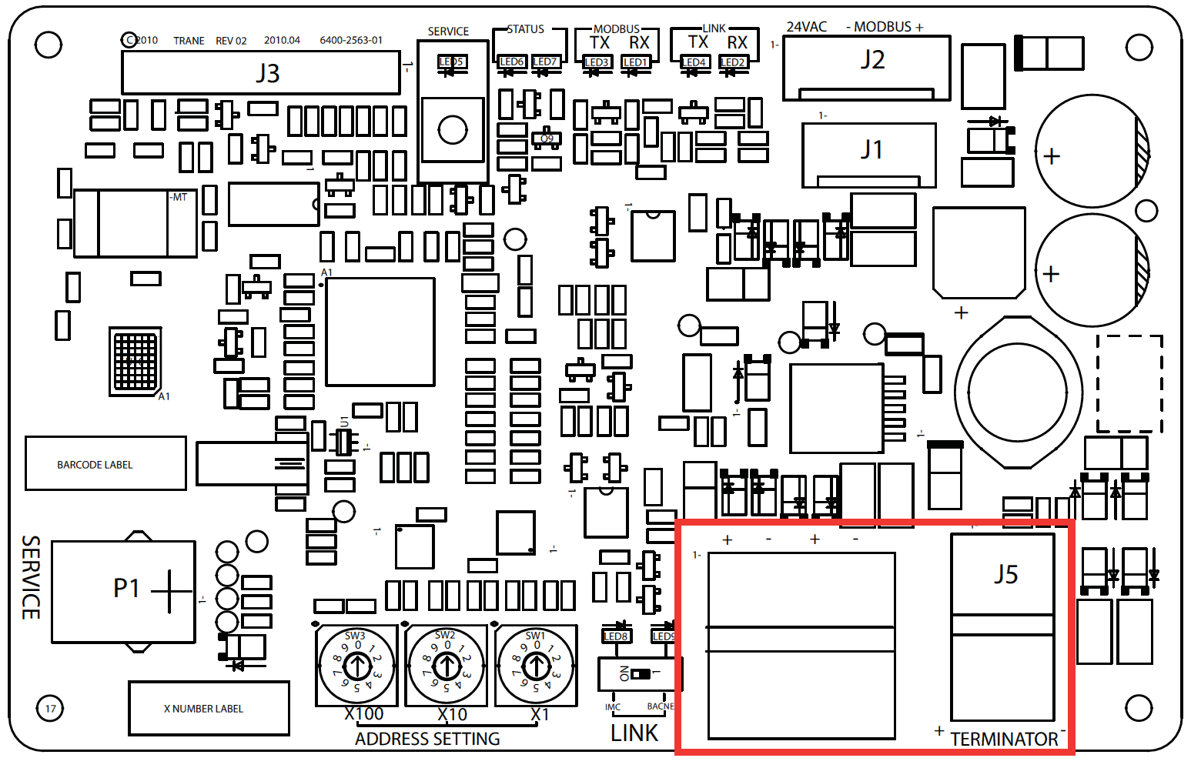
Setup procedures for the baysens924
Start by setting address on the BCIR card located in the units control cabinet.
See where the first dial has been set to 1. others to zero.
Notes:
Welcome remarks TBD.

Slide 3
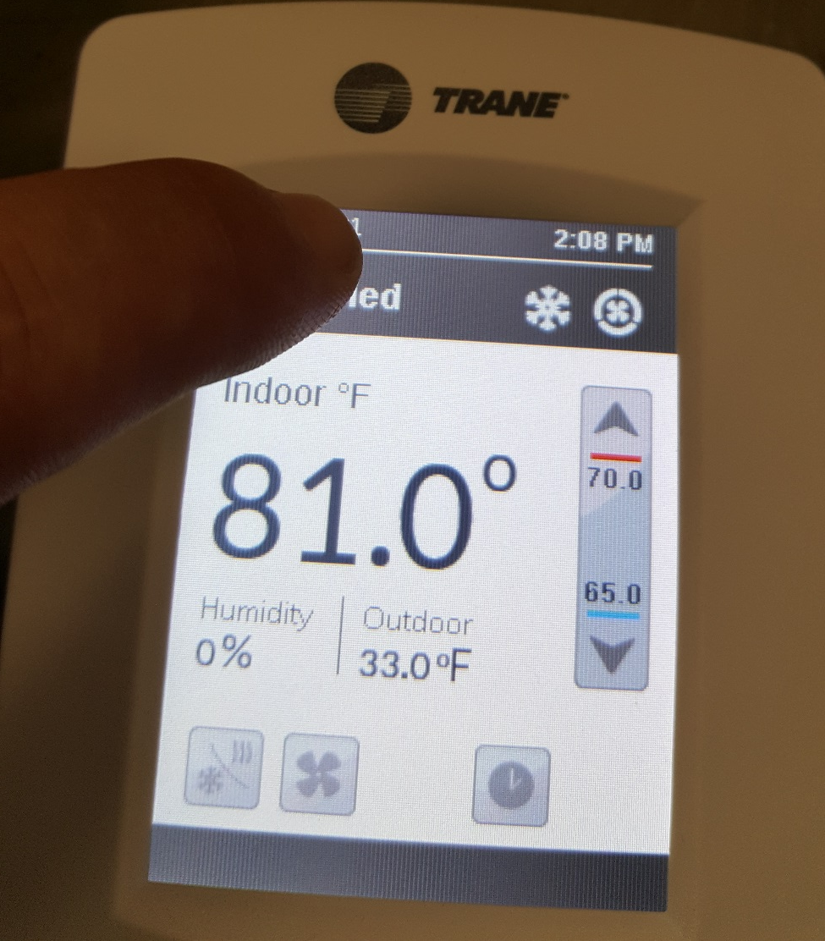
Setting the Address on the Baysens924
Go into configuration screen by pressing and holding the top center of the main display.
.
Notes:
Welcome remarks TBD.

Slide 4
.
Pass word is 4017
Next screen will show you setup. Press Network to access options setup
Notes:
Welcome remarks TBD.

Slide 5
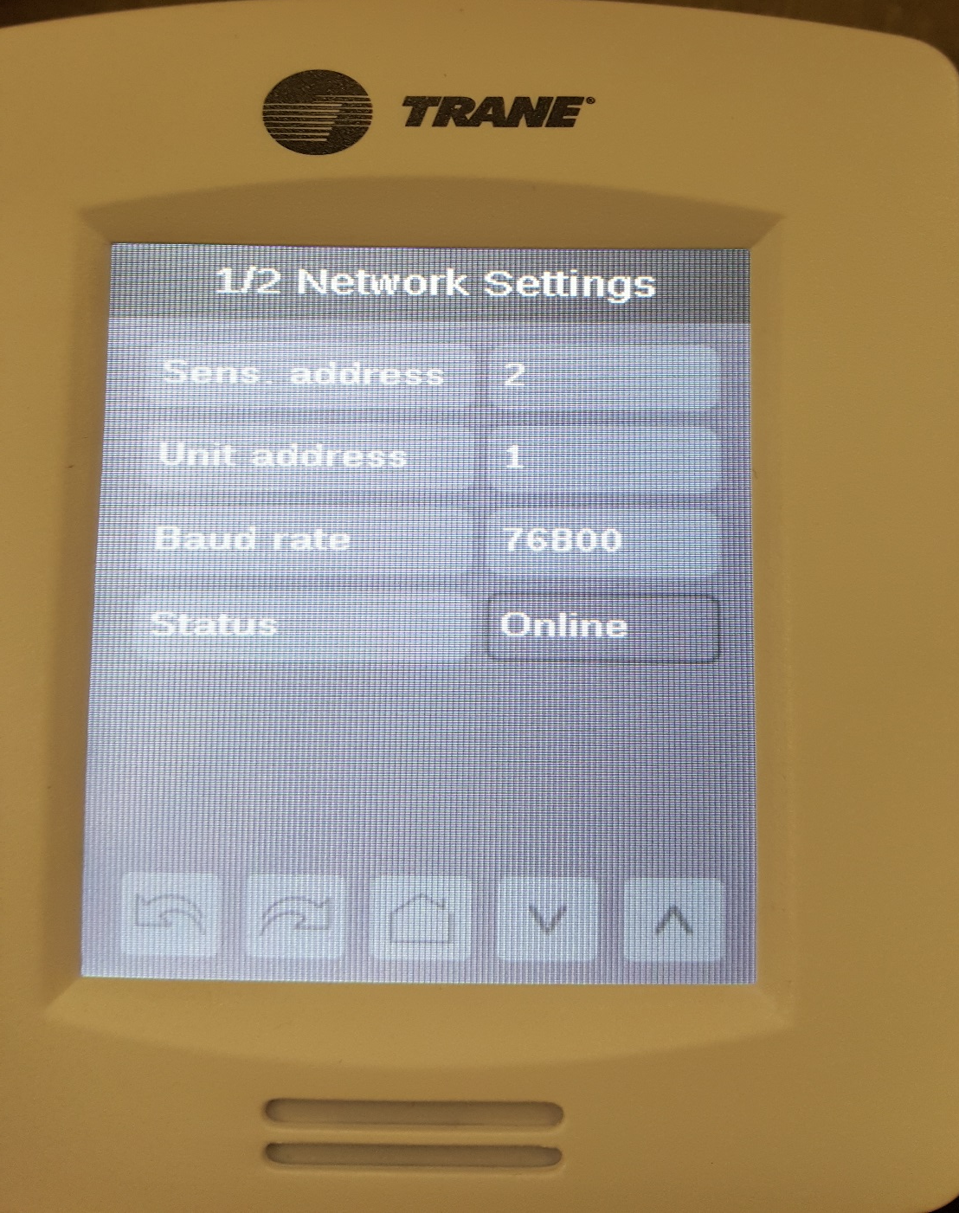
Set Unit address to the same number that is addressed at the units BCIR.
Sens. Address can’t be the same as the unit address.
Notes:
Welcome remarks TBD.

Slide 6
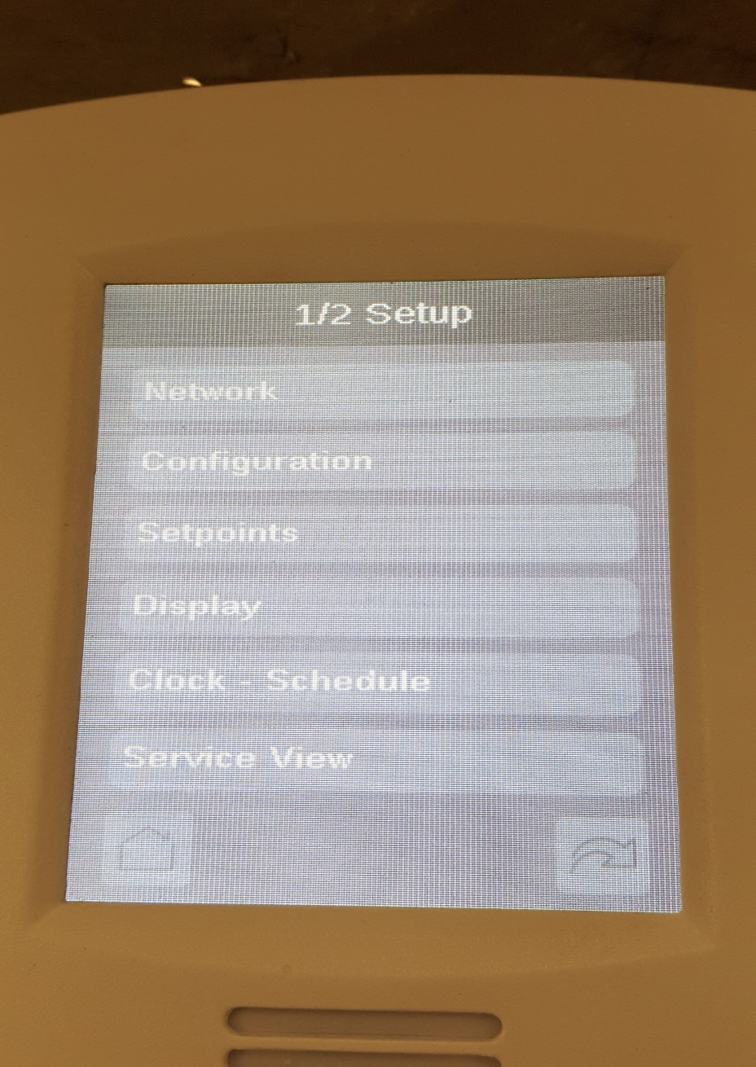
How to check and make sure sensor is communicating.
Go into service view tab on the configuration screen.
Notes:
Welcome remarks TBD.

Slide 7
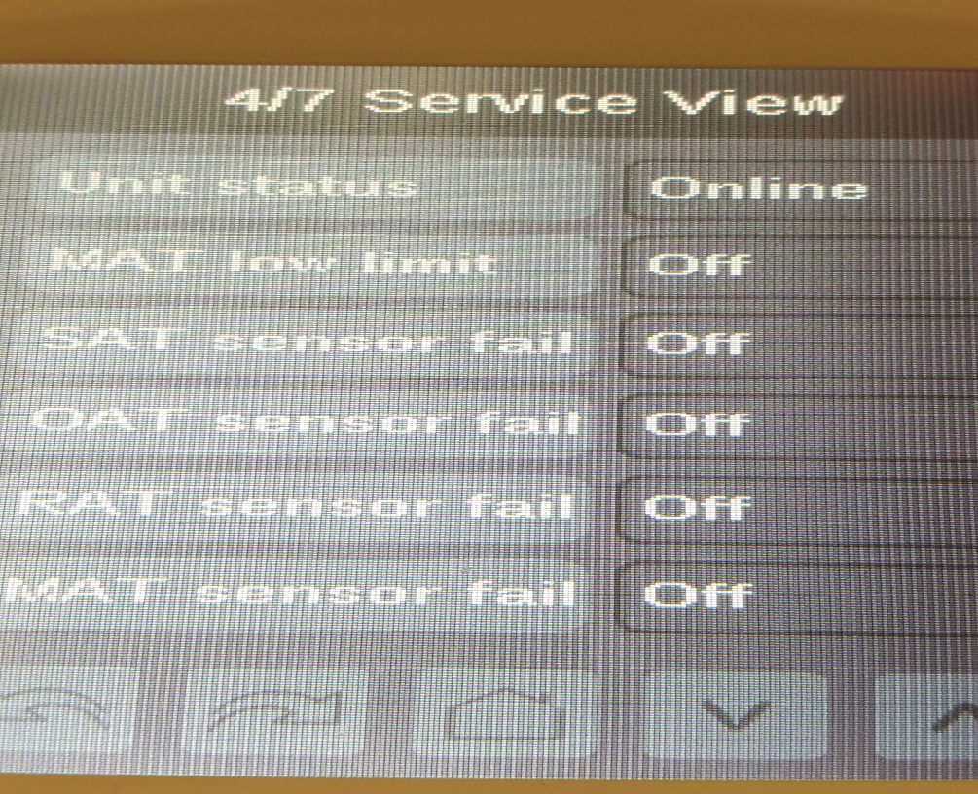
Not communicating
Scroll screens until you get to 4/7.
Online
Notes:
Welcome remarks TBD.

