Slide 1
VRF SEQUENCE OF OPERATION

Slide 2
Indoor Unit - Terms
EEV- 12vdc, gear driven, refrigerant metering device.
When the indoor unit is cool mode the EEV will try and maintain a target EVAin and EVAout temp ΔT. When in cooling mode and satisfies space temp and EEV goes to 0 steps fully closing.
When the indoor unit is in heat mode the EEV will open or close to manage the amount of hot gas that enters the indoor coil. When the space temp is satisfied the EEV will stay slightly open between 80 to 230 steps, this is to prevent the indoor unit from hoarding refrigerant in the coil. The steps of the EEV will be determined based on the compressor speed, the faster the compressor runs the more the valve will be open.
EVA In- Entering refrigerant temp in the cool mode, Leaving refrigerant temp in Heat Mode
EVA out- Leaving refrigerant temp in the cool mode, Entering refrigerant temp in the heat mode
Return air sensor- used to sense return air temp at the IDU. RAT is the default room temperature
sensor for comfort heating and cooling on all IDU’s. Must be changed at the wired controller if wanting to sense space temperature at the wired controller. Another option is to use the remote room temperature sensor.
Discharge air temperature sensor - Used on ducted IDU or an Air handling kit (AHU) applied unit only for sensing discharge air temperature. Can be used for discharge air temperature control when option code is set at the wired controller or VRF System Controller
Fan- Feedback or non-Feedback type blower motor. Non-feedback motors are used on the ducted units. Feedback motors are used on all other indoor units.

Slide 3
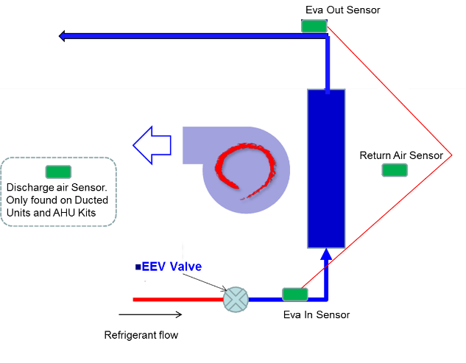
Indoor Unit - Terms

Slide 4
Indoor Unit - Terms
Drain Pump- Factory installed on all Cassettes and new MSP ducted units. Accessory for Slim duct, HSP ducted. Ceiling/ Convertible and High Wall will require a field solution
Main control board – main control board, specific to each indoor type of indoor unit
EEPROM- on all units except the High Wall. Memory Module, stores the model# serial # and installation option settings
Sub Assembly Board- On all units except the High Wall, controls the power and communication between the Indoor unit and the wired controller
Thermal On- Indoor Unit is powered on and the EEV is controlling refrigerant flow for the purpose of comfort heating and cooling.
Thermal Off- Indoor unit is powered on and EEV is closed (or at minimum step for heating mode).
Layers of Communication
F1/F2 – outdoor unit to the MCU, External EEV and Indoor Units
F3/F4 – Communication between the indoor unit and the 2 wire controller
R1/R2 – Communication between the outdoor unit and the upper level controller (VRF SC).
OF1/OF2 – Communication between the outdoor units on the same system module.

Slide 5
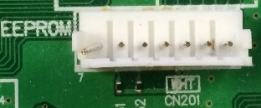
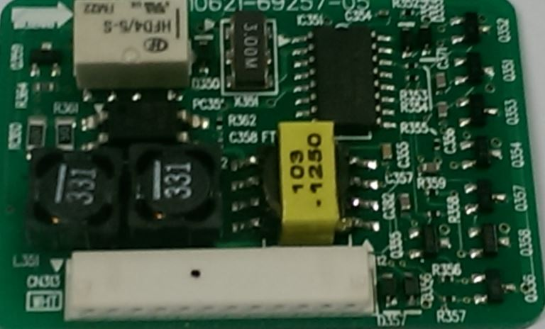
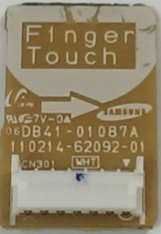
Indoor Unit Control Boards
MAIN Control Board
Saves
Option Code settings
Model #
Serial #
If lost or damaged you will lose the ability to see the unit serial number.
Provides 12vdc to the 2 wire controller for communication and operation on F3/F4.
SUB Assembly Board
EEPROM

Slide 6
Indoor Unit Control Boards – Option Codes
Product Option Code- Identifies the model and capacity of the indoor
Product option code should only be changed on a ducted unit to change the static pressure profile. Refer to the IOM for the specific ducted unit
Installation Option Code- is used to set specific options like enable the pump, disable the chime, use of the remote room sensor etc…
Installation Option Code 2- is used to set the dead bands and only used with heat recovery systems.
Function | No. of digits to set ( Logical [physical] ) | Code structure (Logical)
Indoor unit Product Code setting (Digit 2=1) | 24 [20] | 01xxxx-1xxxxx-2xxxxx-3xxxxx
Install option setting1 (Digit 2=2) | 24 [19] | 02xxxx-1xxxxx-2xxxxx-3xxxxx
Install option setting2 (Digit 2=5) | 24 [19] | 05xxxx-1xxxxx-2xxxxx-3xxxxx

Slide 7
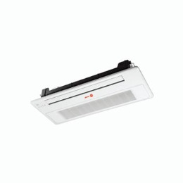
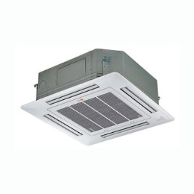
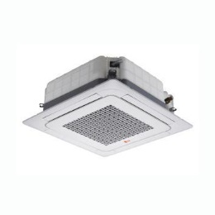
Indoor Unit Type - Cassette
1 Way Cassette
4TVE
4 Way Mini Cassette
4TVB
4 Way Cassette
4TVC
Accessories -
Factory installed condensate drain pumps
External Contact Control Board
Multi-Tenant Control Board
Remote Room Sensor

Slide 8
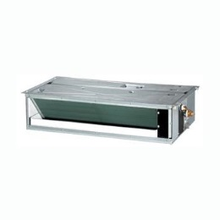
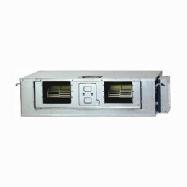
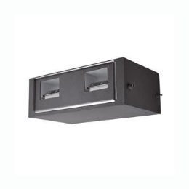
Indoor Unit Type - Ducted
Product option codes can be changed to over come static pressure on the fan. Ducted models only
(0)1XXXXX (1)XXXXX (2)XXXXX (3)XXXXX
Slim Duct
4TVL
Max static .16
7mbh to 24mbh
Max Static .24
30mbh to 48mbh
*MSP
4TVD
Max static .60
7mbh to 18mbh
Max Static .80
24mbh to 48mbh
HSP
4TVA
Max static 1.0
76mbh
Max static 1.1
96mbh
Accessories -
Drain Pumps
External Contact Control Board
Multi-Tenant Control Board
Remote Room Sensor
*Factory Installed Pump

Slide 9
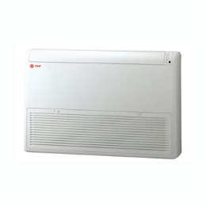
Indoor Unit Type - Convertible
Can be installed 6in above the floor or rotated 90° and mounted on the ceiling.
Requires an external EEV kit. Drain pump is a field solution.
Accessories –
External Contact Control Board
Multi-Tenant Control Board
Remote Room Sensor

Slide 10
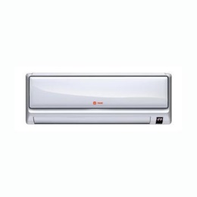
Indoor Unit Type - Highwall
High Wall
Now comes with the EEV internal to the unit
New 4TVCXXXXB100NC has the EEV internal.
Old model 4TVCXXXXB100NB, requires an external EEV
Drain pump is a field solution
Does not have an EEPROM or a sub-assembly board
Accessory's
Drain Pump
External Contact Control Board
Multi-Tenant Control Board
Remote Room Sensor

Slide 11
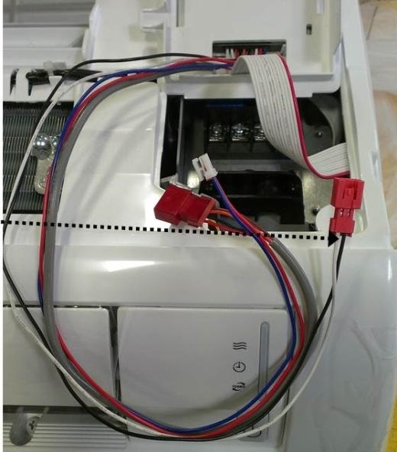
High Wall Indoor Unit -
Wired controller connection, Blue and Red wire are the F3/F4 connections for the wired controllers
Condensate overflow safety switch connections
Must set digit 14 of the installation option code to 2 in order for the unit to shut down because of a high condensate level.
02xxxx 1xxxxx 2x2xxx 3xxxxx

Slide 12
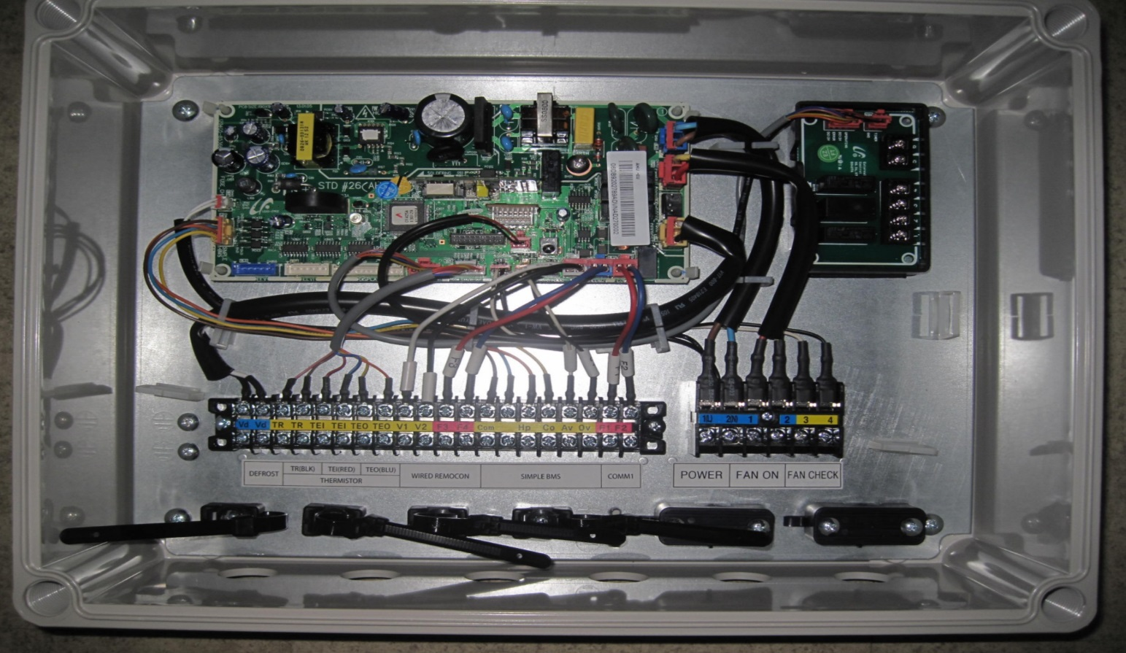
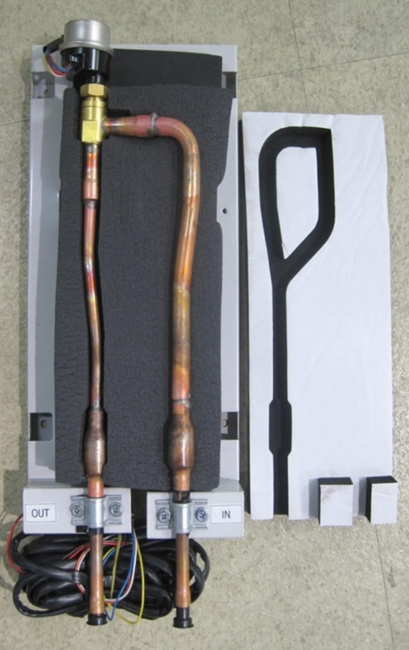
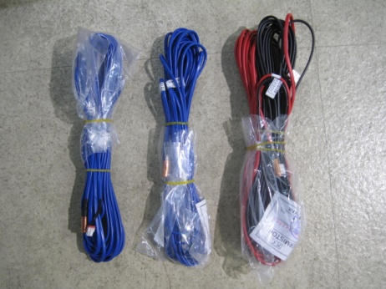
Indoor Unit AHU Kit
AHU hit can be installed on a traditional indoor unit so that it can be connected to the VRF system
Designed for comfort heating and cooling
Not Recommended for 100% Outside Air

Slide 13
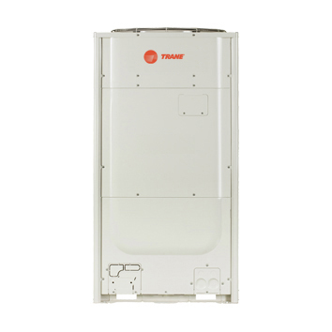
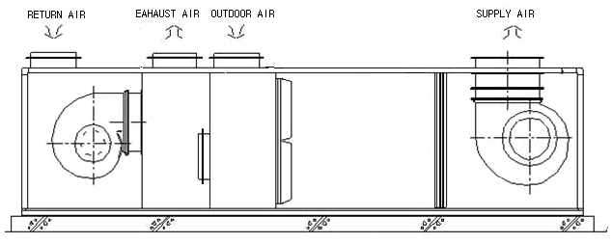
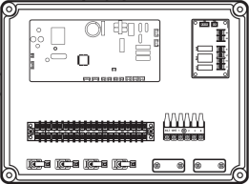
Indoor Unit AHU Kit
EEV
F1, F2
EEV wire
RAT
EVAin
DAT
H/X
F3, F4
EVAout

Slide 14
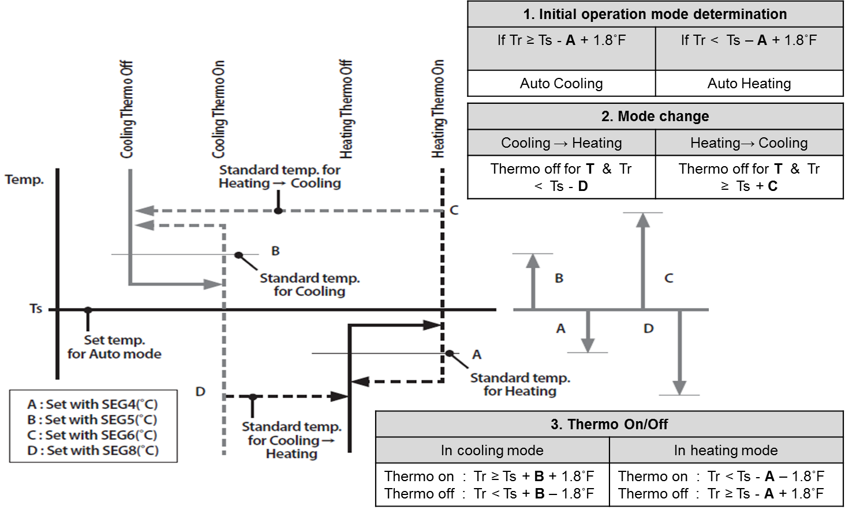
Indoor Unit Mode of Operation
Auto Mode- Heat Recovery- auto mode for a heat recovery system will change over between heat to cool modes and cool to heat modes based on the space temperatures relationship to set point.
Mode Determination
Auto Heat to Auto Cool- If the indoor unit is in heat mode and the space temp is above the set point 1.8˚F for 5 minutes (default setting) the indoor unit will change to cool mode.
Auto Cool to Auto Heat- If the indoor unit is in cool mode and the space temp is below the set point 1.8˚F for 5 minutes (default setting) the indoor unit will change to heat mode.

Slide 15
Auto Mode Change Profile – Heat Recovery
Mode Change from Auto Heat to Auto Cool
Set Point
73
Thermal On
Auto Cool Mode
74.8
Auto Heat
Thermal Off
74.8
Auto Cool
Thermal Off
74.8
5 Minute delay
Auto Heat
5 Minute delay
Auto Cool
Thermal Off
71.2
Mode Change from Auto Cool to Auto Heat
Thermal On
Auto Heat Mode
71.2
Heat Recovery Auto Change Over.xlsx

Slide 16
Auto Mode Cooling Thermal On and Thermal Off
Auto Cool, cool mode profile
Thermal On
Cool Mode
74.8
Cool Mode
Thermal On
74.8
Cool Mode
Thermal On
74.8
Cool Mode
Thermal On
74.8
74.8
Cool Mode
73
71.2
Cool mode
Thermal Off
71.2
Cool mode
Thermal Off
71.2
Cool mode
Thermal Off
71.2

Slide 17
Auto Mode Heating Thermal On and Thermal Off
Auto heat, heat mode profile
Thermal Off
Heat Mode
74.8
Heat Mode
Thermal Off
74.8
Heat Mode
Thermal Off
74.8
Heat Mode
Thermal Off
74.8
74.8
Heat Mode
73
71.2
Heat Mode
Thermal On
71.2
Heat Mode
Thermal On
71.2
Heat Mode
Thermal On
71.2

Slide 18
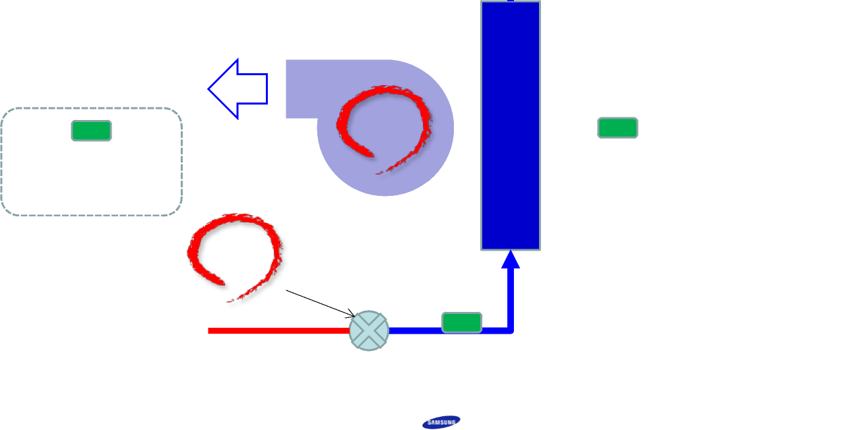
Indoor Unit EEV Sequence of Operation Cooling
EEVin target in cool Mode- default target 44-48, Target delta across the coil is 3.8f.
Before the indoor unit starts to cool the eev opens to 280 steps. Once cooling begins the EEV will adjust itself to maintain these targets.
Eva Out Sensor
eev
The target temp across the coil is 3.8 degrees. If higher than 3.8 the EEV will open in very small steps, if the difference is lower than 3.8 the EEV will close in very small steps
Return Air Sensor
Discharge air Sensor. Only found on Ducted Units and AHU Kits
EEV Valve
The target temp for the EVAin sensor is 44-48.
Evain Sensor
Refrigerant flow

Slide 19
Indoor Unit EEV – Cooling Mode
When an indoor unit reaches thermal off (satisfied) the indoor units EEV will be closed
(0 Steps). The other indoor units will continue to operate as normal.
Suction refrigerant flow
Cool Mode
On
Off
Off
On
Liquid Refrigerant flow
EEV closed 0 steps

Slide 20
Indoor Unit EEV Sequence of Operation Heating
EEVout in heating mode is close to the compressor discharge temperature. Target delta across the coil is 25°F in heat mode. Before the indoor unit starts to heat the eev opens to 960 steps. Once heating begins the eev will adjust itself to maintain the 25 to 30°F ΔT.
Refrigerant flow
Eva Out Sensor
eev
The difference between these 2 sensors is what drives the eev. EVAout will typically be about 20 degrees cooler the compressor discharge temp.
Return Air Sensor
Discharge air Sensor. Only found on Ducted Units and AHU Kits
EEV Valve
Eva In Sensor

Slide 21
Indoor Unit EEV Sequence of Operation Heating
When an indoor unit reaches thermal off (satisfied) the indoor units EEV will be open between 80 to 230 steps, this will be determined by the speed of the compressor. This is to prevent the indoor coil from hoarding refrigerant and oil. The other indoor units will continue to operate as normal.
Liquid refrigerant flow
Heat Mode
Off
Off
On
On
Hot Gas Refrigerant flow
EEV 80 to 230 steps for thermal off IDU’s depending on the compressor speed

Slide 22
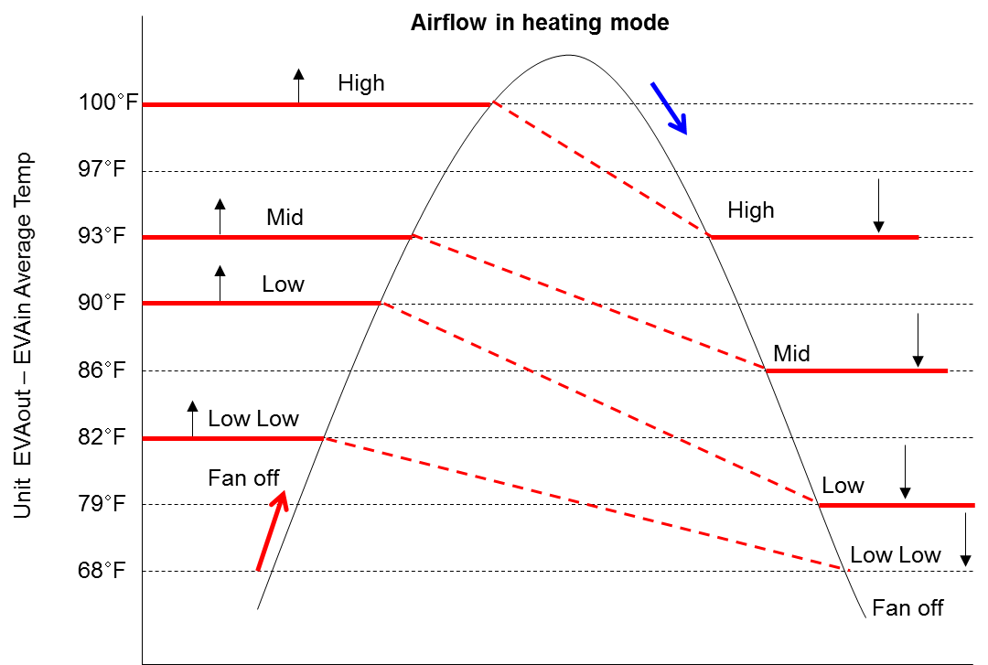
Heat Fan Profile
The fan will be off until the indoor coil warms up
This prevents the indoor unit from blowing cold air during mode change and after defrost mode.
Is the average temperature of the EVAin and EVAout across operating IDU’s

Slide 23
Auto Fan Profile
When auto is set for the fan speed the fan will adjust from low, medium and high based on the distance the space temperature is away from the set point temperature.
When the indoor unit is operating in auto mode the fan mode is default to auto.
When the indoor unit is operating in cool or heat mode the fan speed is selectable low, medium or high and will always run in that mode unit it is changed.
Recommended mode of operation for heat recovery system is Auto mode.
5.4 and greater from set point
High Speed
1.9 to 5.3 from set point
Medium Speed
1.8 or less from set point
Low Speed
LL or UL
Set Point

Slide 24
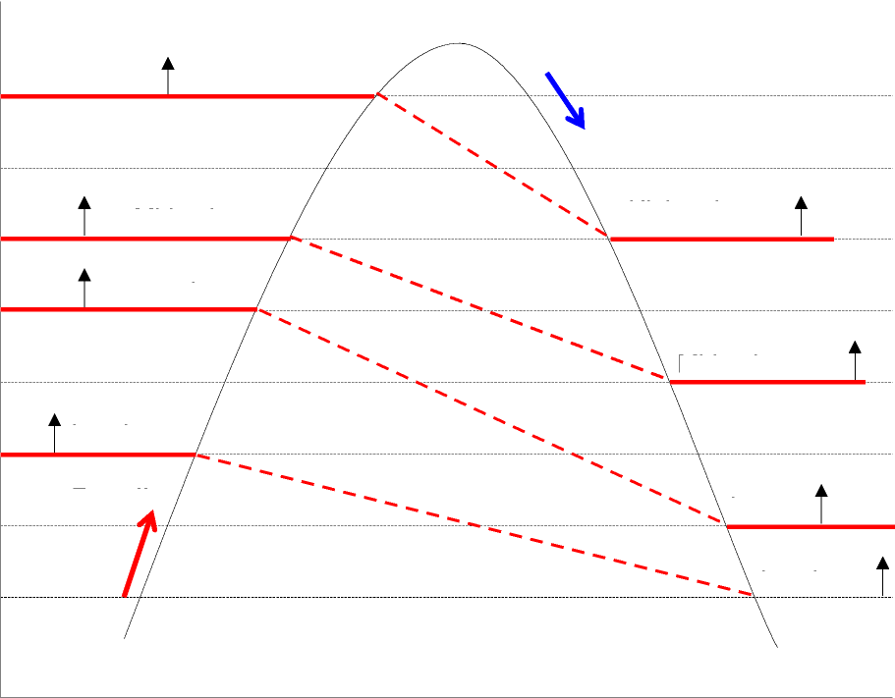
Indoor Unit Defrost Function, Oil Recovery Mode
All indoor unit fans stop during a defrost cycle.
After leaving defrost, the indoor unit fan will not restart until the coil warms back up to prevent blowing cold air into the space.
The EEV will open to a preset step to allow refrigerant flow through the coil during defrost.
Oil recovery mode is the same as above.
Evap average Temp.
100°
High
96°
93°
Medim
High
Average temperature for the EVAin and EVAout of operating IDU’s
89°
Low
86°
Medium
82°
Low Low
78°
Low
Fan off
68°
Low Low

Slide 25
Indoor Unit Drain Pump Function
Installation option code (digit2=2) digit 8 must be set to either 1 or 2 (Refer to IOM)
The pumps are limited to 29 in lift, measured from the bottom of the indoor unit
Cassettes and new MSP ducted unit come with a pump, slim duct and HSP requires the accessory, high wall and ceiling convertible are a field solution.
The drain pump will be energized if the indoor unit is actively operating in cool mode, auto cool or dry mode. (See indoor unit IOM installation option codes for selectable pump settings). When the indoor unit is satisfied the pump will shut off based on the settings from the installation option setting.
While the indoor unit is running in auto cool, cool or dry mode, the drain pump will always be energized to run. The first time the float switch opens, an error code 702 will appear on the ODU and associated controller(s). If the float switch is open for more than 60 seconds, an error code 153 will result and the associated IDU will shut down until the error is cleared. The rest of the system will continue to run.
Thermal on pump is on
Cool Mode/Dry Mode
Overflow switch closes for 60 seconds error released.
Switch opens
702 open longer than 60 seconds E153

Slide 26
Indoor Unit Drain Pump Function
Installation option code (digit2=2) digit 8 must be set to either 1 or 2 (Refer to IOM)
While the indoor unit is in auto heat, heat or fan mode or thermal off state, the pump will be off. While off, if the float switch opens the pump will run for 3 minutes to clear the drain pan of any condensation. If the float switch reopens within 60 seconds after that, the indoor unit will display error code (E153). The rest of the system will continue to operate.

Slide 27
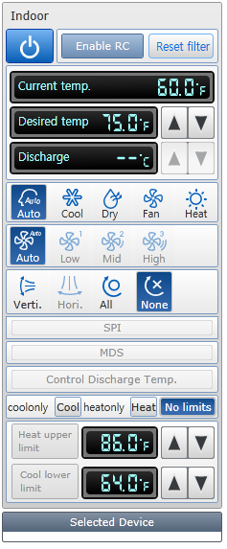
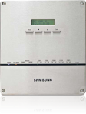
Discharge Air Temp Control
Discharge air control only works with ducted units and AHU Kit
Discharge air control will not start or stop the indoor unit cooling or heat operation.
Thermal on and thermal off will be based on the space temperature difference from set point, not the supply discharge air temperature difference from discharge air temperature set point
Wired Controller
VRF SC
Main Menu
Sub-Menu
Must be configured from the wired controller IOM
Must be selected from the controller panel

Slide 28
Accessory – External Contact Control Board
External Control Board- A multi-purpose control board used on IDU’s. There are 3 sets of terminals that are used to interlock, shut down or error reporting through a warning light or other indicator.
Error reporting Terminals - Terminals 1 & 2 it can be used as an error reporting signal. When the indoor unit is energized these contacts will be closed and will open upon an error at the indoor unit. There is no voltage at these terminals (dry contacts).
Interlocking/Auxiliary heat terminals - Terminals 3 & 4 can be used to interlock other devices such as but not limited to ERV, dampers, exhaust fans and auxiliary heat relays. There is no voltage at these terminals (dry contacts). These terminals can be used to close when the IDU is powered up or when the unit is actually heating or cooling depending on the installation option code setting. Please refer to the IOM for the IDU. These terminals can also be used to operate an auxiliary heat source.
Shutdown terminals - Terminals 5 & 6 can be set up to be used for either a start/stop or a stop operation that would require a manual reset.
The operation of these terminals are dependent on installation option code (digit 2=2) digits 14 and 15. Please refer to the IDU IOM for specific details.
** These terminals are rated at 250vac @3A. Do not exceed.

Slide 29
Accessory – External Contact Control Board
02xxxx 1xxxxx 2xxxx 3xxxxx
Controls terminals 3 & 4
Controls terminals 5 & 6

Slide 30
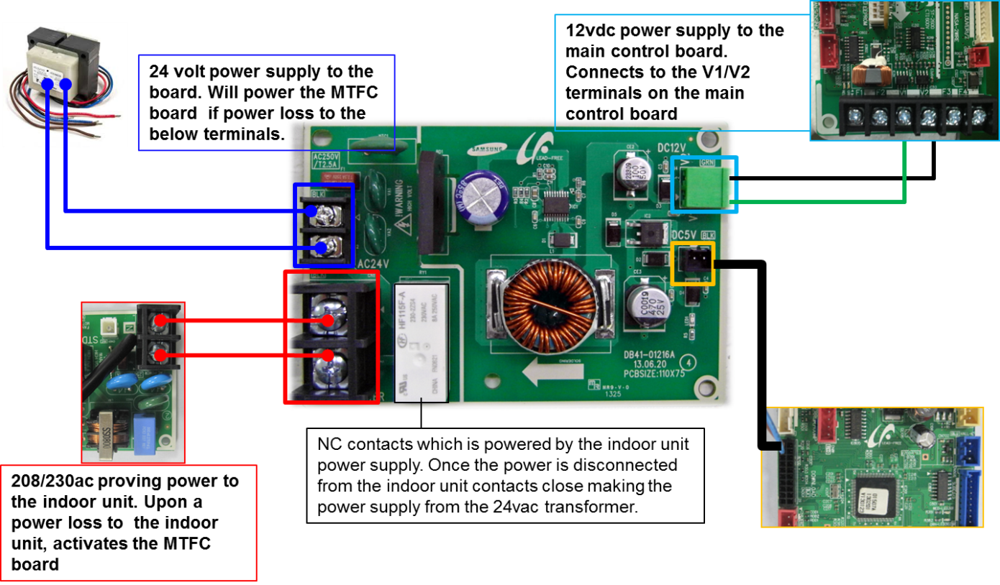
Accessory- Multi Tenant Function Control Board
Multi Tenant Function Control Board- In the event that power is interrupted to any IDU the entire system will shut down within 3 minutes because of an IDU quantity mismatch. This accessory control device will prevent the entire system from shutting down with a loss of power to an indoor unit. It will allow the communications from the affected indoor unit to be active while power is interrupted. By powering the transformer from an independent power source the 24 volt step down transformer will power the multi-tenant function controller. This will allow 12vdc to the V1/V2 terminal on the indoor unit main control board. It will also provide 5vdc to the download plug on the main control board of the indoor unit. This will prevent the system from shutting down during an unexpected power loss to an indoor unit(s) or during routine maintenance or service. Each indoor unit will require its own multi-function control board.

Slide 31
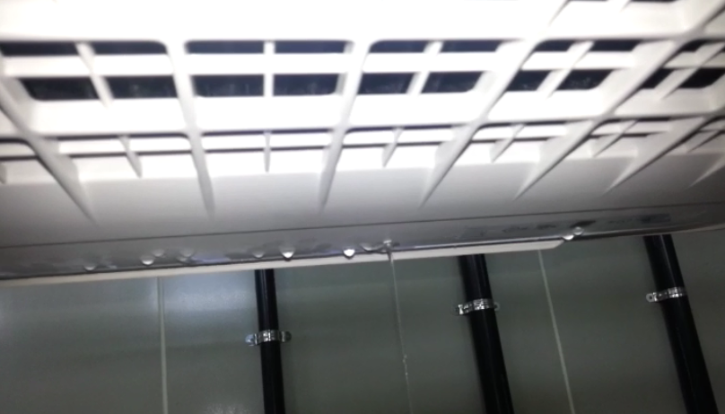
Multi Tenant Function Control Board
Caution: condensation could occur depending on the EEV position when power is interrupted to the indoor unit.

Slide 32
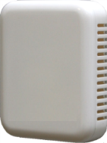
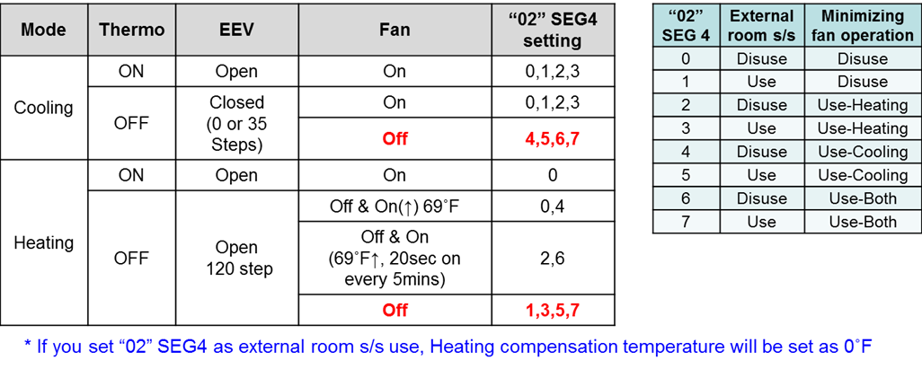
Accessory – Remote Temperature Sensor
Remote Room Sensor- This is an accessory that can be used to take the place of the indoor units return air temperature sensor. The installation code must be changed to disable the compensation offset when using the return air temperature sensor in the indoor unit. The compensation is used to offset the warmer temperature that is typically measured at the ceiling height. If the remote temperature sensor is used there is no need for the compensation. Digit 4 of the installation option must be changed.

Slide 33
Accessory – Remote Temperature Sensor
Remote room sensor replaces the return air sensor in an indoor unit.
It will allow the indoor unit to operate sensing temperature in the space at occupant level.
The other option is to use a wired controller to sense the room temperature.
8ft from floor, return air sensor can read 3 to 5 degrees warmer temperature difference
Check IOM setting when used, digit 2=2 digit 4 must be changed
5ft from floor, more accurate temperature sensing
02xxxx 1xxxxx 2xxxx 3xxxxx

Slide 34
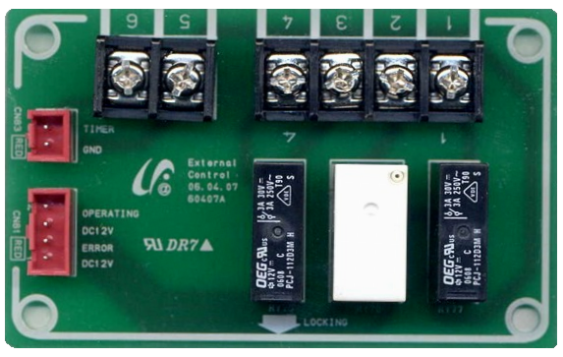
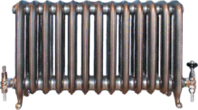
AUX Heat Function
02xxxx 1xxxxx 2xxxxx 3xxxxx
Digit 15 will need to set to 3
Relay
05xxxx 1xxxxx 2xxxxx 3xxxxx
Digit 18 will need to be set for the desired offset;

Slide 35
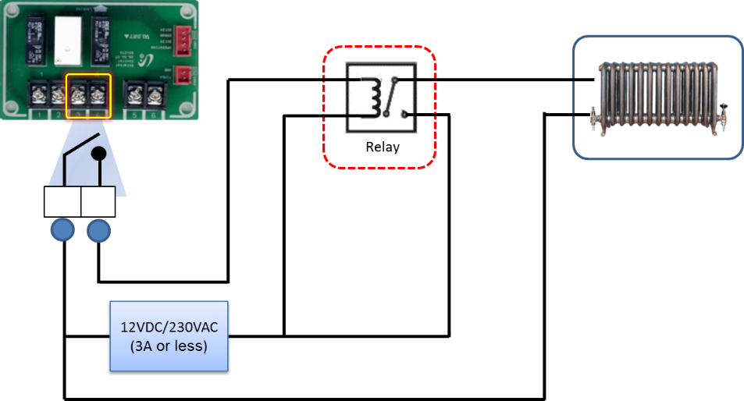
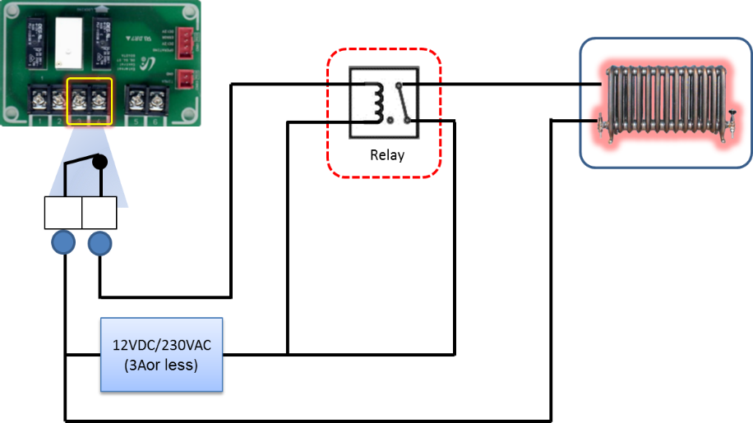
AUX Heat Function
Auxilary Heat Function - A secondary heat source maybe needed on some projects. For cassette indoor units, an external contact control board will be needed. For ducted indoor units the hot water terminals on the main control board may be used to enable the use of auxiliary heat. Both of these option will require a specific option code setting,(refer to the Auxiliary Heat IOM for specific information). In addition to temperature, a designated time delay period can be added to the temperature settings for the point at which auxiliary heat will energize (refer to the Auxiliary Heat IOM).
Note: At this time the use of electric heat is not allowed in the supply duct of any indoor unit.

Slide 36
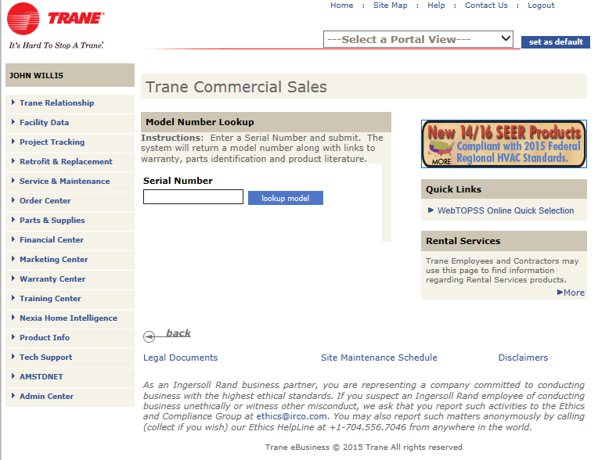
Indoor Unit Control Boards – Updating Firmware
Click Product Info

Slide 37
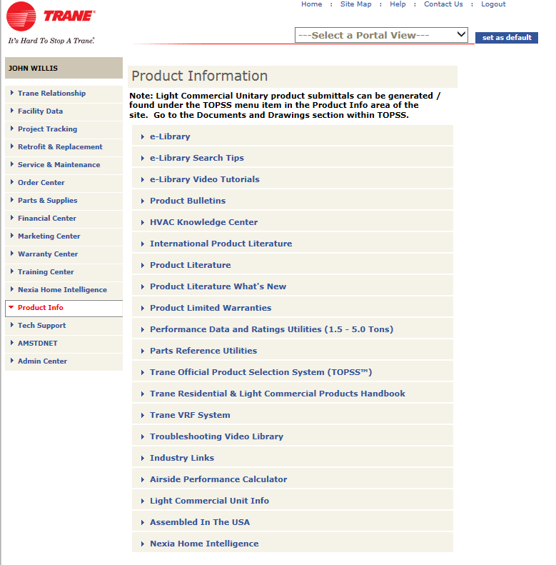
Indoor Unit Control Boards – Updating Firmware
Click Trane VRF Systems

Slide 38
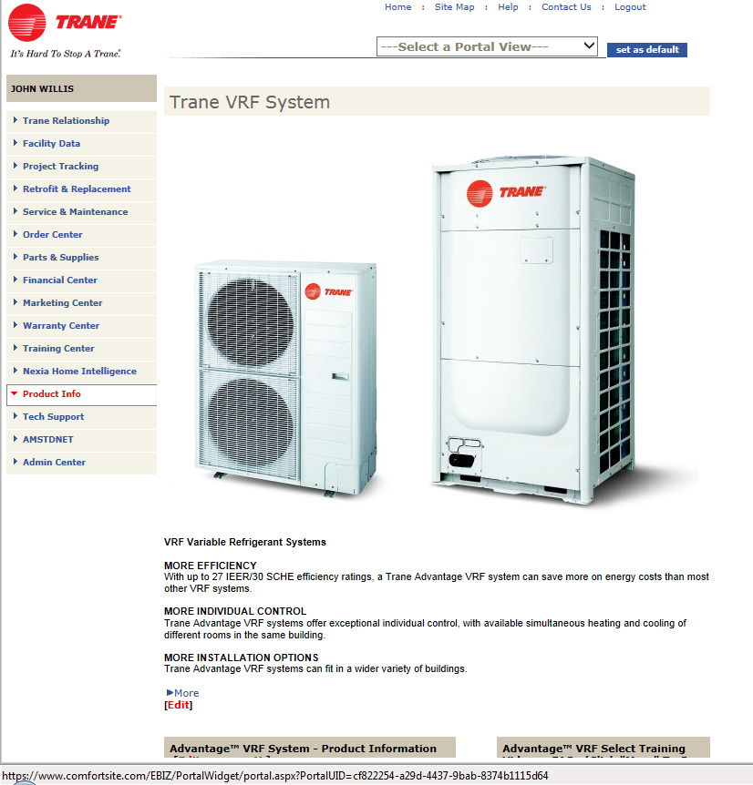
Indoor Unit Control Boards – Updating Firmware
Information you will find here Along with the instructions
VRF Select
VRF SC Integration guide
Latest version of TUT
Latest IDU Firmware
Training Schedule
Service Manual

Slide 39
Mode Change Unit

Slide 40
Mode Change Unit Components
Rotary Switch- used to set the port address, it must match the indoor unit address that it is connected to.
Dip Switch- in the on position makes the port active, off position disables the port
Cooling Solenoid- energizes on a call for cooling from the indoor unit
Heating Solenoid- energizes when system is operating in all heating mode or when the IDU is calling for heat in mainly heating or mainly cooling mode.
Equalizing EEV- opens to equalize the pressure during mode change of the indoor unit
It also opens to 480 steps during the cooling mode but closed during main cooling mode
Sub-cooling loop- provides extra sub-cooling at the MCU during certain conditions
Sub-cooling Solenoid- opens to allow for extra sub-cooling within the MCU
also opens to flush the MCU of oil during partial operation of indoor units
Sub-cooling EEV- controls the sub-cooling with in the MCU
Temp Sensors- measures the sub-cooling loop, refrigerant temp in and refrigerant out of IDU coil

Slide 41
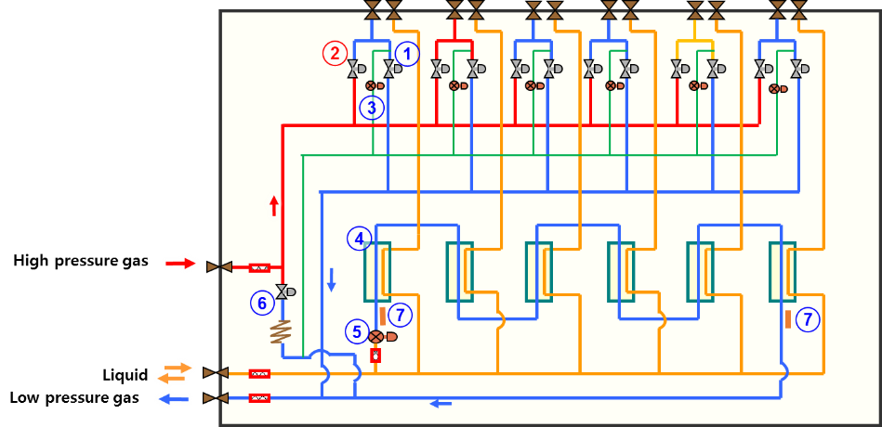
Mode Change Unit Components
No | Cycle parts
1 | Cooling solenoid valve
2 | Heating solenoid valve
3 | MCU EEV
4 | Sub-cooler
5 | Sub-cooler EEV
6 | MCU liquid bypass valve
7 | Sub-cooler temp sensors

Slide 42
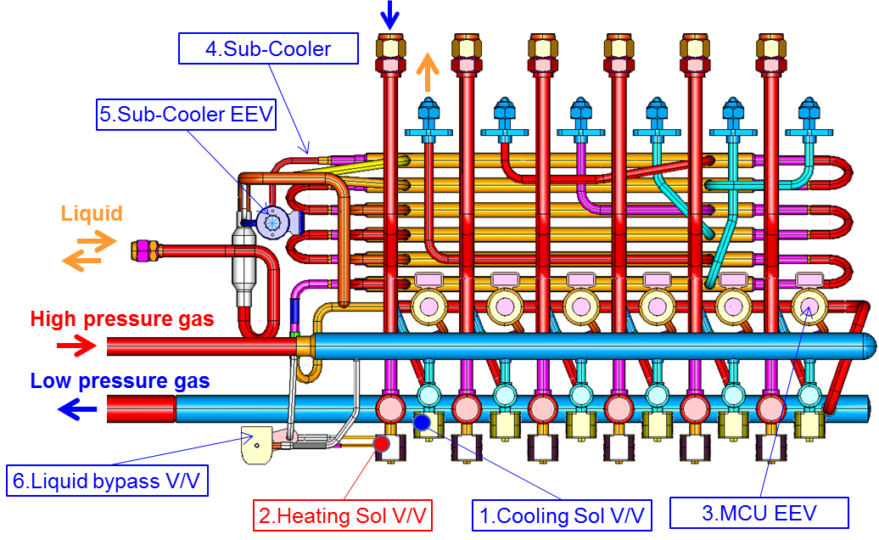
Mode Change Unit Components
No | Cycle parts
1 | Cooling solenoid valve
2 | Heating solenoid valve
3 | MCU EEV
4 | Sub-cooler
5 | Sub-cooler EEV
6 | MCU liquid bypass valve
7 | Sub-cooler temp sensors

Slide 43
Mode Change Unit
The sum of connected indoor units to each MCU must not exceed its capacity:
120,000 Btu/h for the 4 port
180,000 Btu/h for the 6 port
192,000 Btu/h for the dedicated 2 port
You must use two ports (2 liquid & 2 gas) to feed a 36-48MBh IDU regardless of the MCU model number.
If using a 72MBh or 96MBh HSP ducted unit you must use the dedicated 2 port MCU & feed each unit with 2 liquid & 2 gas ports.

Slide 44
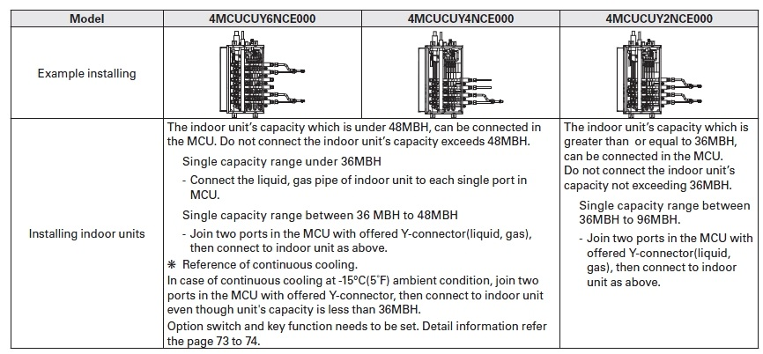
Mode Change Unit
MCU-KIT | Model Number | Units | Unit Dimensions LxWxH(inches) | Unit Weight (lbs) | Shipping Dimensions LxWxH(inches) | Shipping Weight (lbs)
 | 4MCUCUY6NCE000 | Up to 6 indoor units | 32.67X7.87X18.5 | 59.52 | 38.30X9.84X21.84 | 70.55
 | 4MCUCUY4NCE000 | Up to 4 indoor units |  | 52.91 |  | 63.93
 | 4MCUCUY2NCE000 | Up to 2 indoor units - HSP 36 -96MBH)

Slide 45
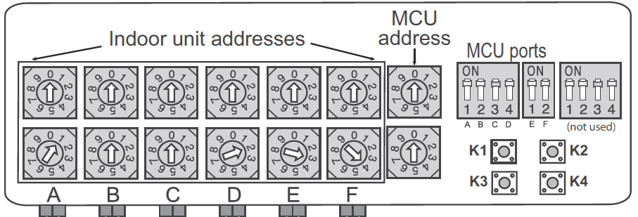
MCU Addressing
Rotary switches read from left to right facing the rotary switches
All the main control boards are the same with 6 rotary switches for port addresses the last one on the right is for the MCU address.

Slide 46
MCU Addressing
The rotary dials found on the MCU main control board are how the MCU ports get addressed. These ports must match the indoor unit address for proper operation. This is crucial to the operation of a heat recovery system. The component location is a tool that can help minimize a cross address if used properly.
Caution: while facing the MCU control board the rotaries read from left to right,
A,B,C,D,E,F

Slide 47
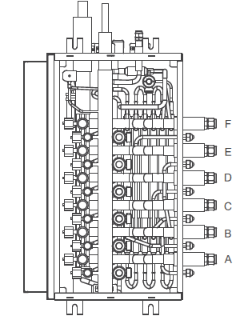
MCU Addressing
While facing the ports they read from left to right
A,B,C,D,E,F

Slide 48
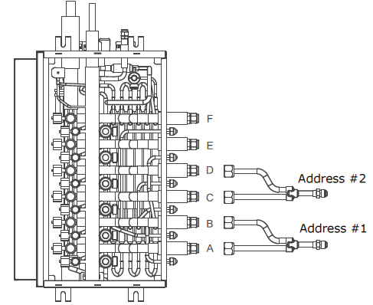
MCU- Mode Change Unit
Any indoor unit that is 36mbu or larger will need to be connected using 2 ports.
Dual ports must be connected to A,B or C,D or E,F.

Slide 49
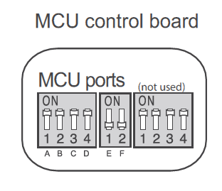
MCU Dip Switches
Dip switches must be in the on position for the port to be active. Unused ports should have matching dip switch off.

Slide 50
MCU Switches

Slide 51
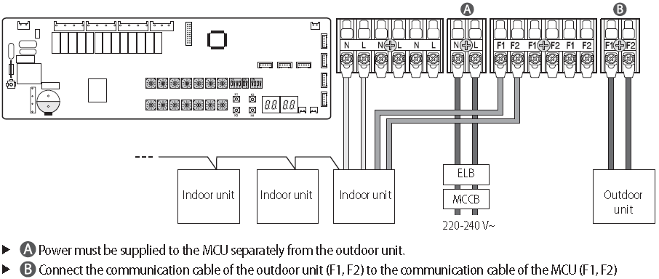
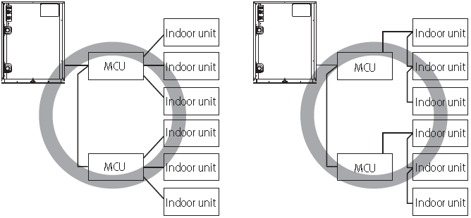
MCU- Mode Change Unit
ODU/WCU Wiring to MCU
MCU
ODU/WCU

Slide 52
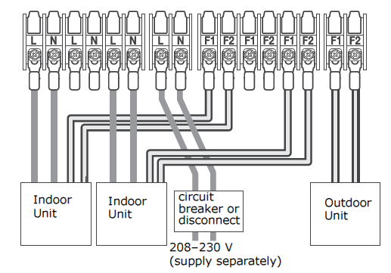
MCU- Mode Change Unit

Slide 53
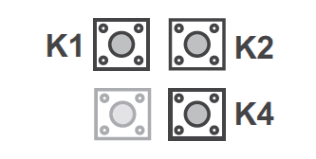
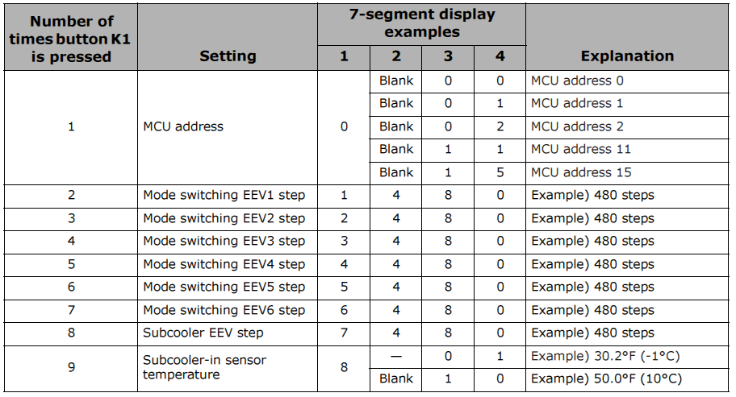
MCU- Mode Change Unit, K-Buttons

Slide 54
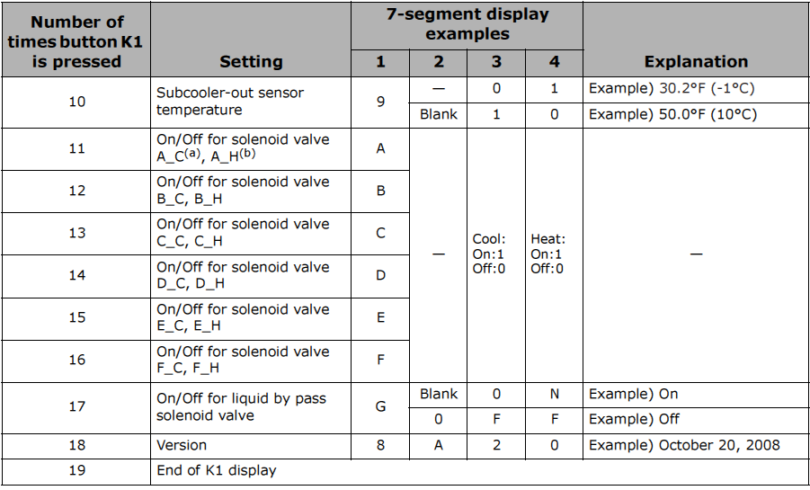
MCU- Mode Change Unit, K-Buttons

Slide 55
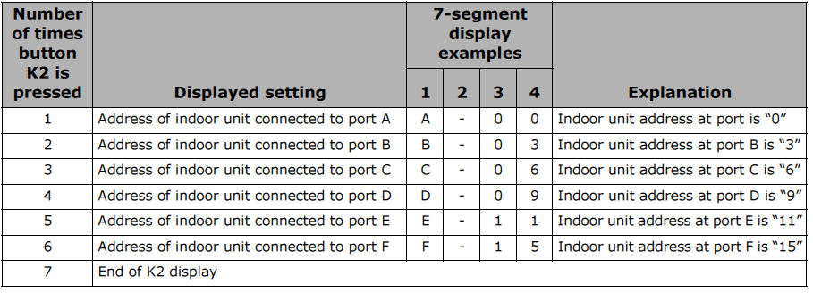
MCU- Mode Change Unit, K-Buttons

Slide 56
MCU- Mode Change Unit, K-Buttons

Slide 57
MCU- Mode Change Unit
If you suspect an MCU solenoid is leaking refrigerant
Place the indoor unit connected to the suspected port in fan mode and on high speed
While leaving the other indoor units connect to the MCU operating as normal
Let the system operate for 10 to 15 minutes while watching the EVAin and EVAout temperature.
Double check that the EEV valve is closed at 0 steps
They should be close the space temperature, with in 2 or 3 degrees difference.
If the MCU solenoid is leaking there will a large temperature difference. This will indicate that the MCU solenoid is leaking.

Slide 58
Outdoor Unit

Slide 59
Outdoor Unit Components
Heat pump (HP) – Two pipe, heat or cool only Variable Refrigerant Flow (VRF) HVAC system.
Heat Recovery (HR) – Three pipe, simultaneous heating and cooling Variable Refrigerant Flow (VRF) HVAC system.
Cooling – Operation of ODU and IDU in all cooling. Mode for both HP and HR units.
Main Cooling – Operation of majority of IDU(s) and ODU in cooling mode. At least one or more IDU(s) are operation in heat mode. HR unit only, not a mode of operation for HP units.
Heating - Operation of ODU and IDU in all heating. Mode for both HP and HR units.
Main Heating - Operation of majority of IDU(s) and ODU in heating mode. At least one or more IDU(s) are operation in cool mode. HR unit only, not a mode of operation for HP units
High Pressure, high temperature gas – discharge gas leaving the compressor
High pressure, high temperature liquid – Condensed refrigerant
Low pressure, low temperature gas – suction gas returning to the compressor
Inverter Compressor – single or dual inverter driven scroll compressors depending on unit size and voltage. Standard operating frequency range is between 20-140Hz. The frequency of the compressor will change based on indoor unit capacity requests. A capacity request from an IDU is required to bring on a compressor. Once running, it will turn down to 14Hz in special situations. Compressor(s) will run continuously until all indoor unit capacity requests are satisfied. Vapor injection can boost heating capacity of the compressor by 20%
Outdoor Fan – Modulating inverter driven fan motor utilized on air cooled units. Number of outdoor fans will depend on tonnage and voltage of the unit.
Cooling mode – fan is driven by the high pressure sensor. As the compressor discharge pressure increases the fan speeds up, as the discharge pressure decreases the fan begins to slow down. Default target high pressure in cooling mode is 355 psig.
Heating mode – fan is driven by low pressure sensor. As OA temp changes, the fan will speed up or slow down to maintain a Target low pressure. Target low pressure is dependent on OA temperature. As the OA temperature decreases, so will the target low pressure. As the OA temperature increases, so will the target low pressure.

Slide 60
Outdoor Unit Components
Heat Exchanger (HX) – Allows for the transfer of heat. Tube and fin heat exchanger on air cooled units. Water cooled units utilize a brazed plate heat exchanger.
Cyclone Oil Separator – used to separate oil from the refrigerant at the discharge of the compressor. On a two compressor model, oil is returned to the common suction line of the compressors.
Accumulator – Protects the compressor from liquid refrigerant flooding by separating liquid refrigerant from gas refrigerant. The Accumulator collects excessive refrigerant. As the refrigerant boils off, it allows refrigerant as a vapor to enter the compressor.
Accumulator Oil Return Valve (ARV) – Prevents liquid refrigerant from flowing directly to the compressor while it is stopped or during the initial startup process. When the compressor is running in normal operation, the ARV opens to allow oil return to the compressor.
Intercooler- Secures up to 36°F of sub-cooling for liquid refrigerant used during cooling mode. Secures up to 3.6°F superheat for use during vapor injection to the compressor in heating mode.
Refrigerant Cooled Heat Sink (IPM) – Utilizes liquid refrigerant to cool the Integrated Bi-polar Transistor (IGBT) on the compressor inverter board(s).
Crankcase Heaters – Drives refrigerant from the compressor sump. Used during cold start to help secure a Discharge Superheat (DSH) of 18F at start up.

Slide 61
Outdoor Unit Components
High Pressure Sensor – Utilizes a 0-5vdc signal to report compressor discharge pressure to the main control board. This allows for control of the OD fan motor in cooling and compressor operation in heating mode. Also used as a secondary safety to the high pressure switch to aid in the prevention of a high pressure situation.
Low Pressure Sensor – Utilizes a 0-5vdc signal to control the compressor speed in the cooling operation and the OD fan motor in heating mode.
High Pressure Switch – Primary safety device used to prevent high pressure situations. Opens at 650 psi. Resets at 575 psi.
Main EEV – Refrigerant metering device used in heating mode for the ODU/WCU.
Main EEV is fully open in the cooling mode. The Main EEV is closed when the unit is stopped.
In Mainly Cooling mode (HR only), the Main EEV is used as a regulating device to force high temperature, high pressure refrigerant through the Main Cooling valve. The amount of refrigerant needed for heating during the mainly cooling mode will dictate how much the Main EEV is open/closed.
Electronic Vapor Injection EEV (EVI EEV) – Metering device used to regulate sub cooling and super heat in heating mode through the intercooler refrigerant circuit.
In cooling mode
Target sub cooling is 36°F out to the system. By opening or closing the EVI EEV, the ΔT across the plate HX will rise or fall to meet the target system sub cooling. As a result of keeping the target sub cooling at approximately 36°F, the proper refrigerant temperature for vapor injection will be maintained.
In heating mode
Target superheat (SH) during vapor injection is 3.6°F across the plate HX to the compressor for vapor injection (EVI EEV energized). If SH is above 3.6°F, the EVI EEV will open more to reduce the SH. If the SH is below 3.6°F, the EVI EEV will close down to increase SH.
Target superheat (SH) in EVI bypass mode (EVI EEV de-energized) is 18°F and a compressor discharge temperature of 194°F. For increased compressor reliability, if the compressor discharge temp is abnormally high, the EVI EEV will open to decrease the discharge temperature.

Slide 62
Outdoor Unit Components
EVI Bypass Valve – Electronic Vapor Injection Bypass valve is opened anytime the EVI Solenoid Valve is closed. This will recirculate refrigerant back to the suction side of the compressor through the accumulator while maintaining adequate sub cooling through the intercooler. In EVI bypass mode, target super heat is 18°F.
EVI Solenoid Valve – Electronic Vapor Injection valve used to maintain mass flow rate during compressor operation at start up and during heating mode.
At startup, the EVI bypass valve closes and the EVI opens to ensure the compressor is supplied with sufficient refrigerant to operate safely. Typically will close 5-8 minutes after startup.
In the heating mode, the EVI bypass valve closes and the EVI opens to boost heating capacity by up to 20% in low ambient, low load conditions.
also, the solenoid valve can help to equalize suction pressure between operating ODU modules
**Tout is 96°F cooling, 50°F heating

Slide 63
Main Cooling Valve – Used in mainly cooling mode to allow hot gas out to the Mode Change Unit/Indoor Unit to satisfy an indoor unit(s) request for heating. w
Hot Gas Bypass Valve 1 (HGBP1) – Used to compensate for an abnormally low suction pressure condition. On during Safety Start. On during low pressure protection control.
Valve Position | Cooling (psi) | Heating (psi)
Off | 59 | 34
On | 45 | 19
Hot Gas Bypass Valve 2 (HGBP2 - Heat Recovery only) – Equalizes refrigerant pressure between the high pressure and low pressure gas lines when the system is stopped. When open, it also increases the suction line refrigerant volume back to the compressor by allowing the low pressure, low temperature gas line and the high pressure, high temperature gas line to be “combined”. This will effectively increase the volume of refrigerant being brought back to the compressor in the cooling only mode. This reduces pressure drops due to long line lengths in cooling only mode.
4-way Valve – Diverts refrigerant flow based on mode of operation. Fails to cooling mode and energizes to heating mode.
Cooling mode – Diverts high pressure, high temperature gas to the heat exchanger for condensing.
Heating mode – Diverts high pressure, high temperature gas to the MCU/Indoor units.
Outdoor EEV Bypass Solenoid Valve – valve closes in the mainly cooling mode, which forces high pressure liquid through the Main EEV.
The only time this valve is energized is in cooling mode.
Outdoor EEV Bypass Check Valve – allows for flow in one direction through the EEV Bypass Solenoid Valve.
Discharge Check Valve – Prevents the discharge from an online compressor from entering the discharge of an off line compressor.
Heat Recovery (HR) Check Valve – Prevents high pressure gas from entering the suction line through the 4-way valve.
Discharge Temperature Sensor (DTS) – Measures the temperature of the refrigerant as it leaves the compressor. These measurements are then used to protect the compressor from damage by holding at or reducing capacity up to and including shutdown when a high discharge temperature is sensed.
212°F | 221°F | 230°F | 248°F
Hz hold | Hz down by 10% | Capacity reduced 10% | Units shuts down - E416

Slide 64
Suction Temperature Sensor (STS) – Measures the temperature of the suction gas returning to the compressor.
Condenser (HX) Out Temperature Sensor – Measures the temperature of the refrigerant leaving the condenser in the cooling mode. Also used as an input to terminate defrost mode.
EVI_{in} and EVI_{out} Temperature Sensor – Measures the temperature across the intercooler. Provides a reference for target superheat.
Liquid Tube Temp Sensor (LTT) – Measures the liquid line temperature after the intercooler.
Compressor Top Temperature (CTT) – Temperature reference for the temperature at the dome of the compressor.
Input is utilized to help diagnose under or overcharged system(s).
Input is utilized to prevent damage to the compressor.
These measurements are then used to protect the compressor from damage by holding at or reducing capacity up to and including shutdown when a high compressor top temperature is sensed.
221°F | 230°F | 239°F | 248°F
Hz hold | Hz down by 10% | Capacity reduced 10% | Units shuts down - E416
Outdoor Temperature Sensor (ODT) – Senses the outdoor temperature. Used as a reference for
Heating mode lockout – 86°F for heating mode
Commissioning mode – 14°F to 104°F, above 50°F it will commission in cooling mode, below 50°F it will commission in heating mode.
Service Valves – Heat Pump and Heat recovery units have a liquid and suction gas isolation valve. Heat Recovery units will also have a discharge gas isolation valve.
Discharge Superheat (DSH) – Discharge superheat is the difference between Compressor Discharge Temp (CDT) and High Pressure Saturated Temp (HPST) → DSH = CDT – HPST
Sub cooling Control (SC) – Optimal system sub cooling is 36°F. Sub-cooling control is utilized to increase efficiency of the VRF system by modulating the EVI EEV to maintain a difference between High Pressure Saturated Temperature and Liquid Tube Temp (SC = HPST – LTT)

Slide 65
Outdoor Temperature Sensor (ODT) – Senses the outdoor temperature. Used as a reference for
Heating mode lockout – 86°F for heating mode
Commissioning mode – 14°F to 104°F, above 50°F it will commission in cooling mode, below 50°F it will commission in heating mode.
Service Valves – Heat Pump and Heat recovery units have a liquid and suction gas isolation valve. Heat Recovery units will also have a discharge gas isolation valve.
Discharge Superheat (DSH) – Discharge superheat is the difference between Compressor Discharge Temp (CDT) and High Pressure Saturated Temp (HPST) → DSH = CDT – HPST
Sub cooling Control (SC) – Optimal system sub cooling is 36°F. Sub-cooling control is utilized to increase efficiency of the VRF system by modulating the EVI EEV to maintain a difference between High Pressure Saturated Temperature and Liquid Tube Temp (SC = HPST – LTT)
Superheat (SH) – Superheat is the difference between Suction Temp and Low Pressure Saturated Temp (SH = ST – LPST)
Super Heat Control – Optimal system superheat in heating mode is 18°F. Modulation of the EVI EEV is utilized in the heating mode to maintain a difference between EVI_{out} temp and EVI_{in} temp (EVI_{out} temp - EVI_{in} temp = 18°F).
Safety Start – is a combination of a pump down or pump out, soft start and a mild start. Time associated with a safety start is directly related to securing 27°F DSH. Could last as long as 12 minutes. Compressor speed and capacity increase is limited during a safety start.
Normal Start – No limitations at start up. Compressors will start one at a time with normal increase in frequency and speed.
Cold Start – Cold start is based on (higher of CTT or CDT) – ODT < 27°F temperature at start up. By limiting the maximum frequency and the speed at which the compressor increases, it will minimize oil foaming and ensure proper oil levels in the compressor. Cold start will last until DSH is > 27°F.
Normal Operation – Judged after the soft start has ended. If DSH is greater than 18°F at point of judgment it will enter into normal operation.
Cold Operation – Judged at the point where soft start ends. If DSH is less than 18°F at point of judgment it will enter into cold operation until DSH reaches greater than 27°F.
Quick Start – if there is more than a 30% request for capacity at start up. Outdoor unit(s) will start multiple compressors to meet heating and cooling requirements faster. Only applies within the heating/cooling quick start envelope. Cold start will take precedence over a quick start.

Slide 66
Oil Recovery Cycle – Used to bring oil back to the compressors in both heating and cooling mode. A fixed operation that operates off of system variables to determine the frequency of the oil recovery cycle. It will calculate the time between oil recovery cycles to be between 40 minutes – 7 hours based on IDU capacity request and the compressor frequency.
Pump Down – After stopping the system in cooling mode, the IDU will close its IDU EEV to pump down the IDU coil to prevent liquid refrigerant flood back at start up.
Pump Out – After stopping the system in heating mode, the ODU will close its main EEV and pump refrigerant out of the ODU coil to prevent liquid refrigerant flood back at start up.

Slide 67
Component location and description – Major Components
Component location and description -
Inverter Compressor - single or dual inverter driven scroll compressors depending on unit size and voltage. Operating frequency range is between 20-140Hz. The frequency of the compressor will change based on indoor unit capacity requests. A capacity request from an IDU is required to bring on a compressor. Once running, it will turn down to 14Hz in special situations. Compressor(s) will run continuously until all indoor unit capacity requests are satisfied. Vapor injection can boost heating capacity by 20%
Cyclone Oil Separator – used to separate oil from the refrigerant at the discharge of the compressor. On a two compressor model, oil is returned to the common suction line.
Intercooler- Secures up to 36°F of sub-cooling for liquid refrigerant used for cooling mode. Secures up to 3.6°F superheat for use during vapor injection to the compressor in heating mode.
Accumulator- Protects the compressor from liquid refrigerant flooding by separating liquid refrigerant from gas refrigerant. The Accumulator collects excessive refrigerant. As the refrigerant boils off, it allows refrigerant as a vapor to enter the compressor.

Slide 68
Component location and description – Valves
Hot Gas Bypass valve 1- Used to compensate low pressure situations
Hot Gas Bypass valve 2- Allows the use of the hot gas line in cool mode for suction gas return, also is used to equalize the pressure when the system shuts down
4 Way Valve- change the direction of the gas in heat mode
Main Cooling Valve- allows hot gas to flow to the indoor unit that is requesting heat in the main cool mode
Outdoor EEV Solenoid Valve- to control refrigerant flow during the main cooling mode
EVI Bypass Valve- returns refrigerant to the accumulator from the intercooler
Accumulator Oil Return Valve- returns oil back to the compressor from the accumulator
EVI Solenoid Valve- vapor injection solenoid valve boost heating capacity by 20%

Slide 69
Component location and description – Valves
Outdoor Main EEV- metering device in the heating mode
EVI EEV- controls the refrigerant flow for the sub-cooler (intercooler

Slide 70
Component location and description – Sensors
Discharge Temp Sensor- 204CT type sensor, measures the discharge line temperature
Compressor Top Temp Sensor- 204CT type sensor, measures the compressor top temperature
High Pressure Switch- safety switch opens on high pressure (650psi). Power to the HUB board is supplied through the high pressure switch. When the switch is open, power is lost to the HUB board.
High pressure Sensor- measures the high pressure
Ambient Air Temp Sensor- 103AT type measures the outdoor ambient temperature.
Condenser Out Temp Sensor- 103AT type measures the refrigerant temp when it leaves the OD coil
Liquid Tube Temp Sensor- 103AT type, measures the liquid line temp
EVIi_{n} and EVI_{out} Temp Sensor- two 103AT type measures the difference across the intercooler
Suction Tube Temp Sensor 1 & 2- 1003AT type measures the suction tube temp of each compressor
Suction Pressure Sensor- measures the suction line pressure

Slide 71
Refrigerant Flow HR: Cooling-Only
HGBP-2 equalizes pressure between gas return lines & allows both gas lines to return suction gas from MCU’s.
All Cooling
SV_HG
E
s
s
E
E
s
E
SV_LG
s
E
E
s
s
s
s
SV_L
E
E
Low temperature & pressure gas
MCU’s Sub-Cooling allows for greater distance and reduces sound as EEV can open more.
High temperature & pressure gas
Mid temperature & High pressure liquid
Notes:
From: DVM S – HR ppt: 21
Needs Intro slide for MCU & run the video (pg 93-94) Photo & schematic

Slide 72
Refrigerant Flow HR: Mainly Cooling
Cooling
SV_HG
E
Cooling
s
s
E
s
E
Cooling
E
SV_LG
Heating
s
E
E
s
Cooling
s
s
s
SV_L
E
Heating
Low temperature & pressure gas
High temperature & pressure gas
E
Mid temperature & High pressure liquid
Electronic Expansion Valve (480-EEV) to slowly change mode from Htg to Clg (noise)
Notes:
From: DVM S – HR ppt: 22

Slide 73
Refrigerant Flow HR: Heating Only
All Heating
SV_HG
E
s
s
E
s
E
E
SV_LG
s
E
E
s
s
s
s
SV_L
E
Low temperature & pressure gas
High temperature & pressure gas
E
Mid temperature & High pressure liquid
Notes:
From: DVM S – HR ppt:
23

Slide 74
Refrigerant Flow HR: Mainly Heating
Heating
SV_HG
E
Heating
s
s
E
s
E
Heating
E
SV_LG
Cooling
s
E
E
s
Heating
s
s
s
SV_L
E
Cooling
Low temperature & pressure gas
High temperature & pressure gas
E
Mid temperature & High pressure liquid
Notes:
From: DVM S – HR ppt: 24
Change color of changing lines…. Or dashed…
Keep it more simple by having just 2 zones…
Main Htg or Clg – means “Mainly”
Taking total load htg vs total load clg demand along with OA temp – to make decision for Outdoor Unit

Slide 75
Outdoor Unit Starting Sequence
Upon a request from an indoor unit the compressor will start, the indoor unit capacity doesn't matter.
Example our smallest indoor unit capacity is 7.5mbh, if this is the only indoor unit requesting capacity the outdoor unit will start.
Outdoor unit target capacity is 7.5mbh.
Doesn’t matter the ODU total capacity
7.5 mbh
7.5 mbh
7.5 mbh
7.5 mbh
on
off
off
off

Slide 76
Outdoor Unit Starting Sequence
Example
Outdoor unit target capacity is 48 mbh.
24 mbh
7.5 mbh
24 mbh
7.5 mbh
on
off
on
off

Slide 77
Outdoor Unit Operating Priority
ODU and compressor operating priority – The designated main outdoor unit changes based on operating priority. This is different from the designated main set by dip switches. The main designated by dip switches will always remain the main outdoor unit from which all error codes are read and communications between the systems are transmitted and received. The main unit based on operating priority is the main for no more than 60 minutes after which a new main ODU is chosen.
A new main will also be chosen if a defrost cycle, oil recovery cycle or all ODU are off because they have satisfied and the main has operated for more than 60 minutes. Another method of choosing a new main by operating priority is if an ODU is off for more than 40 minutes, it will be started to become the new main and the old main will be shut down if not needed.

Slide 78
Outdoor Unit Compressor Operating Priority
Compressor starting and rotation – Compressor #1 of the designated main outdoor unit will always be the first to run at initial startup or when power is restored after a loss. After the outdoor unit operating priority changes (see ODU operating priority), the compressor with the least amount of runtime in the main ODU designated by operating priority will be the first to start upon a call for capacity.
After initial startup, the main ODU designated by operating priority will start its compressor with the least amount of runtime upon a request for capacity by an IDU. The remaining compressors will be brought online until all compressors in the system are running. If capacity is such that all compressors running is not necessary, compressors will be shut down until compressor capacity matches IDU capacity request.
When more capacity is needed from compressors, any subsequent compressors are brought online when the first compressor reaches 60Hz for three minutes or, the first compressor reaches 76Hz. At 76Hz, the second compressor will start without delay. Compressor #2 will always run at compressor #1 frequency +/- 5Hz. Once capacity requirements have been determined, any un-necessary compressors will be shut down.
Compressors will want to run between 30-80Hz for maximum efficiency.

Slide 79
Outdoor Unit Compressor Operating Priority

Slide 80
Pump Down (Cooling) & Pump Out (Heating)
Pump Down/Out – is a process used to minimize refrigerant shortage and liquid flood back at the outdoor unit during the startup and shutdown routine. This process will last for approximately 60 seconds at initial safety start and is also part of the stop routine before compressor shutdown. In cooling mode, the IDU EEV closes while the compressor is running to pump down refrigerant in the IDU coil. In heating mode, the main EEV closes when the compressor starts to pump out refrigerant from the condenser.

Slide 81
Mode determination – Heat Recovery ONLY
The Criterion of Heating Capacity Ratio (HCR) is used for mode changeover on a Heat Recovery system. The line is based on several factors and is continually changing. It is based on indoor cooling temperature, indoor heating temperature and the operation capacity ratio of the indoor units that are operating. The line shown as a graph will look similar to the graph in the example. What it is simply saying is that anything above the line, the mode will change from mainly cooling to mainly heating. Anything below the line, the mode will change from mainly heating to mainly cooling.
Calculating the HCR → Heating capacity ratio (HCR) = Σ(Heating) / {Σ(Heating) + Σ(Cooling)}
Which says, the HCR is equal to the sum of the indoor units in heating divided by the sum of the total units operating in heating and cooling mode.

Slide 82
Mode determination – Heat Recovery ONLY
For example if –
- the average heating indoor room temperature is 68°F
- the average cooling indoor room temperature 75°F
- the indoor operating ratio is at 50%
The Criterion of HCR becomes a straight line on a graph where the HCR is the y-axis and the outdoor temperature is the x-axis.
So, if the HCR is within 20% of the Criterion of HCR for 30 minutes while running in mainly heating, the unit will change mode to mainly cooling. The opposite is try when running in mainly cooling. If the HCR is within 15% of the Criterion of HCR for 30 minutes, the unit will change to mainly heating. If the HCR has exceeded the Criterion for HCR, changeover will disregard the 30 minute timer and the changeover will take place.

Slide 83
Compressor Starting Logic - Safety Start
**Safety Start - is a process that protects the VRF system during startup. By utilizing a series of judgments to minimize compressor maximum Hz and the rate at which the frequency increases, this 1will help prevent liquid refrigerant from overflowing the accumulator and slugging the compressor. Safety start consists of a pump down, soft start, mild start, cold operation and ultimately normal operation.
Starting Patterns
Cold start is based on (A ǁ B) x C x D where
A. Higher of (CTT or CDT) – ODT < 27°F temperature at start up
B. Or the higher of CTT and CDT < 122°F
C. And power applied less than 12 hours before start
D. And ambient temp less than
68°F in heating
86°F in cooling
Cold Operation is initiated at the end of soft start if the DSH fails to meet the 18°F requirement or the compressor top temperature or compressor discharge temperature fails to make 122°F. Cold operation will run until DSH achieves 27°F or for a max of 30 minutes.
Quick start allows at start up, with a 30% or greater capacity request from the IDU(s), all compressors will start in the requested mode of operation. Quick start is allowed within the operating envelope. A quick start does not override the need to do a cold start. A cold start has higher priority than a quick start.
Normal Start all compressors will start one at a time.
yes
*DSH(Discharge Super Heat)= Comp Discharge Temp – High Pressure Saturation Temp

Slide 84
Compressor Control Logic, Cold Start
A= Max Comp top temp or comp discharge temp –the ambient temp is less than 27
B=Max comp top temp or comp discharge temp less than 122
C= the system is started up less than 12 hours after the power is applied.
D= Cool mode start with the ambient temp less than 86
Heat mode start with the ambient temp less than 68
27
122
86 Cooling
68 Heating
Logic Means
A or B and C and D

Slide 85
Compressor Control Logic, Normal
The purpose of this logic is to help prevent the accumulator from flooding with liquid refrigerant.
This is accomplished by limiting the max frequency of the compressor and the rate at which the compressor increase the speed. Once he DSH reached these limits are lifted.
Cold operation is initiated at the end of soft start if the DSH fails to meet the 18°F requirement or the compressor top temperature or compressor discharge temperature fails to make 122°F. Cold operation will run until DSH achieves 27°F or for a max of 30 minutes.

Slide 86
Compressor Control Logic, Quick Start
Quick start will occur if there is at least 30% indoor unit capacity request and he conditions fall with the chart below for each mode of operation.
* Cold Start condition will take priority over quick start logic

Slide 87
Outdoor Unit Control Logic Basics

Slide 88
Compressor Suction Control, Cooling Mode
Target Suction Pressure
85 92 99 106 113 120 128
Avg eva in temp at target temp low pressure target remains unchanged
Avg eva in temp above the target, low pressure target decreases, comp speeds up
Avg eva in temp lower than target, low pressure target increases, comp slows down
Target eva in temp is selectable in the ODU
Target EVA in Temp
44 – 48 (default setting)
How the eva in temp is used to set the target low pressure.
41 - 44
48 – 51
50 - 53
LP 118 LP 122 LP 126
EVAin 46 EVAin 48 EVAin 50
51 - 55
53 - 57
LP 113
55 - 59

Slide 89
Compressor Suction Control, Cooling Mode
While the system is not in operation (K3 to stop the system)
Push and hold the K2 button until 0000 is displayed on the ODU
Push the K1 until 01 is displayed on the left hand side of the ODU screen
Push the K2 button tot change the digits on the right hand side of the ODU screen
Instruction can be found on page 56 of the ODU IOM
Snippet from the ODU IOM

Slide 90
Compressor High Side Control, Heating Mode
 | Seg1 | Seg2 | Seg3 | Seg4 | High Pressure
Main | 0 | 2 | 0 | 0 | 426(default)
 |  |  | 0 | 1 | 355
 |  |  | 0 | 2 | 369
 |  |  | 0 | 3 | 384
 |  |  | 0 | 4 | 398
 |  |  | 0 | 5 | 412
 |  |  | 0 | 6 | 440
 |  |  | 0 | 7 | 455
 |  |  | 0 | 8 | 469

Slide 91
Compressor High Side Control, Heating Mode
While the system is not in operation (K3 to stop the system)
Push and hold the K2 button until 0000 is displayed on the ODU
Push the K1 until 02 is displayed on the left hand side of the ODU screen
Push the K2 button tot change the digits on the right hand side of the ODU screen
Instruction can be found on page 56 of the ODU IOM
Snippet from the ODU IOM

Slide 92
Outdoor Unit Fan Control
ODU setting | Target high pressure for cooling
Default | 355
ODU lowest setting Menu08 / value03 | 398
Ambient temp. (°F) | Target low pressure for heating
Below 32°F | 106
32 ∼ 50°F | 116
50 ∼ 68°F | 119
69°F> | 123

Slide 93
EVI EEV Control

Slide 94
Main EEV Control
Target SH control Single install : 3.8℃
Target SH control Module install : 9℃

Slide 95
Accumulator Oil Return, ARV
*If the oil return line is plugged it can cause the compressor to fail
Discharge temp less than 50°F, ARV closes for 2 minutes then reopens, will judge the discharge temperature again in 10 minutes
This is to increase discharge temperature.

Slide 96
Hot Gas Bypass Valve
Hot Gas Bypass Valve 1 (HGBP1) – Used to compensate for an abnormally low suction pressure condition. On during Safety Start. On during low pressure protection control
Valve control | Cooling | Heating
On | 45 psig | 19 psig
Off | 59 psig | 34 psig

Slide 97
High Pressure Protection
Prevents high pressure condition, compressor protection
Process HZ hold HZ down HP down Comp down E407
Compressor Trip = E407
High Pressure 568 psig
High Pressure 540 psig
HP Down area
HP Down release
Hz Down area
High Pressure 526 psig
Hz Down release
Hz Hold area
High Pressure 512 psig
Hz Hold release
Normal operation
High Pressure 426 psig
Compressor Trip release

Slide 98
Low Pressure Protection
Protects the compressor form low pressure condition
Process: HZ hold HZ down HP down Comp down E407
Cooling
Heating
Operation | Outdoor temp. | Pressure
Hz Hold | Over 59° | 56
 | Less than 59° | 42
Hz Down | Over 59° | 49
 | Less than 59° | 35
HP Down | Over 59° | 37
 | Less than 59° | 23
Comp Down [E410] |  | 11
Operation | Outdoor temp. | Pressure
Hz Hold | Over 32° | 42
 | 32°~ 14° | 28
 | Less than 14° | 25
Hz Down | Over 32° | 31
 | 32°~14° | 22
 | Less than 14° | 17
HP Down | Over 32° | 25
 | 32°~ 14° | 17
 | Less than 14° | 11
Comp Down [E410] |  | 11
※ [45 psig ] : HGV On / [59 psig ] : HGV Off
※ [19 psig ] : HGV On / [34 psig ] : HGV Off

Slide 99
Discharge Temperature Protection
Purpose to prevent abnormal discharge temperature, protect the compressor and the system
Process ESC EEV open HZ hold HZ down HP down System down E416
Compressor Trip = E416
Discharge Temp. 248
Discharge Temp. 221
HP / Hz Down area
HP Down release
Hz hold area
Discharge Temp. 212
Hz Down release
EVI EEV open
Discharge Temp. 203
Hz Hold release
Normal operation
Discharge Temp. 176
Compressor Trip release

Slide 100
IPM (Intelligent Power Module)
Refrigerant Cooled Heat Sink (IPM) – Utilizes liquid refrigerant to cool the Integrated Bi-polar Transistor (IGBT) on the compressor inverter board(s).
Process HZ hold HZ down HP down System down E400/E500
Operation | Temperature | Remarks
Unit down | 212°F | E400/E500
HP down | 208°F
Hertz down | 199°F
Hertz hold | 194°F

Slide 101
Freeze Prevention Control of the Indoor Unit
Freeze prevention is used to prevent an IDU coil from freezing up during operation. If the EVA_{in} temperature of any one IDU falls below 35°F for 40 seconds, the ODU logics initiates an Hz hold on compressor frequency. If the EVA_{in} temp of any indoor unit falls below 32F for 40 seconds, the ODU logics will begin to drop compressor Hz by 5Hz every 20 seconds. If the EVA_{in} on any IDU falls below 28 for 40 seconds, target cooling capacity is reduced. If the EVA_{in} continues to fall to 24F for 3 minutes, the ODU will shut down. It will remain shut down until EVA_{in} temp rises to 44F. There is no error code if the system shuts down.
Process: HZ hold HZ down HP down ( No error code for freeze protection mode)
Start
Eva_temp< 35°for 40 sec.
*EVA in temp at 24 for 3 min system shuts down
* Will restart when Eva in reaches 44
Hz Hold
Eva_temp< 32° for 40 sec.
EVA temp >32 hold current HZ
EVA temp < 32 reduced by 5 HZ
EVA temp > 39 return to normal control
* Minimum Hertz: HGV1 on
Hz down
2 min.
Eva_temp< 28°for 40 sec.
HP down
EVA temp.>39° → Return to normal control
END

Slide 102
Oil Recovery Mode
As the cumulative run time of the compressors reaches 7 hours, oil recovery mode will start.
Oil recovery will start based on the compressors operating frequency, the lower speed will initialize oil recovery quicker than 7 hours
Oil recovery could occur from 1.4 hours of operation to 7 hours of operation.
B. In the heating mode and defrost last mode than 3 min it is considered to be an oil recovery mode.
After an oil recovery mode of operation the master unit will be changed

Slide 103
Defrost Operation of HR, Rotational Defrost
Rotational Defrost is only available with a heat recovery system

Slide 104
Defrost

Slide 105
Questions?

