Slide 1
CSC

Slide 2
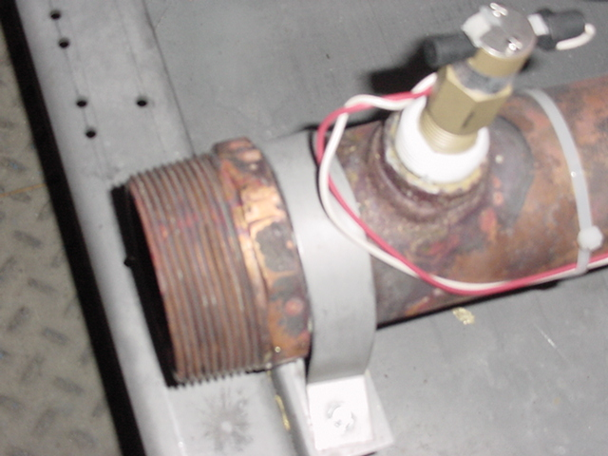
Notes:
Installed flow switch always on the return water pipe. Note direction of wiring towards inside of unit is critical.

Slide 3
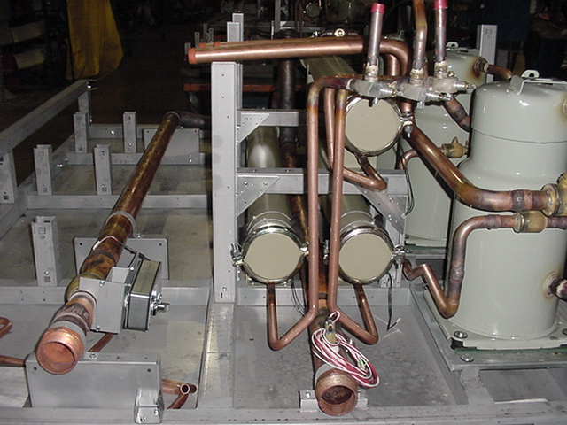
Notes:
Water Bypass valve located on left entering water pipe. Condenser end plates where rodding will take place from. O-ring = RNG00077 necessary for each plate as it is re-installed.

Slide 4
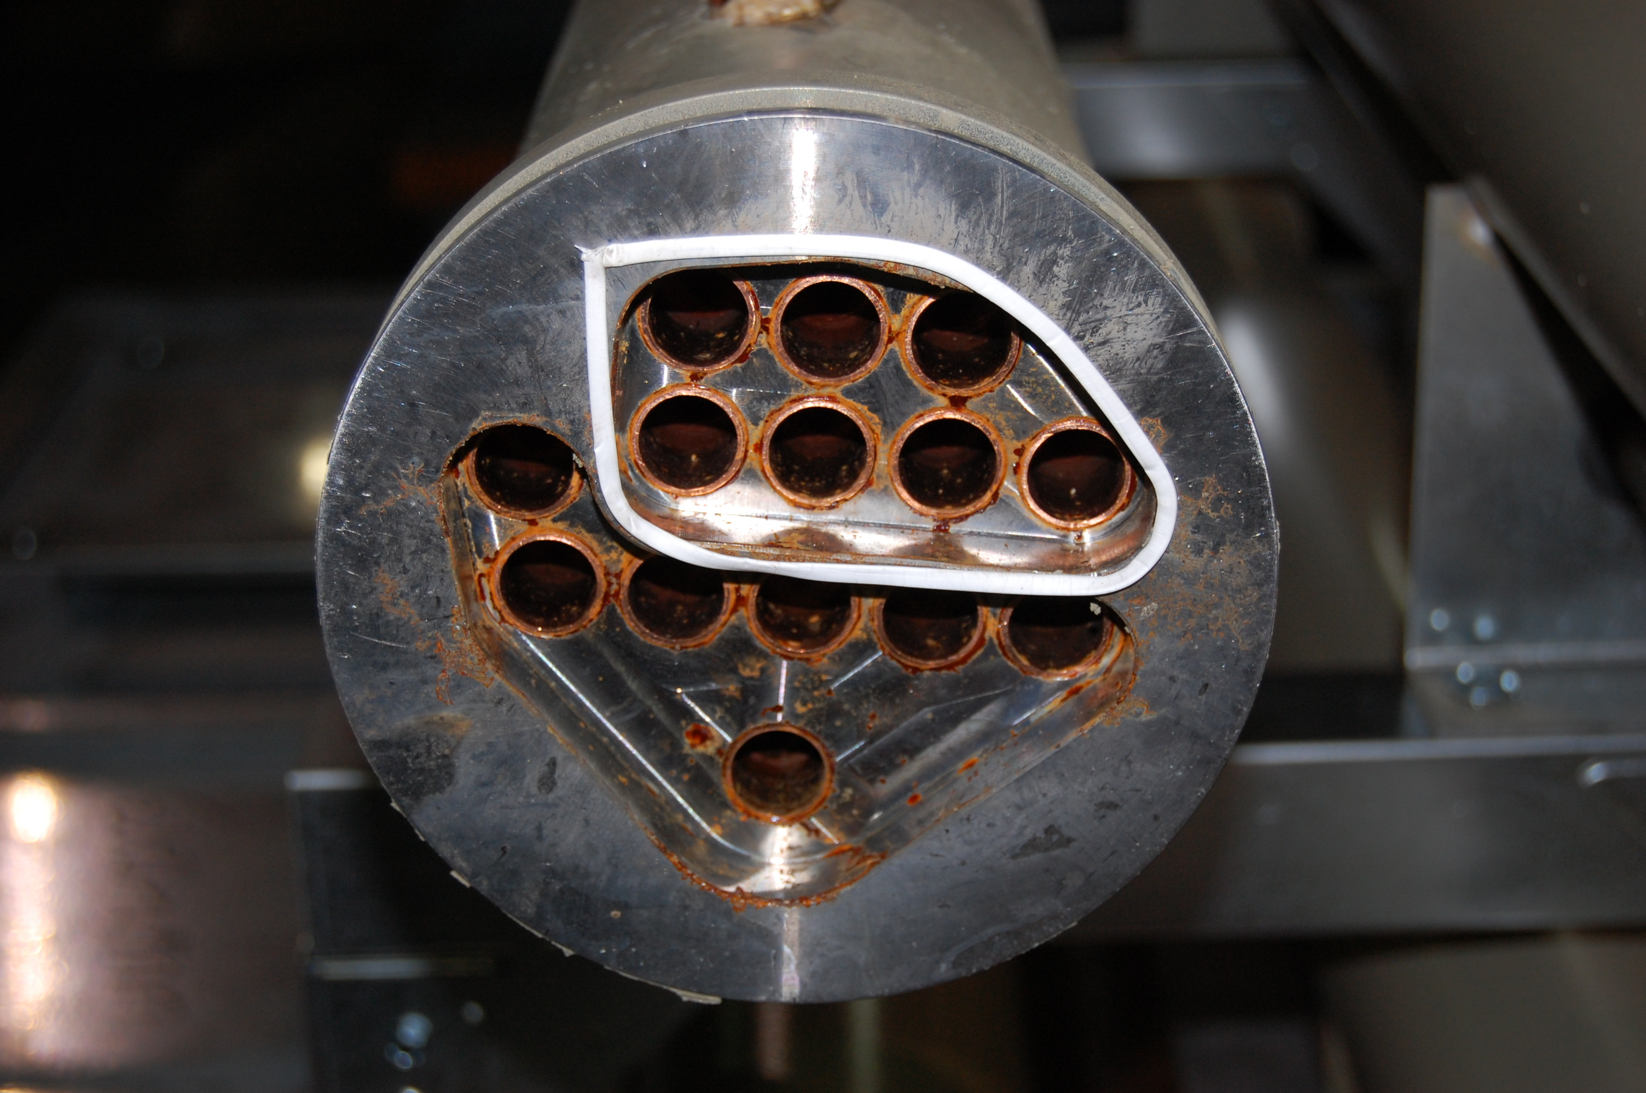
Notes:
Header end view of condenser with new Teflon tape applied. See next slide for pic of Teflon tape.

Slide 5
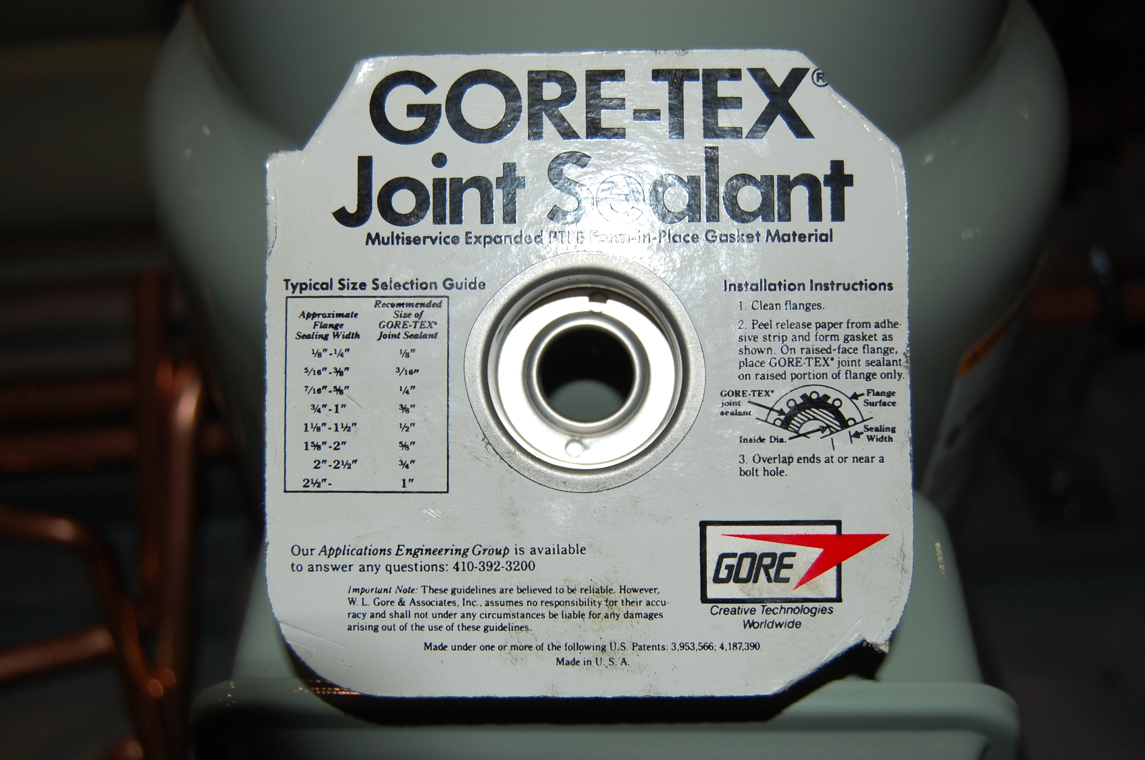
Notes:
Teflon tape for header end of condenser.

Slide 6
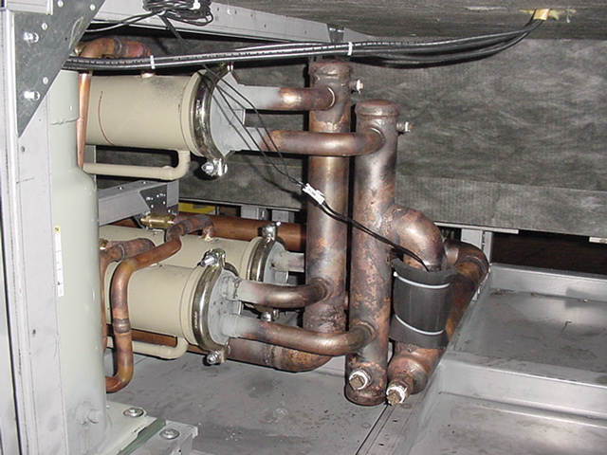
Notes:
Header end of condensers with proper “Entering Condenser water temp sensor” location. The water plugs on the right are the lowest plugs in the unit, for draining the water from the unit.

Slide 7
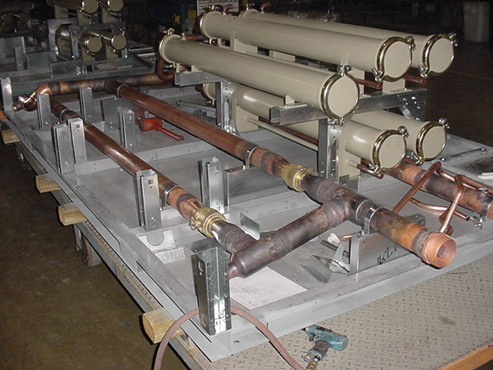
Notes:
Water control valves. WSE Econ valve on left. Condenser Bypass valve on right.

Slide 8
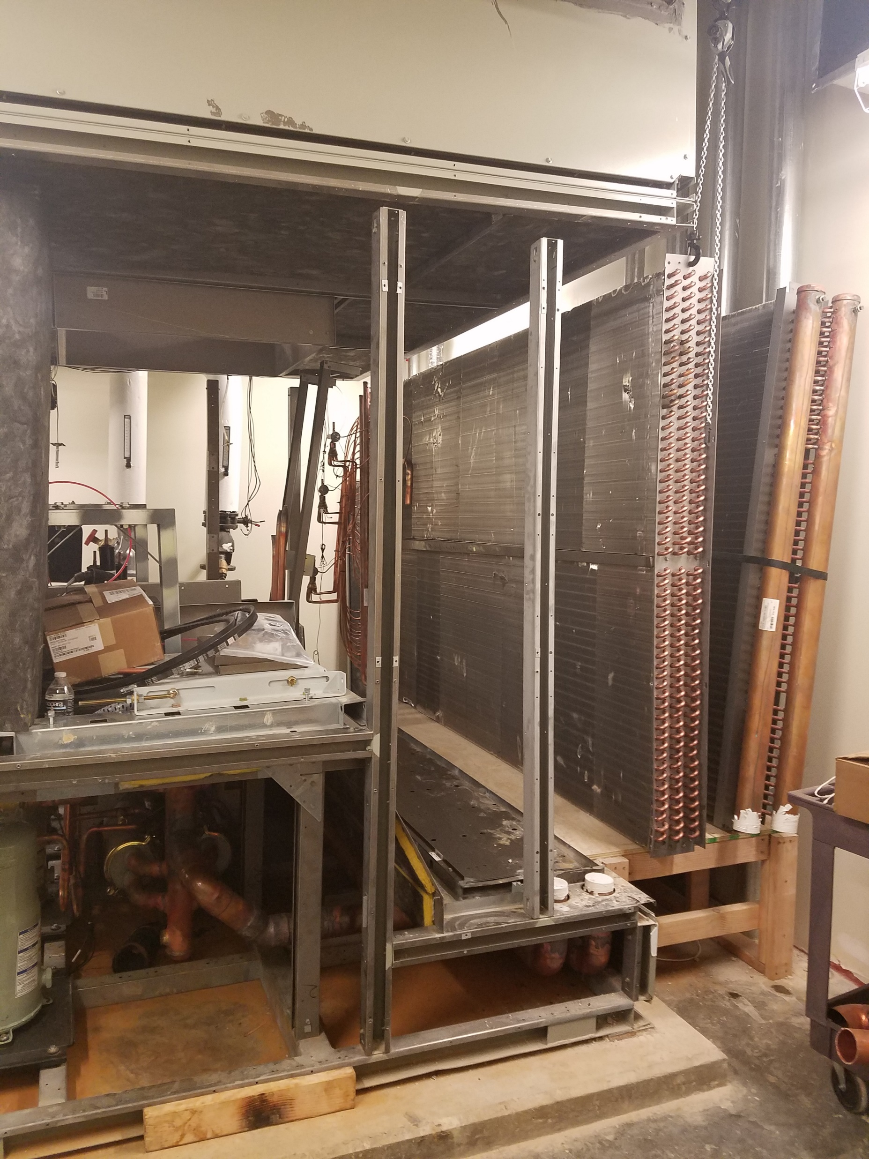
Notes:
Evap coil on left and WSE on right installation in the field.

