Slide 1

E-201
TRANE BRANDED SAMSUNG

Slide 2
E-201 : Communication error between indoor and outdoor units
Verify that the indoor unit quantity rotary switch on the outdoor units main PCB board is set to the physical number of indoor units.
Hit your K3 button on the ODU. Check to see if you ODU is finding any IDUs. It should say ADXX (XX is the IDU address)
Verify Wiring on the F1,F2 Terminals

Slide 3
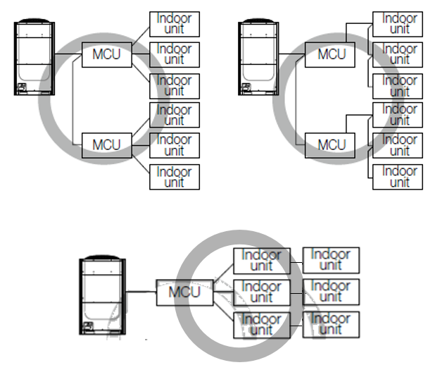
E201
Proper Wiring on F1-F2

Slide 4
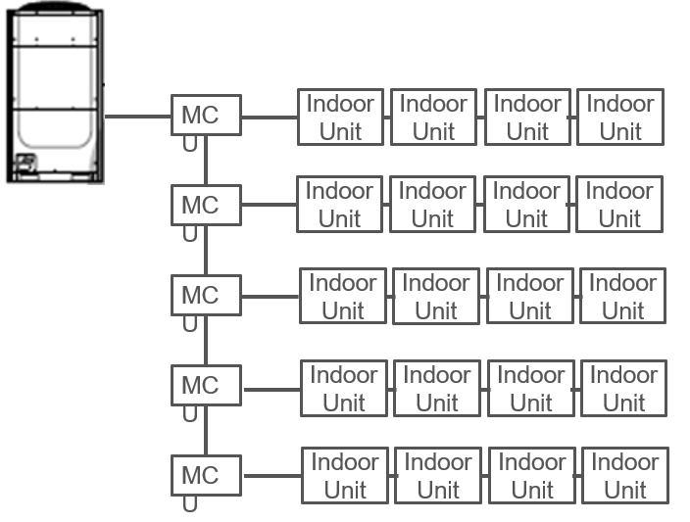
E201
Divide the link.
We are going to divide the link to see which IDU is causing the issues.

Slide 5
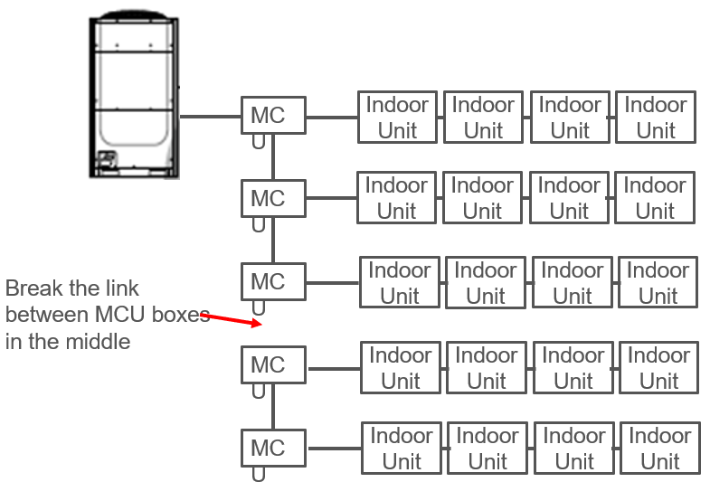
Divide the link.

Slide 6
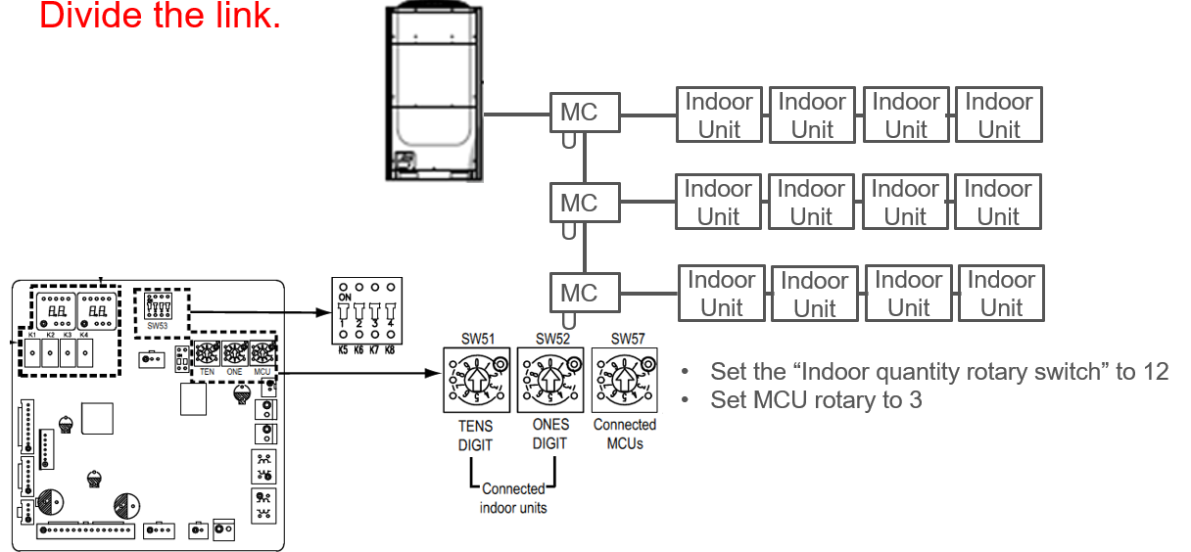
Divide the link.

Slide 7
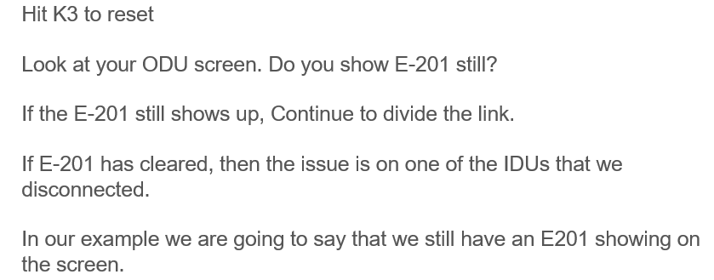
Divide the link.

Slide 8
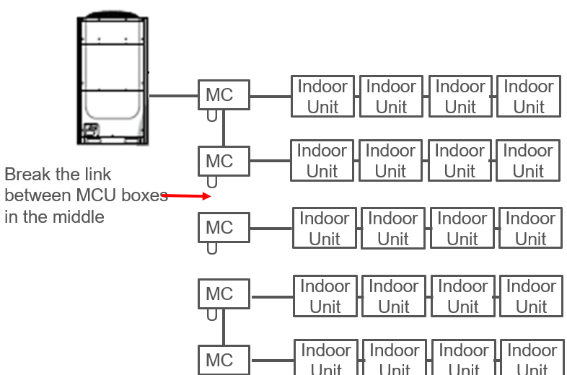
Divide the link.

Slide 9
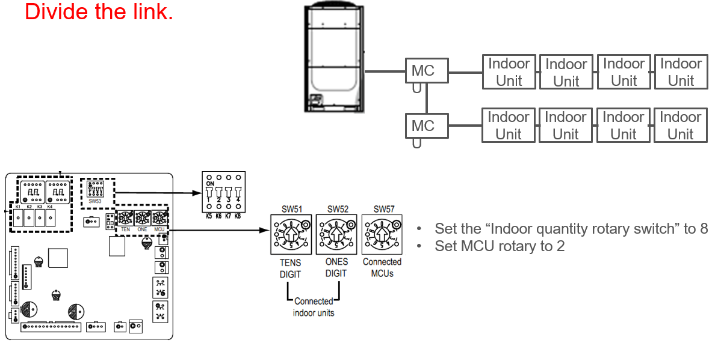
Divide the link.

Slide 10
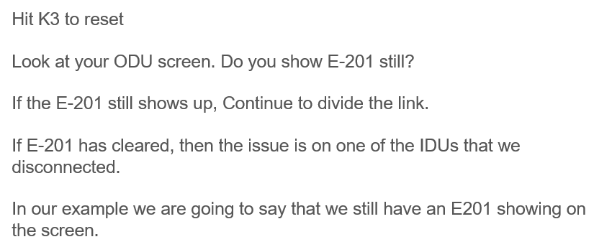
Divide the link.

Slide 11
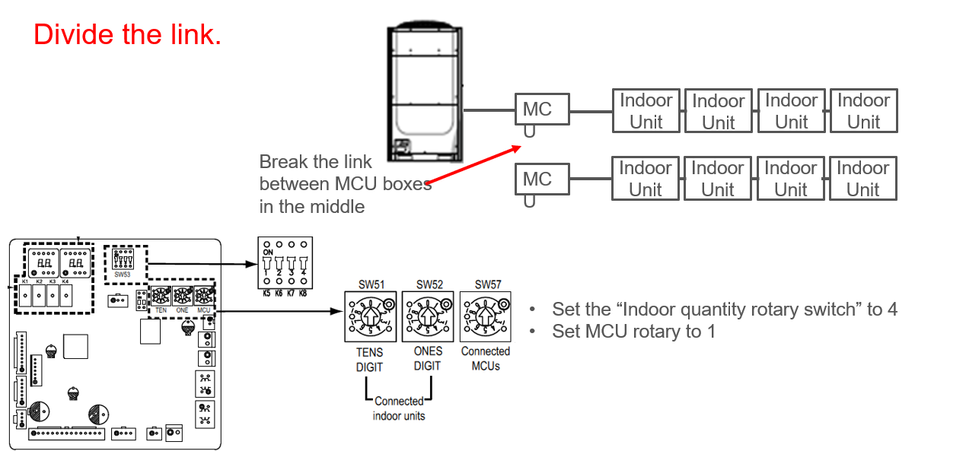
Divide the link.

Slide 12
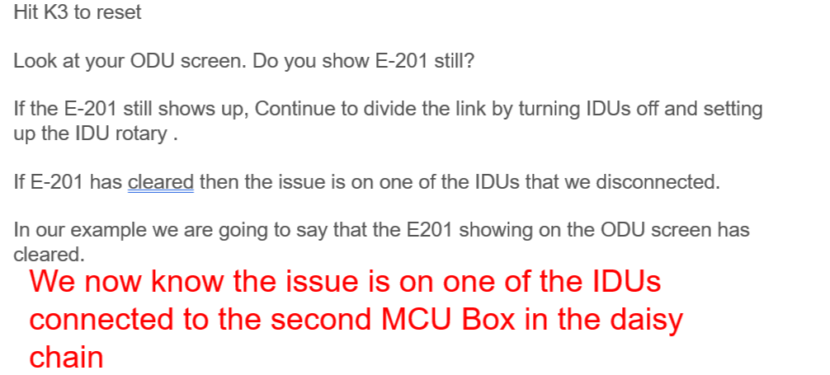
E201
Divide the link.

Slide 13
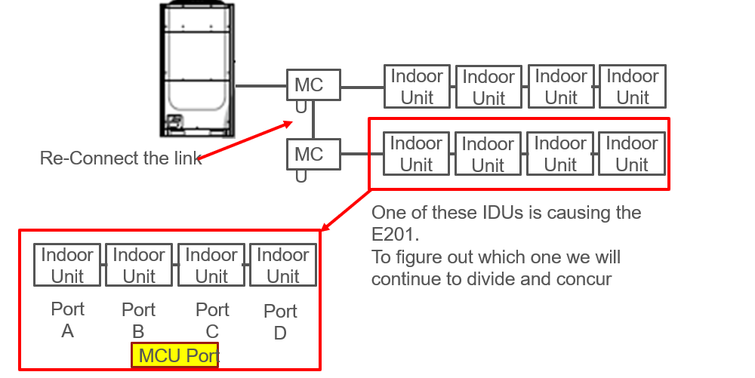
E201
Divide the link.

Slide 14
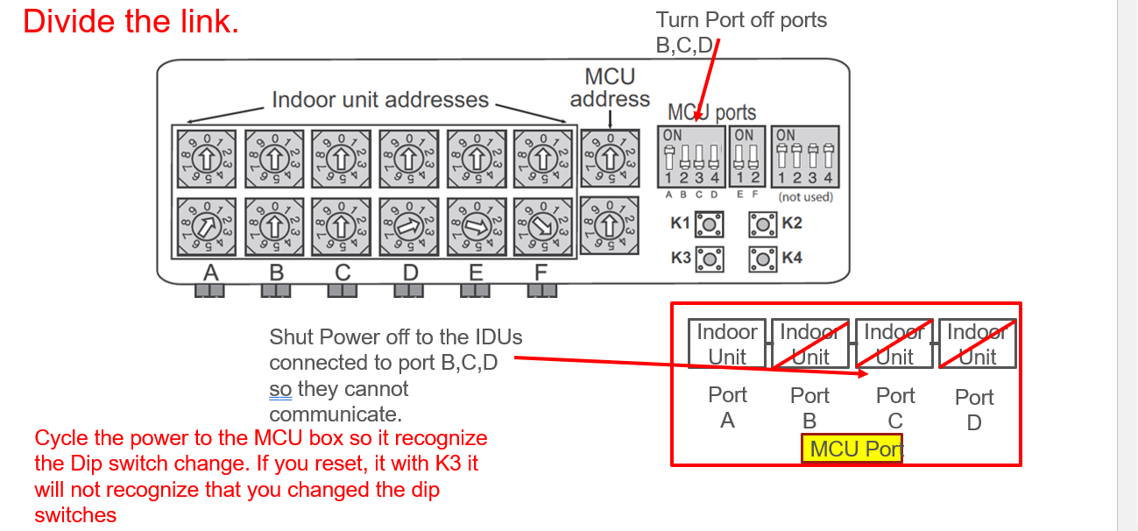
E201
Divide the link.

Slide 15
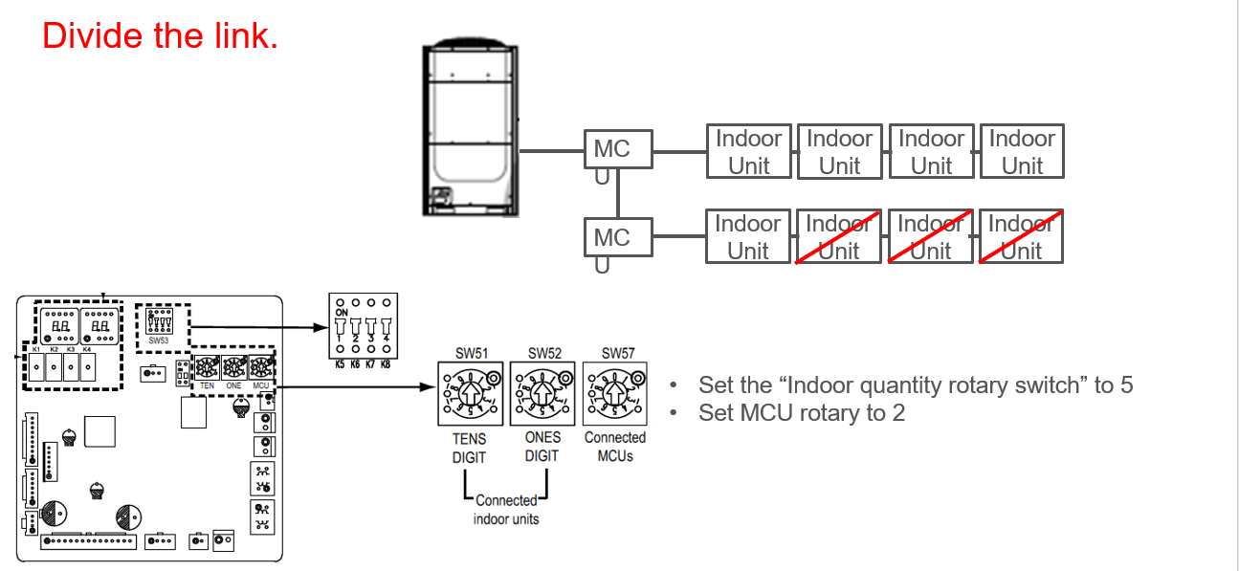
E201 DIVIDE THE LINK.

Slide 16
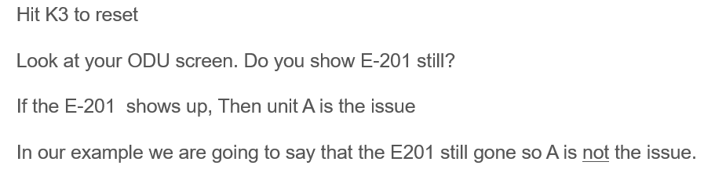
E201Divide the link.

Slide 17
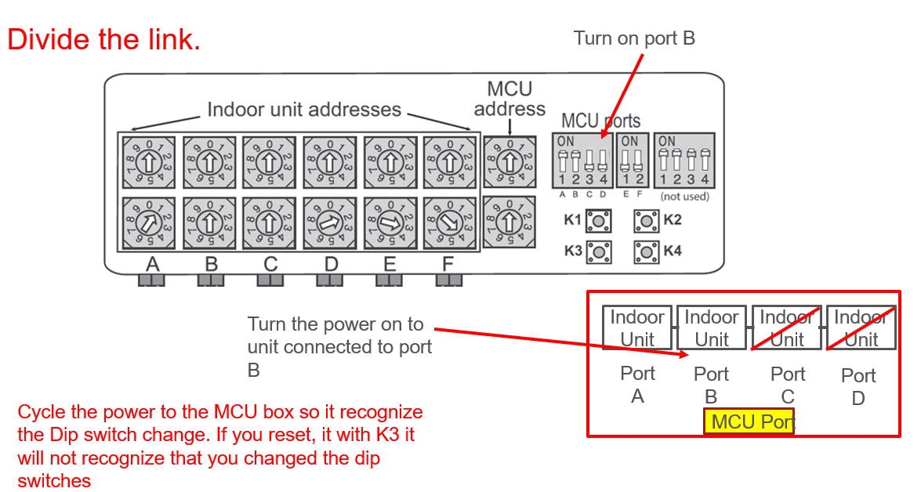
E201
Divide the link.

Slide 18
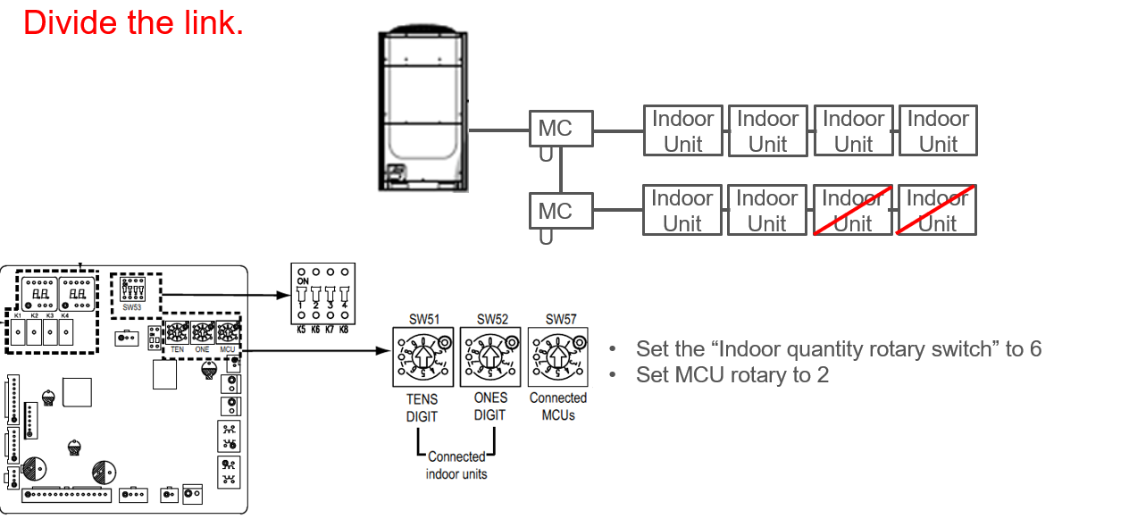
E201
Divide the link.

Slide 19
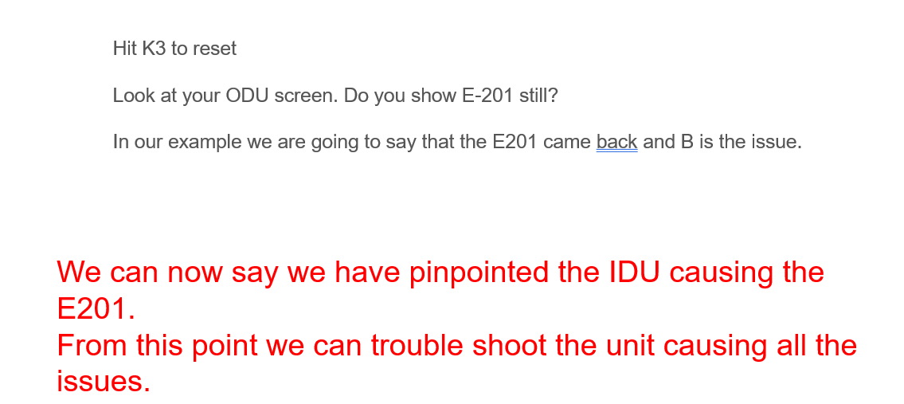
E201
Divide the link.

Slide 20
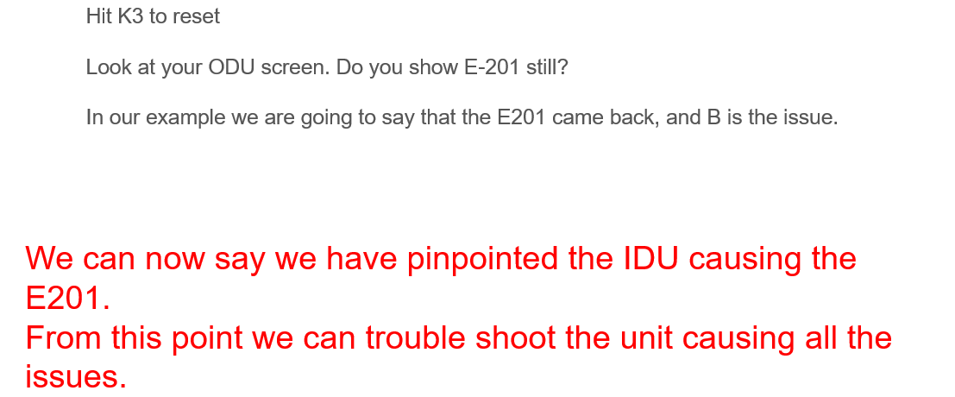
E201
Divide the link.

