Slide 1
Terminal Unit Vent Damper Replacement:
2025
Launch: October 2025

Slide 2
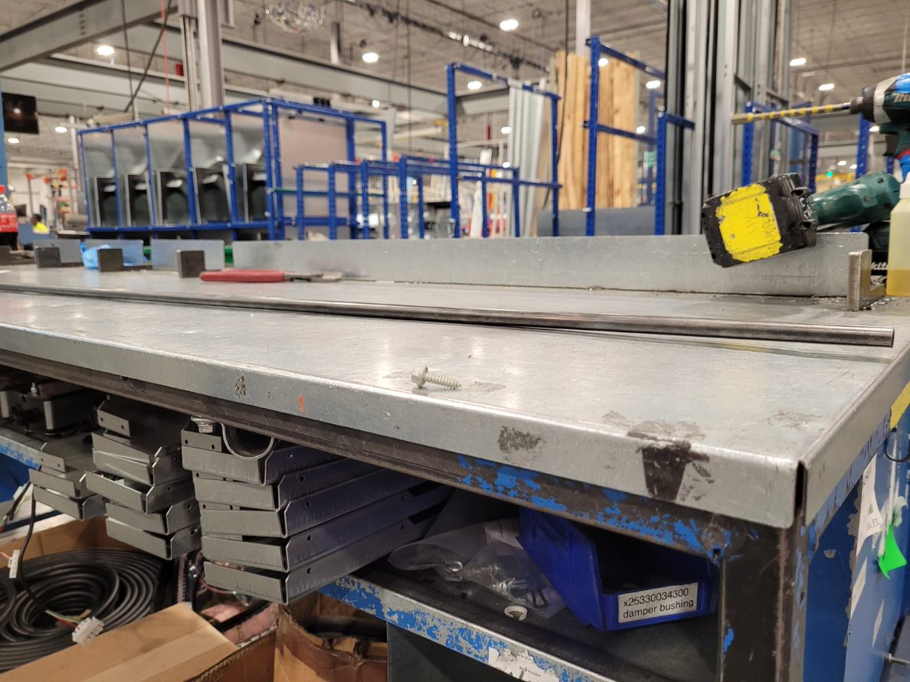
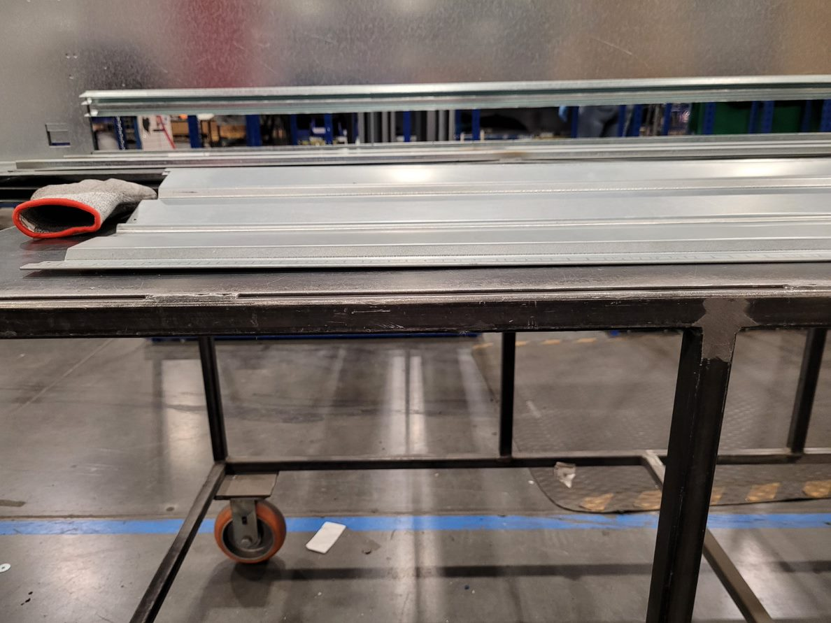
Project Scope
This project is to fix the issue with bowing on VUV dampers.
The damper blades are not being fully closed and allowing outside air to enter the unit.
It appears that we are having bowing issues in both the rod and the blade.
  Rod tends to bend to match the blade

Slide 3
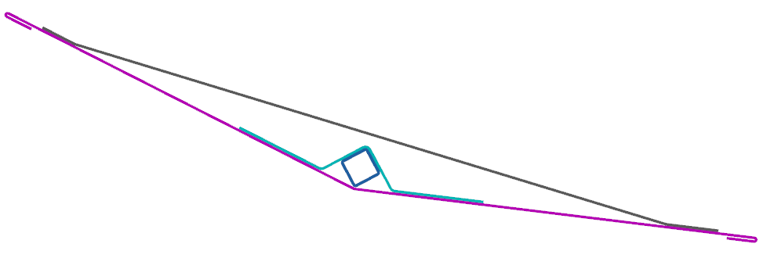
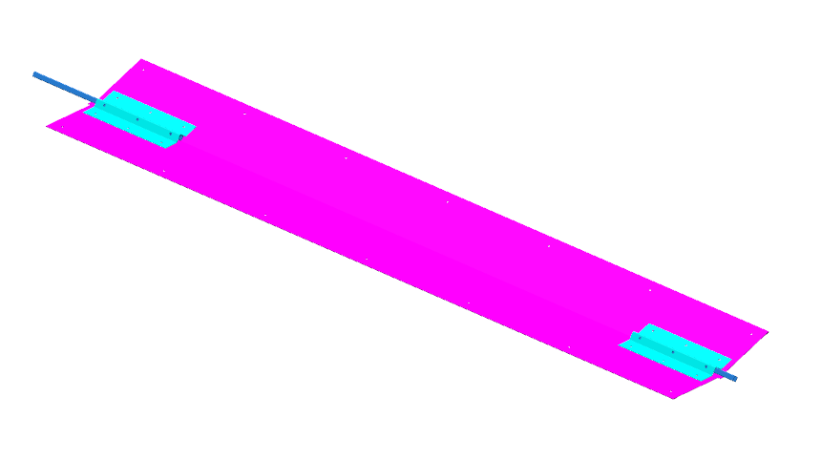
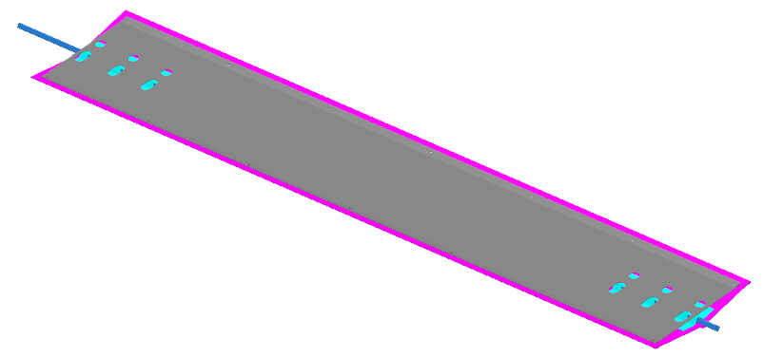
Final Concept
ENGINEERING ANALYSIS, ETC-AP
  Triangular blade
    Easily manufacturable parts with simple geometries.
    Easy to service. Currently to get the damper blade/rod out of the unit it must be taken off the wall, drained, and the bottom of the unit disassembled. With new design none of this will be needed just 7 screws.
    Makes it easier to assemble. The assembly can be broken up into a blade assembly and a damper section assembly where before the section was built around the blade.
Notes:
Mention the gasketing that is factory installed.

Slide 4
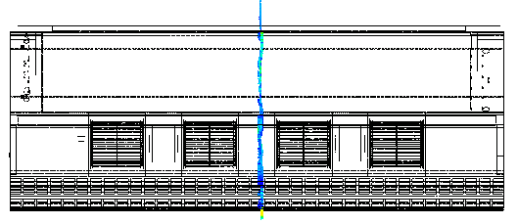
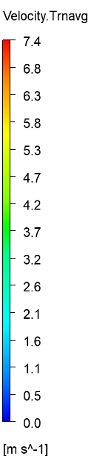
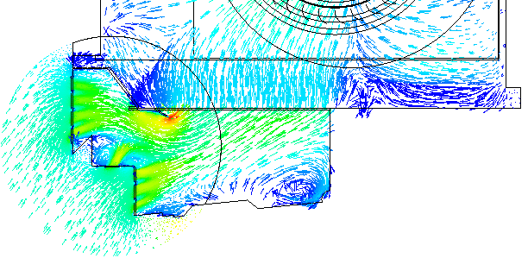
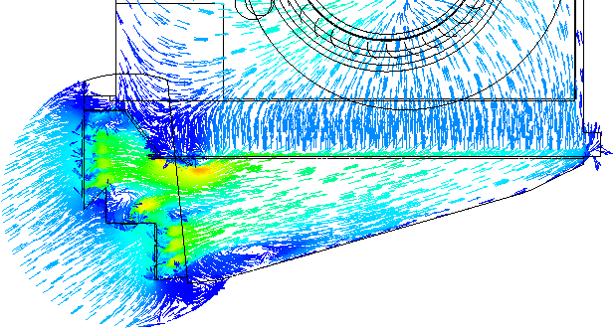
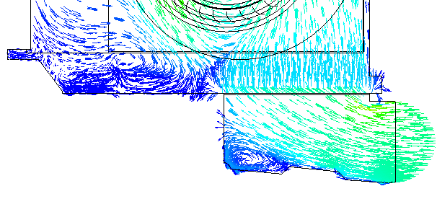
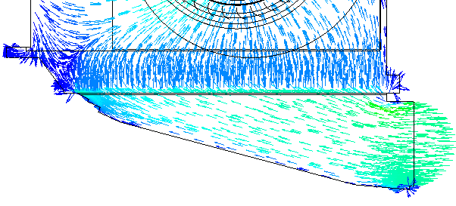
CFD Results – Velocity Vector
ENGINEERING ANALYSIS, ETC-AP
Cut plane
For the new damper, the angle of the airflow before the filter is slightly reduced
The flow direction after the filter is basically same.
Middle plate
Case 1 (Old damper, return opening)
Case 2 (New damper, return opening)
Case 3 (Old damper, fresh air opening)
Case 4 (New damper, fresh air opening)
The middle plate of the old damper has limited effect on changing the direction of the inlet airflow, but instead reduces the flow area of the filter.

Slide 5
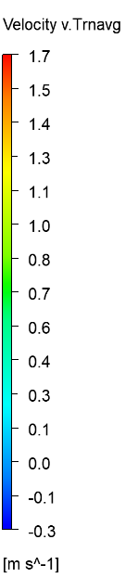
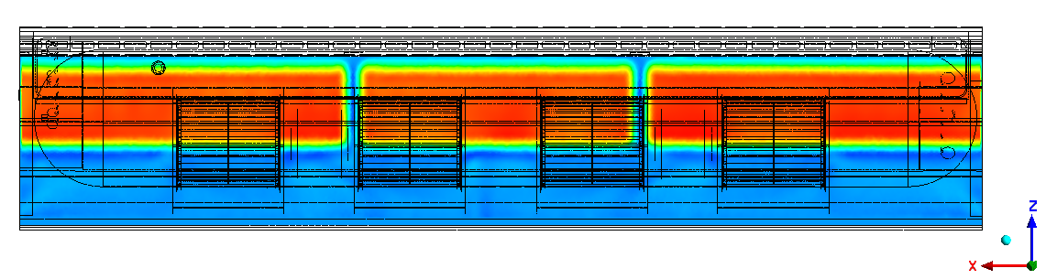
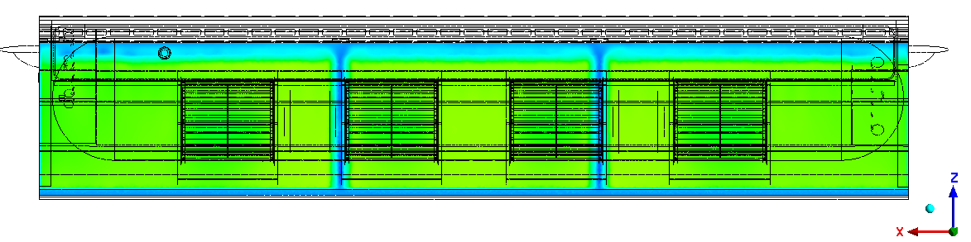
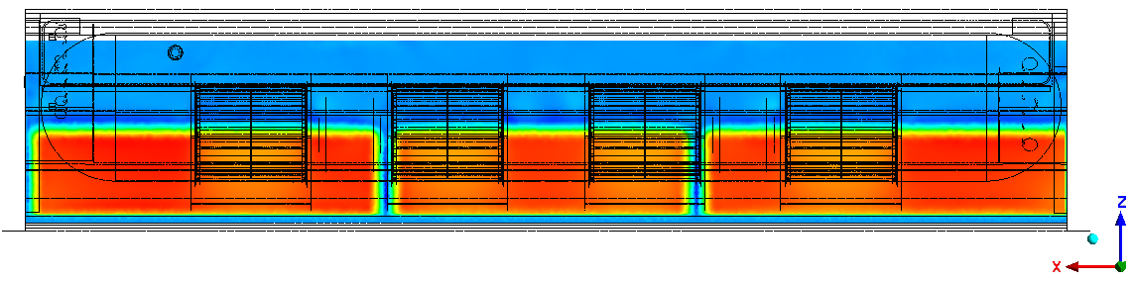
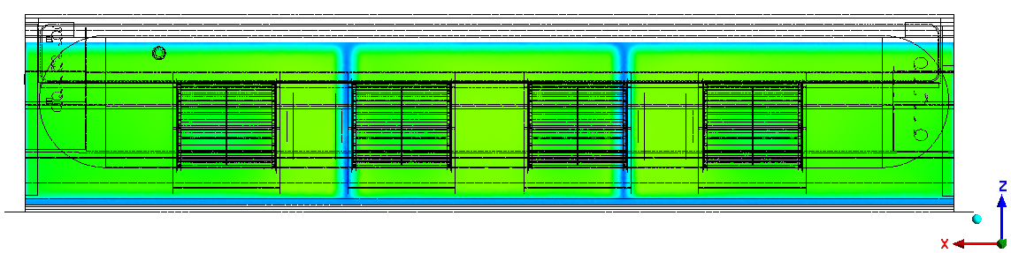
CFD Results – Normal Velocity Contour @ Filter Outlet
ENGINEERING ANALYSIS, ETC-AP
Case 1 (Old damper, return opening)
Case 2 (New damper, return opening)
Case 3 (Old damper, fresh air opening)
Case 4 (New damper, fresh air opening)
After using the new damper, the average velocity on the filter is smaller and the distribution is more uniform.

Slide 6
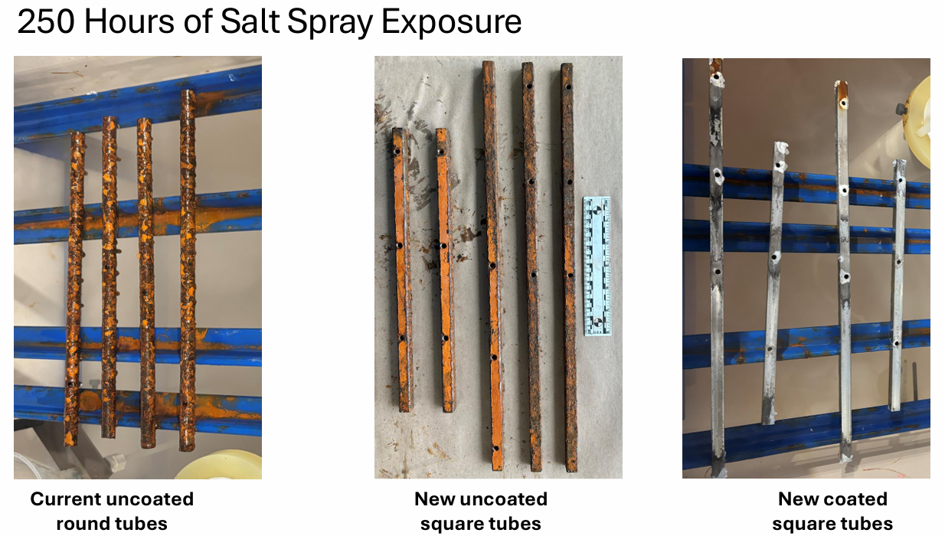
Rod Redesign and Salt Spray Exposure Testing
ENGINEERING ANALYSIS, ETC-AP
Notes:
Square tubes will prevent slippage of the rods.

Slide 7
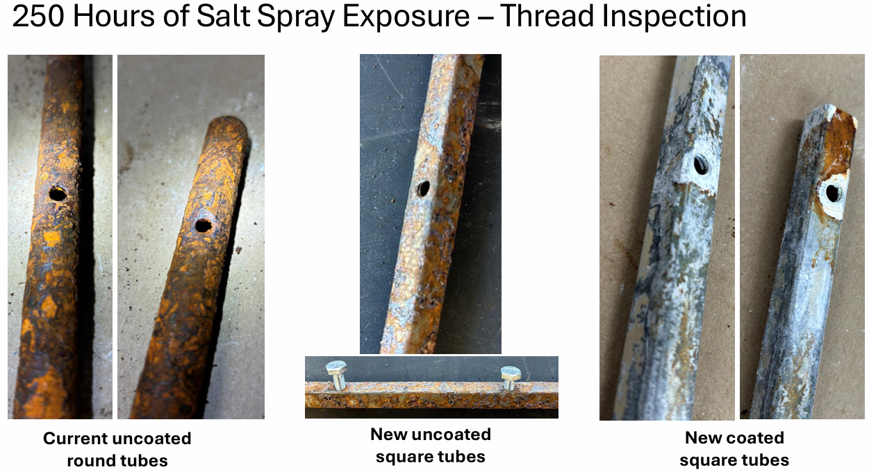
Rod Redesign and Salt Spray Exposure Testing
ENGINEERING ANALYSIS, ETC-AP
Notes:
Talk about the roll out plan here and that they’ll start seeing these soon.

